Slide 1



Angry Olympics Part Four
–
Target (Language) Practise
With the Angry Family

Slide 2
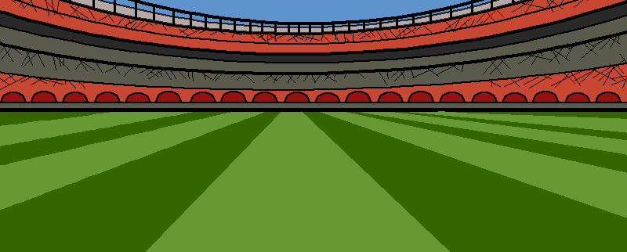








Here we have Mrs Mildly-Angry Carrot-Face, she could win the archery with this next arrow.

Slide 3
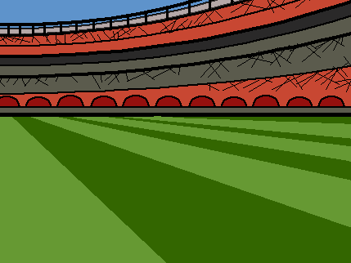
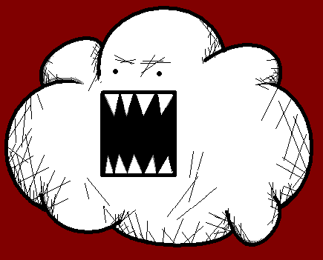
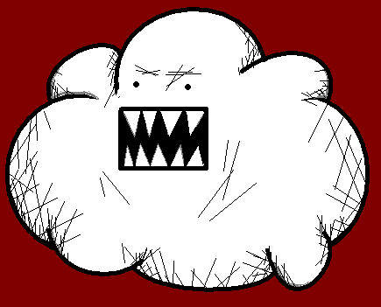

I will go and help her!

Slide 4
Non ! En bas, en bas, en bas !
No! Down, down, down!

Slide 5
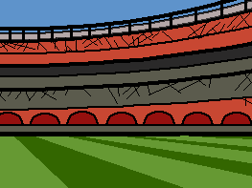



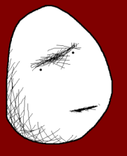


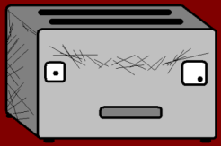

No! Down, down, down!
Ouais ! En bas, en bas, en bas !
No! Down, down, down!
No! Down, down, down!
Yeah! Down, down, down!

Slide 6
Non ! A droite, à droite, à droite !
No! Right, right, right!

Slide 7
Ouais ! À droite, à droite, à droite !
No! Down, down, down!
No! Down, down, down!
No! Down, down, down!
Yeah! Right, right, right!

Slide 8
Non ! À gauche, à gauche, à gauche !
No! Left, left, left!

Slide 9
Ouais ! À gauche, à gauche, à gauche !
No! Down, down, down!
No! Down, down, down!
No! Down, down, down!
Yeah! Left, left, left!

Slide 10
Non ! En haut, en haut, en haut !
No! Up, up, up!

Slide 11
No! Down, down, down!
Ouais ! En haut, en haut, en haut !
No! Down, down, down!
No! Down, down, down!
Yeah! Up, up, up!

Slide 12
Non ! En arrière, en arrière, en arrière !
No! Backwards, backwards, backwards!

Slide 13
Ouais ! En arrière, en arrière, en arrière !
No! Down, down, down!
No! Down, down, down!
No! Down, down, down!
Yeah! Backwards, backwards, backwards!

Slide 14
Non ! En avant, en avant, en avant !
No! Forwards, forwards, forwards!

Slide 15
No! Down, down, down!
Ouais ! En avant, en avant, en avant !
No! Down, down, down!
No! Down, down, down!
Yeah! Forwards, forwards, forwards!

Slide 16

T’es vraiment nulle ! Je m’en vais !
You are terrible, I’m off!

Slide 17
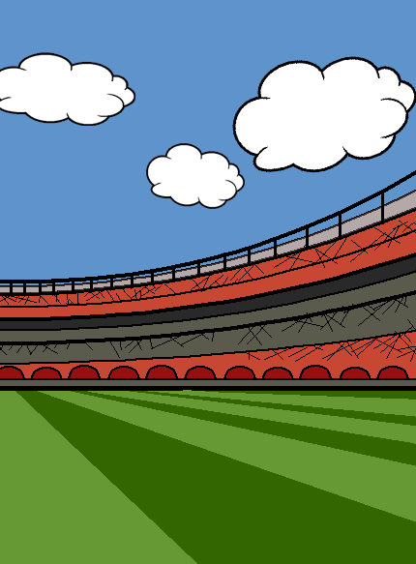



Oh.

Slide 18
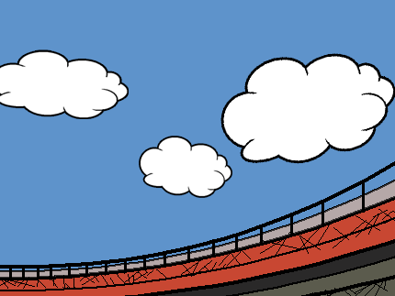
Vocab
Up
Down
Left
Right
Forwards
Backwards
En haut
En bas
A gauche
A droite
En avant
En arrière

Slide 19










Join us again!

