Slide 1

Handy Verbs
Close Future Tense
With the Angry Family
Going to

Slide 2
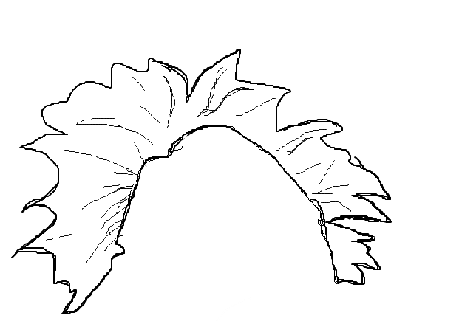
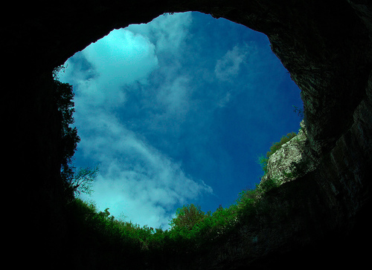


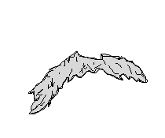
Hello, my name is Mr. Angry Potato Head. I will be a master of tenses. And I will start with the close future!
Notes:
Hello, my name is angrt potato head

Slide 3
The close future tense is not very difficult and I will tell you why…
Notes:
Hello, my name is angrt potato head

Slide 4
Most essentially you will need to know how to conjugate the verb aller.
Notes:
Hello, my name is angrt potato head

Slide 5
Once you learn how to conjugate aller, you can form the close future tense of all verbs by simply adding the infinitive of any word you want to use…
Notes:
Hello, my name is angrt potato head

Slide 6

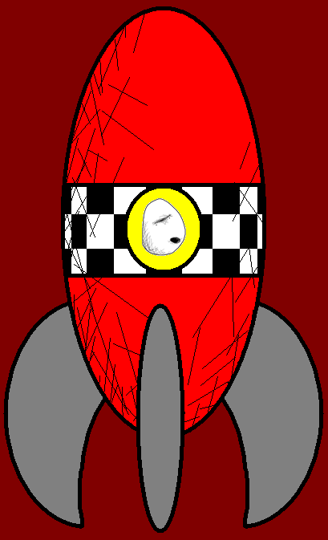

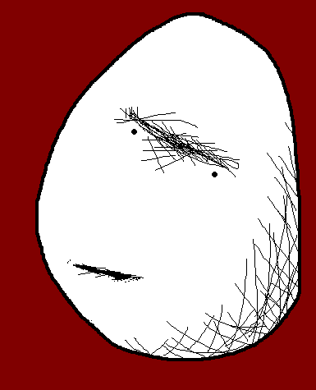



Avec cette machine à voyager dans le temps, je vais voyager vers le future.
With this time machine I will travel to the future.

Slide 7
TOI tu vas venir avec moi!
YOU will accompany me!

Slide 8

Pourquoi lui? Il va tout compromettre.
What do you want him for? He will mess it up!

Slide 9

Wir werden mitkommen
On va venir aussi.
We will come too.

Slide 10

Vous ne savez rien du future! Les ampoules vont être totalement démodées.
You have no clue about the future.
Light bulbs will be totally old-fashioned.

Slide 11
Et les grille-pains vont être remplacés par les téléphones portables!
And mobile phones will replace toasters!

Slide 12
Vous allez attendre ici.
You will wait here.

Slide 13
Quand allons-nous vous revoir?
When will we see you again?

Slide 14
Mmhh... On va être de retour pour le déjeuner.
Uhm… We will be back for lunch.

Slide 15

Going to plus infinitive – Aller plus infinitif
I am going to do
You are going to do
He/she/it is going to do
We are going to do
You (pl.) are going to do
They are going to do
Je vais faire
Tu vas faire
Il/elle/on va faire
Nous allons faire
Vous allez faire
Ils/elles vont faire

Slide 16
Vocab
A time machine
The future
To travel
To accompany
Mobile phone
Old-fashioned
To wait
Lunch
Une machine à remonter le temps
Le future
Voyager
Accompagner
Un téléphone portable
Démodé
Attendre
Le déjeuner

Slide 17















Join us again!

