Slide 1

Handy Ordinal Numbers
With Miss Digitally Angry Clock-Face

Slide 2
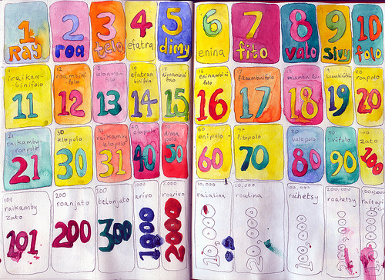
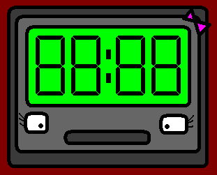
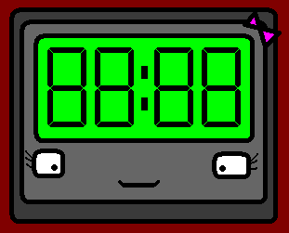
Hello! I am Miss Digitally Angry Clock-Face, and I am here to teach you ordinal numbers. So, pay attention.

Slide 3
Ordinal numbers show you which order things are in. (Just in case you didn’t know.)

Slide 4
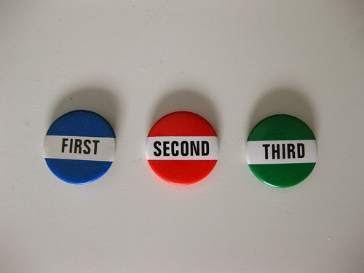

premier (1er)
first (1st)

Slide 5
deuxième (2e)
second (2nd)

Slide 6
troisième (3e)
third (3rd)

Slide 7

quatrième (4e)
fourth (4th)

Slide 8

cinquième (5e)
fifth (5th)

Slide 9
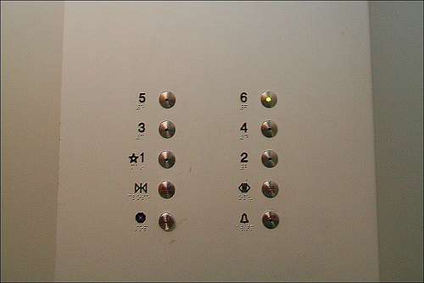
sixième (6e)
sixth (6th)

Slide 10
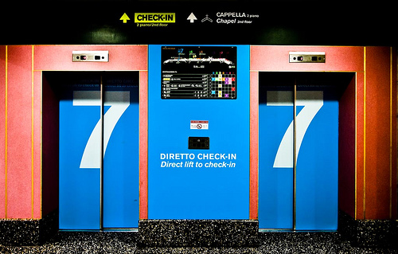
septième (7e)
seventh (7th)

Slide 11
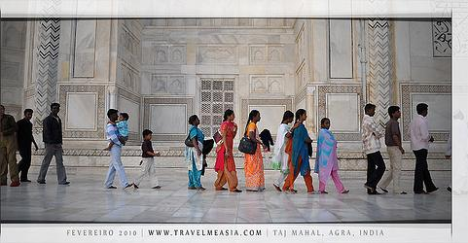
huitième (8e)
eighth (8th)

Slide 12
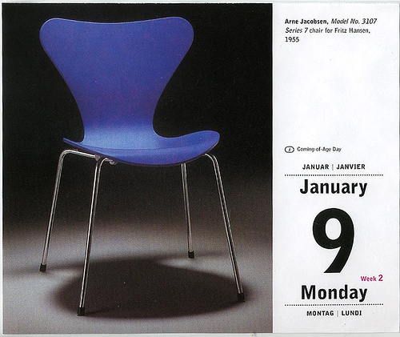
neuvième (9e)
ninth (9th)

Slide 13
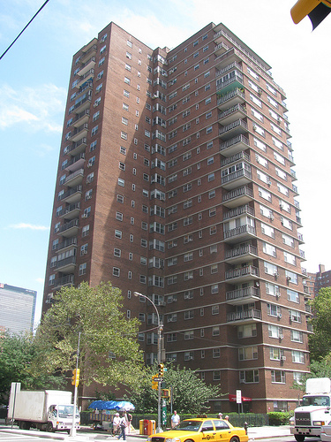
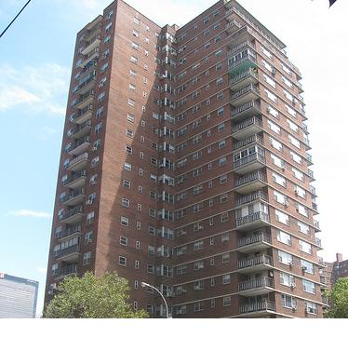
dixième (10e)
tenth (10th)

Slide 14

onzième (11e)
eleventh (11th)

Slide 15
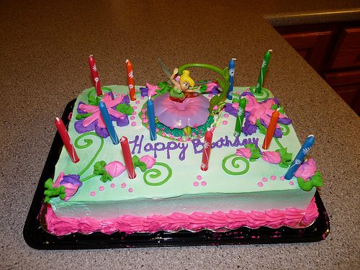
douzième (12e)
twelfth (12th)

Slide 16

From 13th to 20th, you only have to add the ending ième to the ordinal numbers we just learned, minus their final e when they have one.

Slide 17
THIRTEENTH: 13e = treize (-e) + ième
→ treizième
fourteenth (14th) = quatorzième
fifteenth (15th) = quinzième
sixteenth (16th) = seizième
seventeenth (17th) = dix-septième
eighteenth (18th) = dix-huitième
nineteenth (19th) = dix-neuvième

Slide 18

Et bien sûr, vingtième (20e)!
And of course, twentieth!

Slide 19
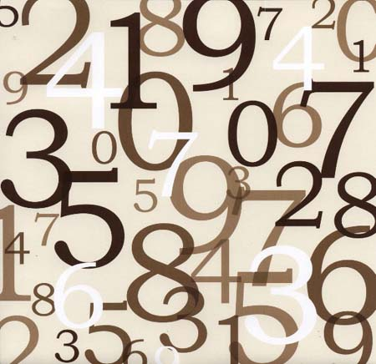
Be careful. Ordinal numbers in French can be masculine or feminine... depending on the noun they are referring to!

Slide 20
Here are some examples!

Slide 21
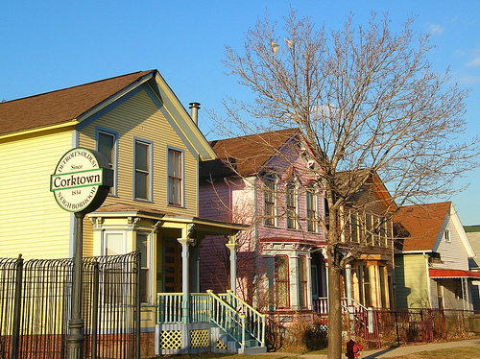
La première maison.
The first house.

Slide 22
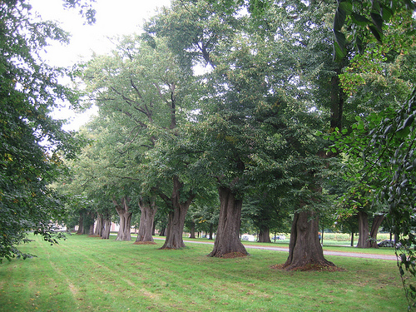
Le premier arbre.
The first tree.

Slide 23
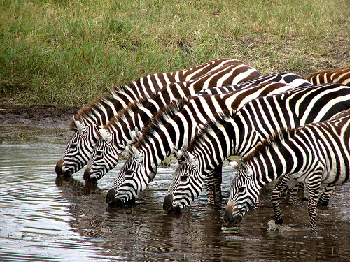
Le deuxième zèbre.
The second zebra.

Slide 24

1 2 3 4 5 6 7
La deuxième bouteille.
The second bottle.

Slide 25

Le dixième étage.
The tenth floor.

Slide 26
And so on! Now watch Angry Olympics 10, you’re ready for some practice!

Slide 27
















Join us again!

