Slide 1

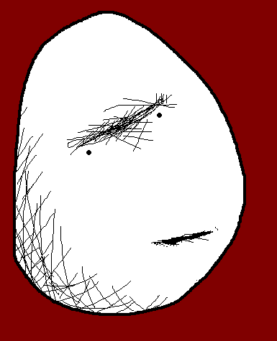

10 Survival Phrases
Survival Answers 4/6
With Mr Angry Potato Head and
Mrs. Mildly-Angry Carrot-Face

Slide 2
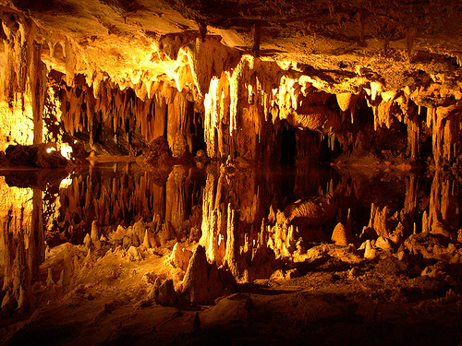

Hello I am the angry potato-head. I have already taught you ten survival phrases. Here are some answers.

Slide 3
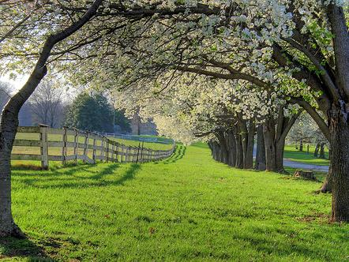

Hello. I am the mildly angry carrot-face. I am going to teach you answers to the survival phrases.

Slide 4
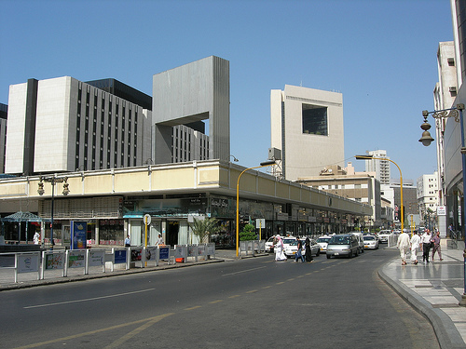

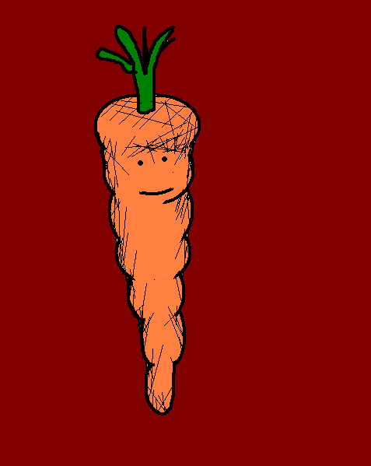
Dürfte ich Ihr Telefon benutzen?
May I use your phone, please?
Notes:
May I use your phone, please?

Slide 5
Tut mir leid, ich habe keins.
Sorry, I don’t have one.
Notes:
Sorry, I don’t have one.

Slide 6
Dürfte ich Ihr Telefon benutzen?
May I use your phone, please?
Notes:
May I use your phone, please?

Slide 7
Ja, wenn Sie mir das bezahlen.
Yes, as long as you pay me back.
Notes:
Yes, as long as you pay me back.

Slide 8
Dürfte ich Ihr Telefon benutzen?
May I use your phone, please?
Notes:
May I use your phone, please?

Slide 9
Hier gibt es keinen Empfang.
There is no signal here.
Notes:
There is no signal here.

Slide 10
Dürfte ich Ihr Telefon benutzen?
May I use your phone, please?
Notes:
May I use your phone, please?

Slide 11
Wen möchten Sie denn anrufen?
Who do you want to call?
Notes:
Who do you want to call?

Slide 12
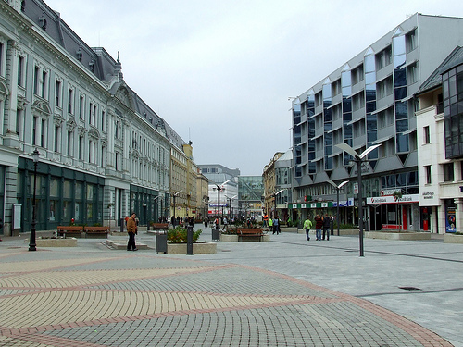
Ohne meinen Anwalt sage ich nichts mehr!
I’m not saying anything until I’ve seen a lawyer.
Notes:
I’m not saying anything until I’ve seen a lawyer.

Slide 13
Dafür ist es jetzt zu spät…
It’s too late for that…
Notes:
It’s too late for that…

Slide 14
Ohne meinen Anwalt sage ich nichts mehr!
I’m not saying anything until I’ve seen a lawyer.
Notes:
I’m not saying anything until I’ve seen a lawyer.

Slide 15
Sind Sie mit dem deutschen Gesetz vertraut?
Are you familiar with the German law?
Notes:
Are you familiar with (French, Mongolian…) law?

Slide 16
Ohne meinen Anwalt sage ich nichts mehr!
I’m not saying anything until I’ve seen a lawyer.
Notes:
I’m not saying anything until I’ve seen a lawyer.

Slide 17
Mir egal!
I don’t care.
Notes:
I don’t care.

Slide 18
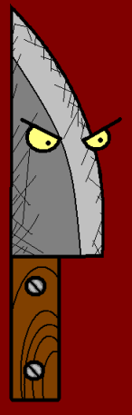















Join us again!

