Slide 1

10 Survival Phrases
With Mr. Angry Potato Head

Slide 2



Hello I am the angry potato-head. I am going to teach you ten survival phrases in German.

Slide 3
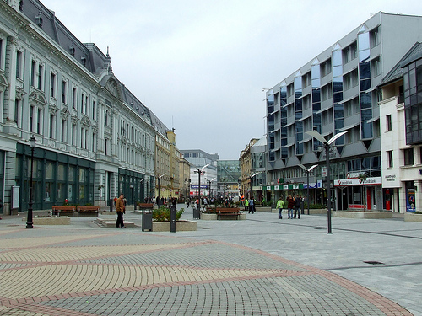
Entschuldigung, sprechen Sie Englisch?
Excuse me, do you speak English?
Notes:
Excuse me, do you speak English?

Slide 4
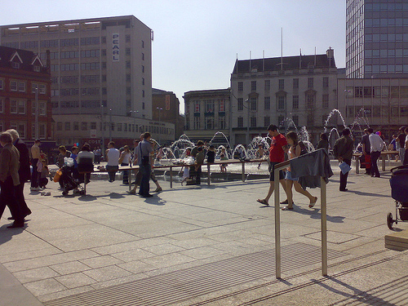
Können Sie bitte langsamer reden?
Can you speak more slowly, please?
Notes:
Can you speak more slowly, please?

Slide 5
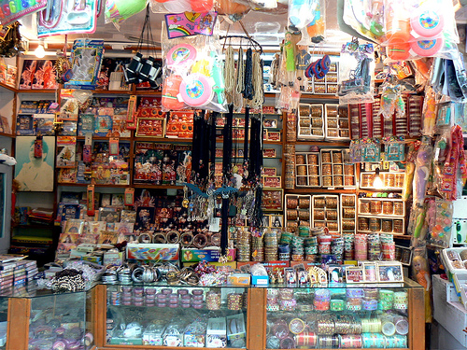
Wieviel kostet das?
How much does that cost?
Notes:
How much does that cost?

Slide 6
Where is the nearest McDonald’s?
Wo ist der nächste McDonald’s?
Notes:
Where is the nearest McDonald’s?

Slide 7
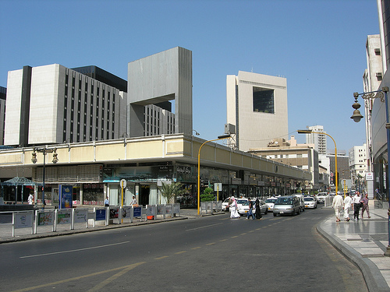
Dürfte ich Ihr Telefon benutzen?
May I use your phone, please?
Notes:
May I use your phone, please?

Slide 8
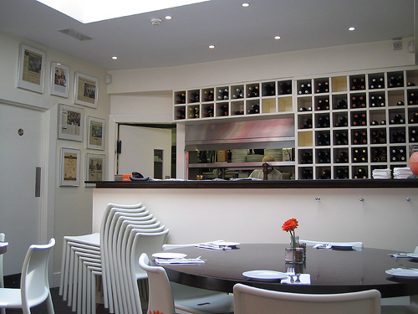
What exactly does this dish contain?
Was genau ist in diesem Gericht?
Notes:
What exactly does this dish contain?

Slide 9
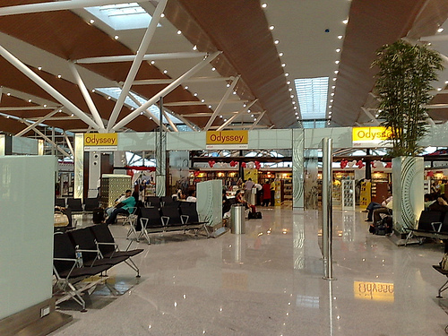
Wann ist der Zug / der Bus / der Flug?
What time does the train/plane/bus leave?
Notes:
What time does the train/plane/bus leave?

Slide 10
Did the guided tour come this way?
I seem to have lost it…
Ist die Stadtführung hier entlang gekommen? Ich habe sie aus den Augen verloren.
Notes:
Did the guided tour come this way? I seem to have lost it…

Slide 11
Ohne meinen Anwalt sage ich nichts mehr!
I’m not saying anything until I’ve seen a lawyer.
Notes:
I’m not saying anything until I’ve seen a lawyer.

Slide 12

Ich platze gleich – Wo ist die Toilette?
I’m going to burst – Where’s the toilet?
Notes:
I’m going to burst – where’s the toilet?

Slide 13
















Join us again!

