Slide 1

Handy Questions 2
-
How Old Are You?
With the Unusual Mike Rophone

Slide 2
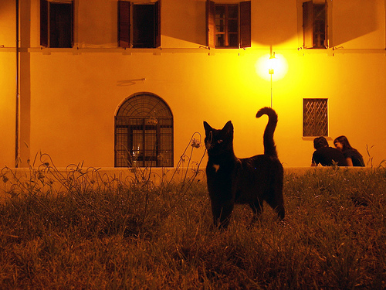

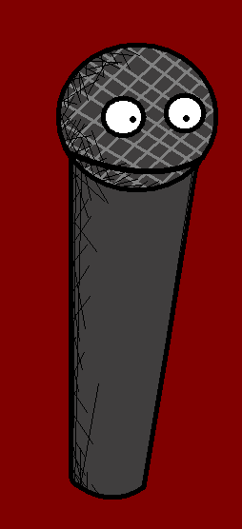
Hello. My name is the Unusual Mike Rophone. I like to ask annoying questions. Here’s one.

Slide 3
Wie alt bist du?
How old are you?

Slide 4
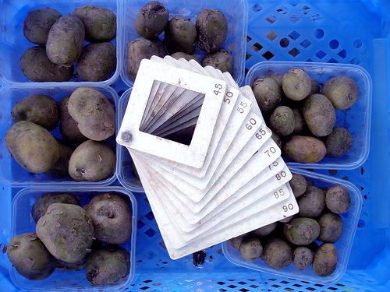
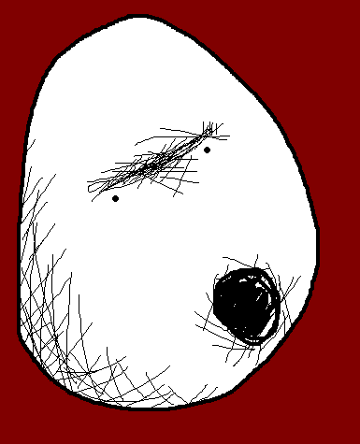
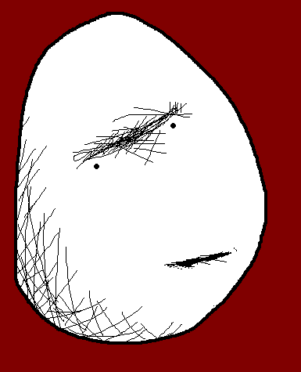
I am forty five years old.
Ich bin fünfundvierzig Jahre alt.
Notes:
I am forty five years old.

Slide 5
Wie alt bist du?
How old are you?

Slide 6



Ich bin 30 Jahre alt.
I am 30 years old.

Slide 7
Wie alt bist du?
How old are you?

Slide 8
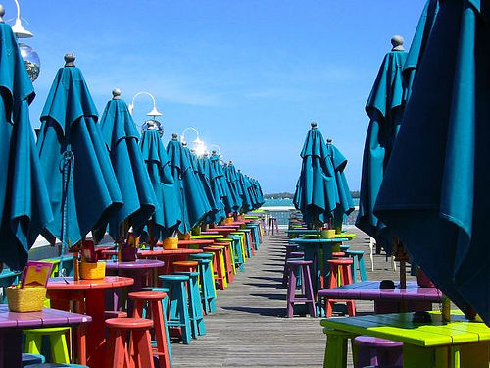


Ich bin fünfzehn Jahre alt.
I am 15 years old.
Notes:
I am 15 years old

Slide 9
Wie alt bist du?
How old are you?

Slide 10
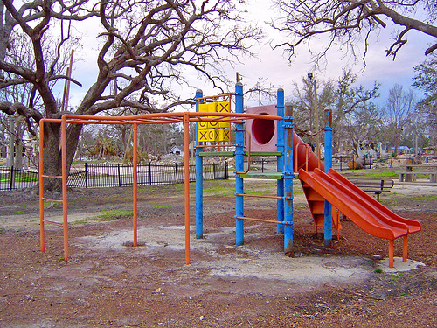
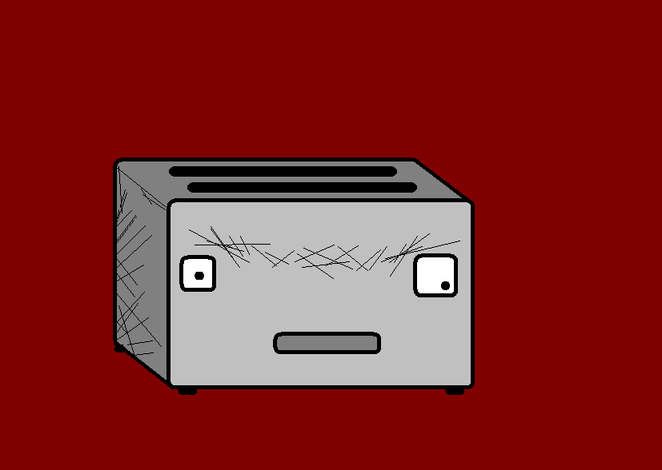
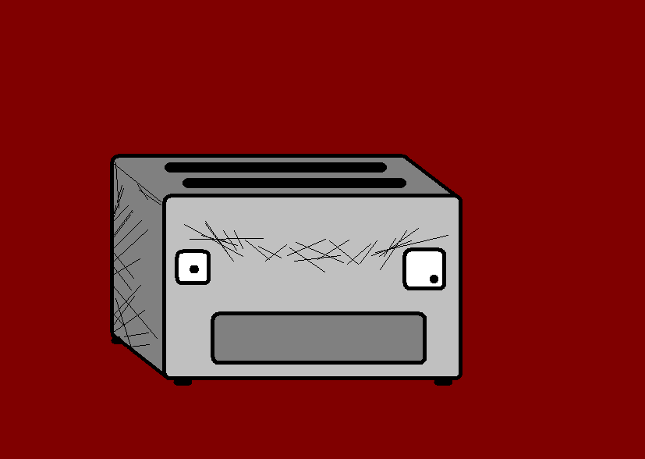
Ich bin acht Jahre alt.
I am eight years old.
Notes:
I am eight years old.

Slide 11
Wie alt bist du?
How old are you?

Slide 12
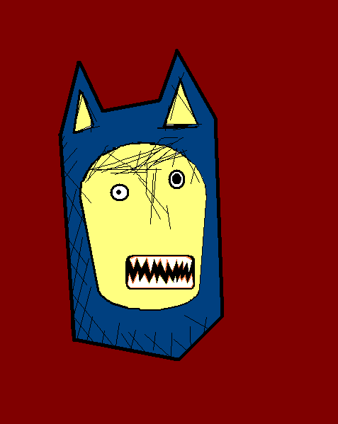
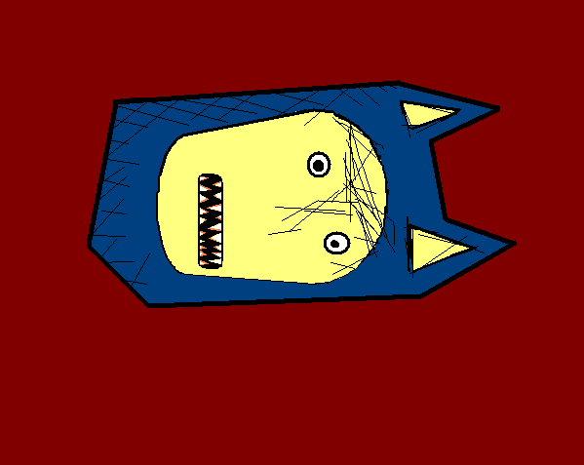
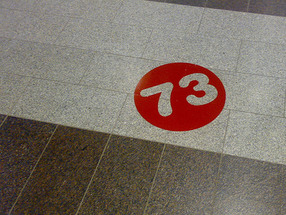
Ich bin dreiundsiebzig Jahre alt.
I am seventy three years old.
Notes:
I am seventy three years old.

Slide 13
Wie alt bist du?
How old are you?

Slide 14



Ich bin tausend Jahre alt.
I am one thousand years old.
Notes:
I am one thousand years old.

Slide 15
Mmmm. Thanks for your honesty.

Slide 16
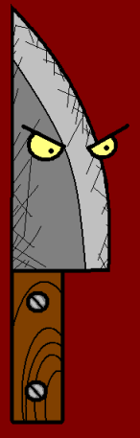














Join us again!

