Slide 1

Handy Questions 4
-
Brothers and Sisters
With the Unusual Mike Rophone

Slide 2
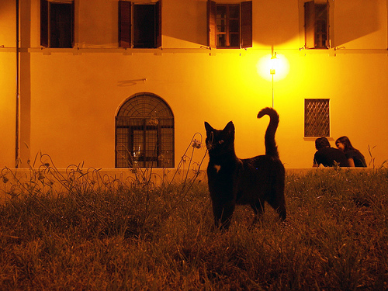


Hello. I was just talking with my brother and sister, and I thought of a question.

Slide 3
Wie viele Geschwister hast du?
How many brothers and sisters do you have?

Slide 4


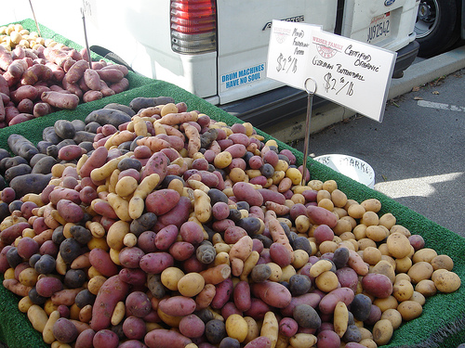
Ich habe sehr viele Brüder und Schwestern.
I have lots of brothers and sisters.
Notes:
I have lots of brothers and sisters.

Slide 5
Wie viele Geschwister hast du?
How many brothers and sisters do you have?

Slide 6


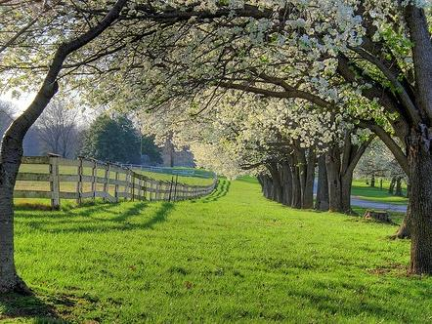
Ich habe acht Brüder und zwei Schwestern.
I have eight brothers and two sisters.
Notes:
I have eight brothers and two sisters.

Slide 7
Wie viele Geschwister hast du?
How many brothers and sisters do you have?

Slide 8



I have no brothers or sisters.
Ich habe keine Brüder oder Schwestern.
Notes:
I have no brothers or sisters.

Slide 9
Wie viele Geschwister hast du?
How many brothers and sisters do you have?

Slide 10
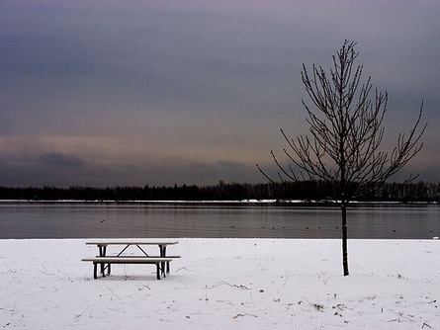


Ich habe einen Bruder und zwei Schwestern.
I have one brother and two sisters.
Notes:
I have one brother and two sisters.

Slide 11
Wie viele Geschwister hast du?
How many brothers and sisters do you have?

Slide 12
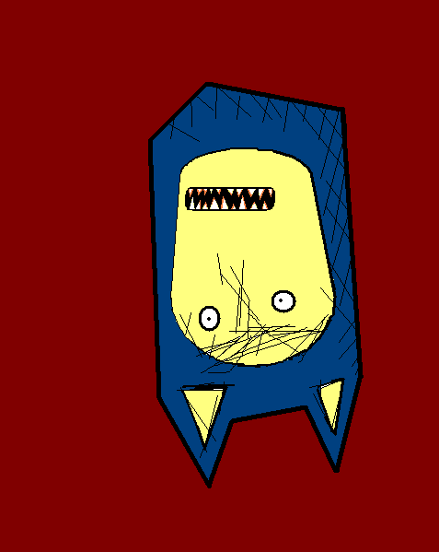
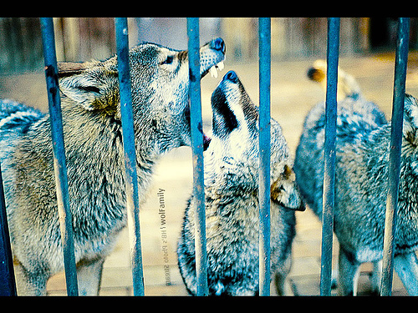
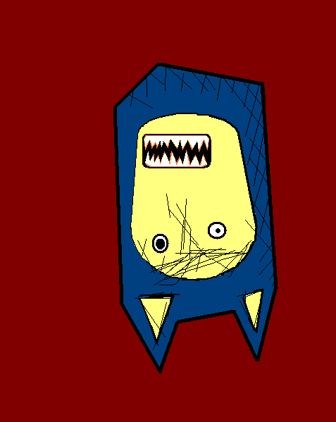
Ich habe drei Brüder und zwei Schwestern.
I have three brothers and two sisters.
Notes:
I have 3 brothers and 2 sisters.

Slide 13
Wie viele Geschwister hast du?
How many brothers and sisters do you have?

Slide 14


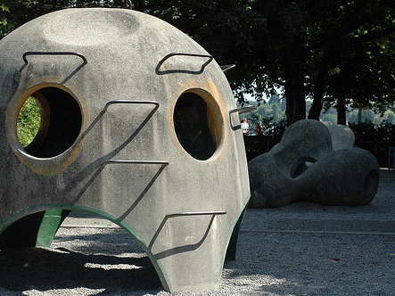
Ich habe keine Brüder und eine Schwester.
I have no brothers and one sister.
Notes:
I have no brothers and 1 sister.

Slide 15
Lovely. I like questions but I’ve got to go.
My tea is ready.

Slide 16















Join us again!

