Slide 1

Handy Questions 6
-
Your Favourite Thing &
What Would You Like To Do Now?
With the Unusual Mike Rophone

Slide 2
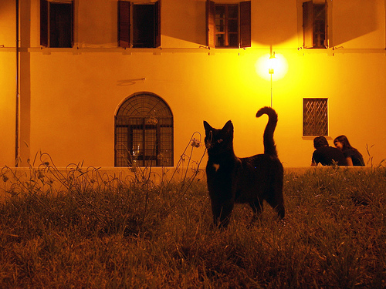

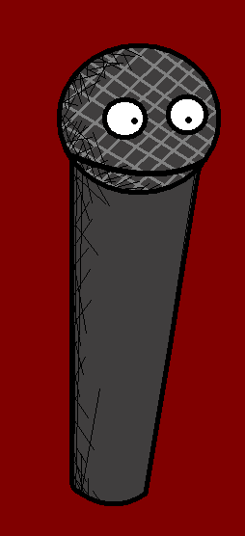
I’m the Unusual Mike Rophone, my questions are interesting to cats and humans alike.

Slide 3
Was magst du am allerliebsten auf der Welt?
What is your favourite thing in the world?

Slide 4
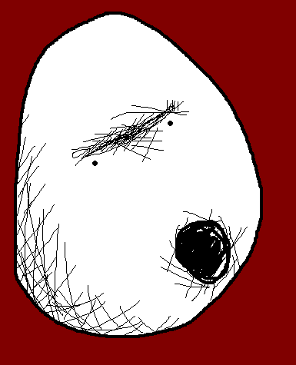
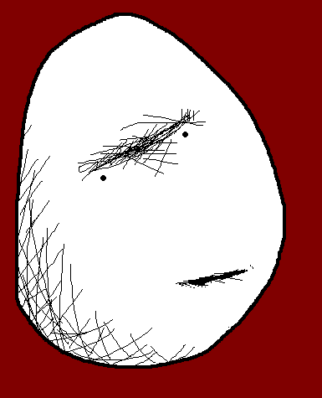
Rosa ist DEFINITIV meine Lieblingsfarbe.
Pink is DEFINITELY my favourite colour.
Notes:
Pink is DEFINITELY my favourite colour.

Slide 5
Faszinierend.
Was würdest du jetzt gern machen?
Fascinating. What would you like to do now?

Slide 6
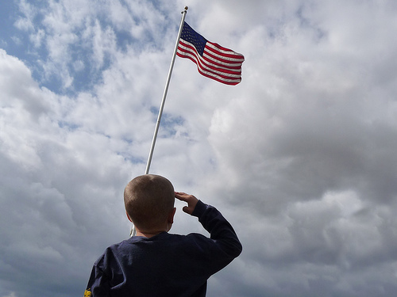
Ich möchte Reisen. Ich würde gerne Amerika sehen.
I want to go travelling. I would like to see America.
Notes:
I want to go travelling. I would like to see America.

Slide 7
Was magst du am allerliebsten auf der Welt?
What is your favourite thing in the world?

Slide 8
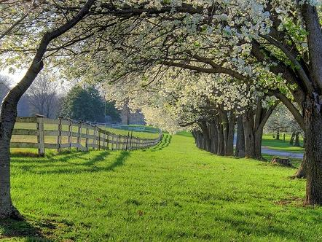


Brote mit Erdnussbutter sind mein Lieblingsessen.
Peanut butter sandwiches are my favourite food.
Notes:
Peanut butter sandwiches are my favourite food.

Slide 9
Faszinierend.
Was würdest du jetzt gern machen?
Fascinating. What would you like to do now?

Slide 10
Ich will Radfahren gehen.
I want to go cycling.
Notes:
I want to go cycling.

Slide 11
Was magst du am allerliebsten auf der Welt?
What is your favourite thing in the world?

Slide 12


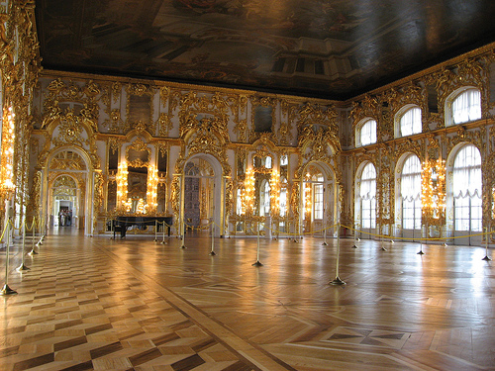
Gesellschaftstanz ist mein liebster Zeitvertreib.
Ballroom dancing is my favourite pastime.
Notes:
Ballroom dancing is my favourite pastime. (or just Tanz?)

Slide 13
Faszinierend.
Was würdest du jetzt gern machen?
Fascinating. What would you like to do now?

Slide 14
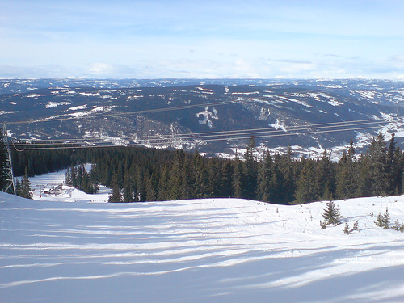
Ich will für eine Weile Skifahren gehen.
I want to go skiing for a while.
Notes:
I want to go skiing for a while. (or Schifahren) (auch:Zeitlang)

Slide 15
Was magst du am allerliebsten auf der Welt?
What is your favourite thing in the world?

Slide 16
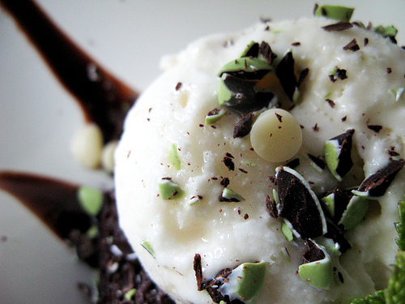


Mint chocolate chip is my favourite ice cream flavour.
Meine liebste Eis-Sorte ist Schokoladen-Minze.
Notes:
Mint chocolate chip is my favourite ice-cream flavour. (Schoko-Minz?)

Slide 17
Faszinierend.
Was würdest du jetzt gern machen?
Fascinating. What would you like to do now?

Slide 18
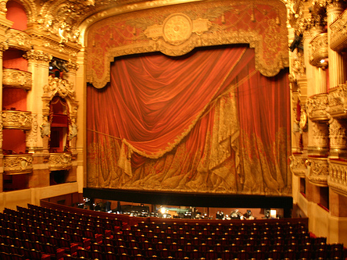
Ich will berühmt werden!
I want to be famous.
Notes:
I want to be famous

Slide 19
Was magst du am allerliebsten auf der Welt?
What is your favourite thing in the world?

Slide 20
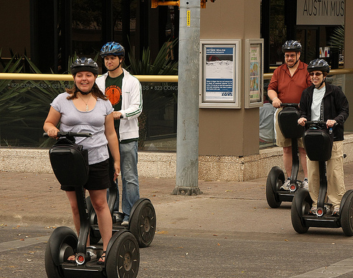
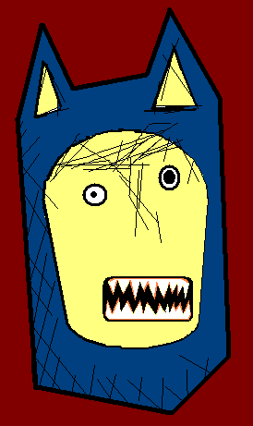
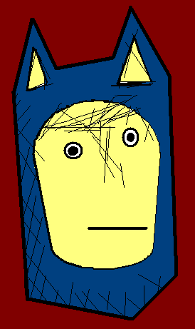
Samstag ist mein Lieblingstag.
Saturday is my favourite day.
Notes:
Saturday is my favourite day.

Slide 21
Faszinierend.
Was würdest du jetzt gern machen?
Fascinating. What would you like to do now?

Slide 22
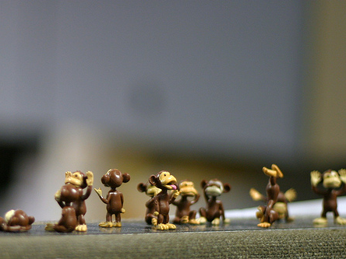
Ich will in den Zoo gehen, um die Affen zu sehen.
I want to go to the zoo, to see the monkeys.
Notes:
I want to go to the zoo, to see the monkeys.

Slide 23
Was magst du am allerliebsten auf der Welt?
What is your favourite thing in the world?

Slide 24
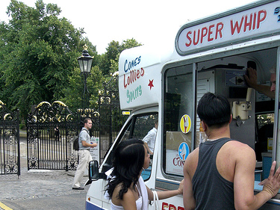
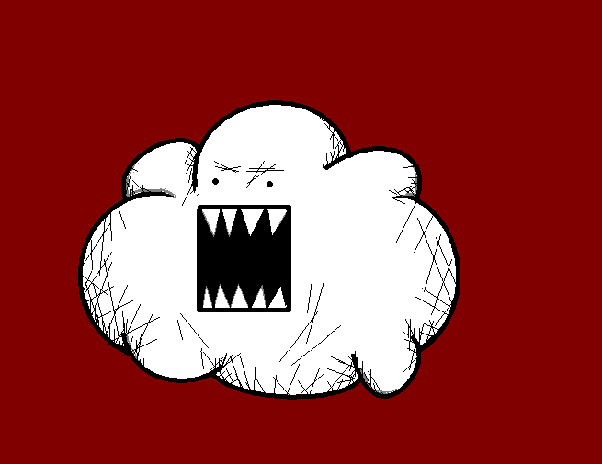
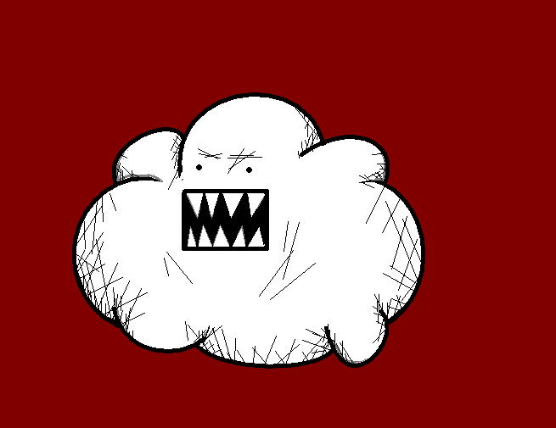
Ice cream is my favourite food.
Eiscreme ist mein Lieblingsessen.
Notes:
But Ice cream is my favourite food.

Slide 25
Faszinierend.
Was würdest du jetzt gern machen?
Fascinating. What would you like to do now?

Slide 26
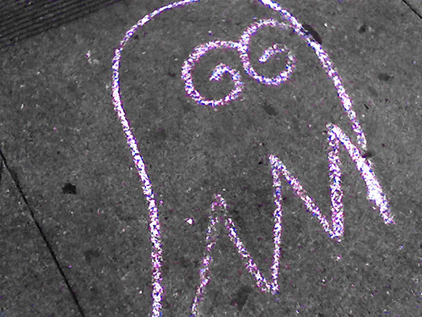
Ich möchte Wasser trinken.
Kannst du mir bitte ein Glas holen?
I want a drink of water, could you get me one please.
Notes:
I want a drink of water, could you get me one please (I want a drink of water, can you get me a glas please)

Slide 27
I just have one more question, but I haven’t written it down. Erm, Thanks for your time.

Slide 28
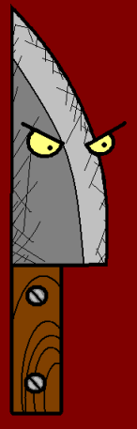











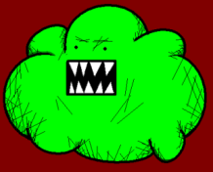


Join us again!

