Slide 1

Handy Animals Vocab 1
Pets
with Mr Angry Cloud-Ghost

Slide 2
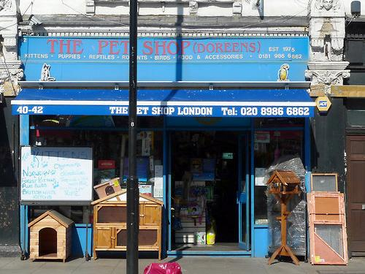
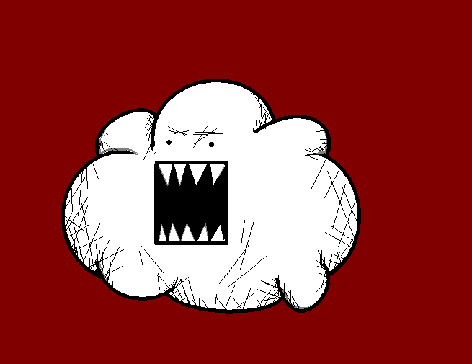
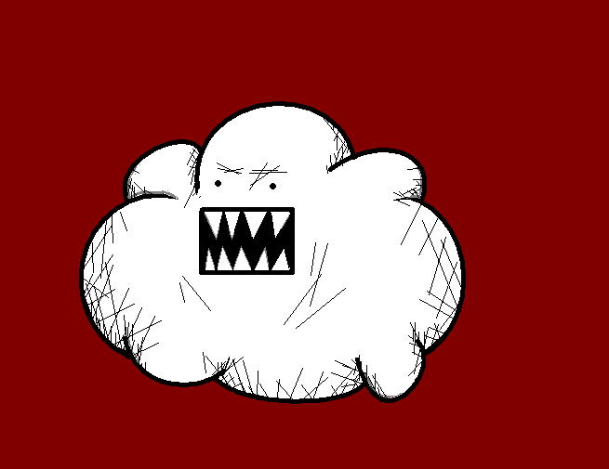
I am Mr Angry Cloud-Ghost. You may not believe it, but I just love pets…

Slide 3
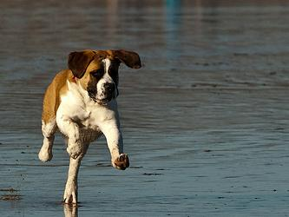
Hund
Dog

Slide 4
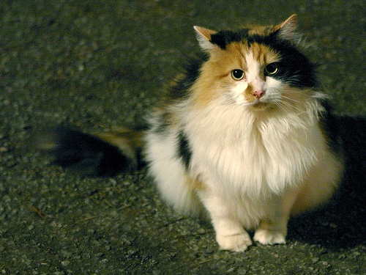
Katze
Cat

Slide 5
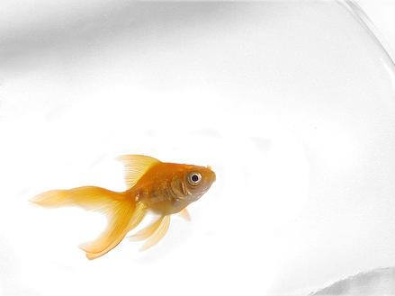
Goldfisch
Goldfish

Slide 6
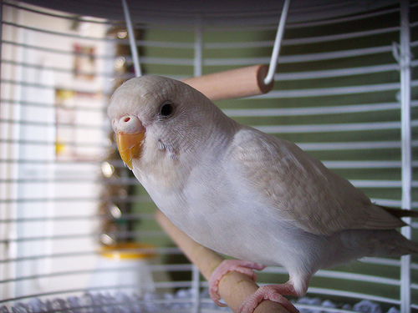
Vogel
Bird

Slide 7
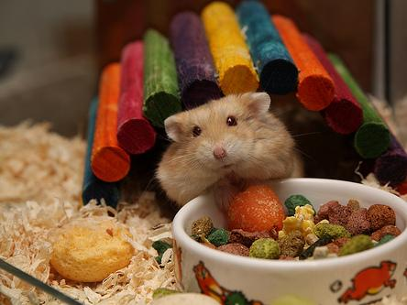
Hamster
Hamster

Slide 8
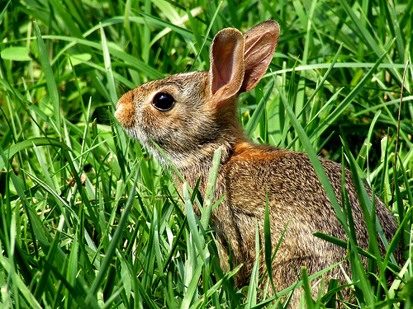
Hase
Rabbit

Slide 9
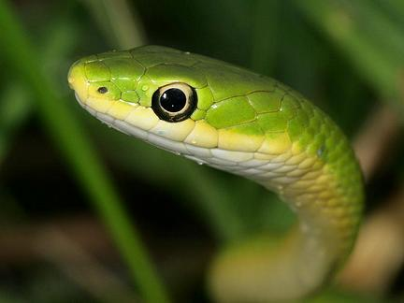
Schlange
Snake

Slide 10
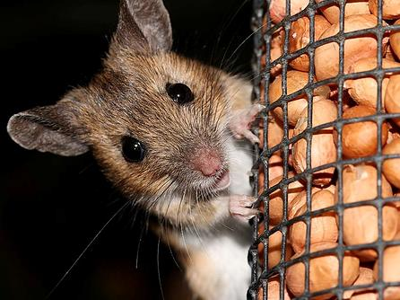
Maus
Mouse

Slide 11
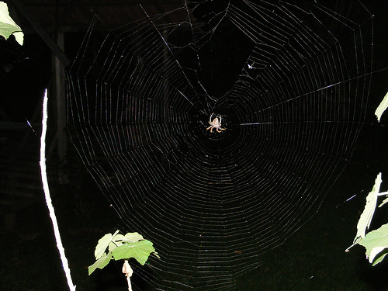
Spinne
Spider

Slide 12
I like spiders because I’m a ghost. They’re not as scary as I am…
Mwahahaha!!!

Slide 13
















Join us again!

