Slide 1

Handy Animals Vocab 2
Wild Animals
with Mr Angry Cloud-Ghost

Slide 2
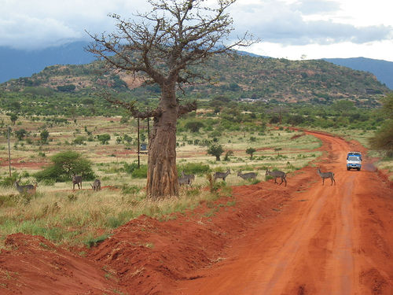


These animals are wild, like me – Mr Angry Cloud-Ghost.

Slide 3
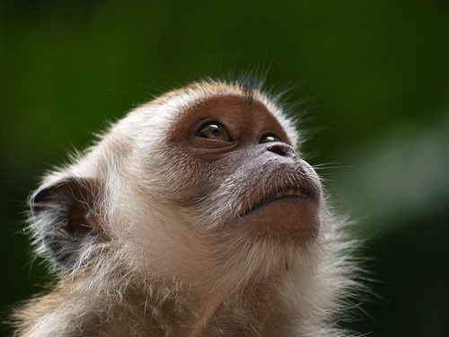
Affe
Monkey

Slide 4
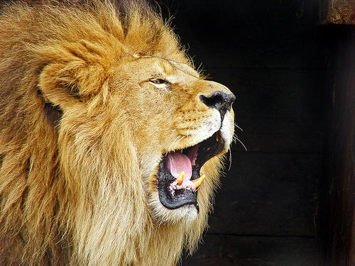
Löwe
Lion

Slide 5
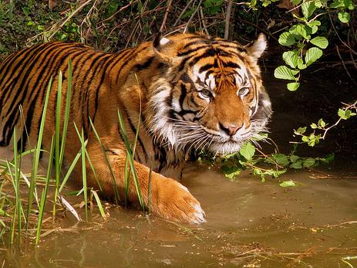
Tiger
Tiger

Slide 6
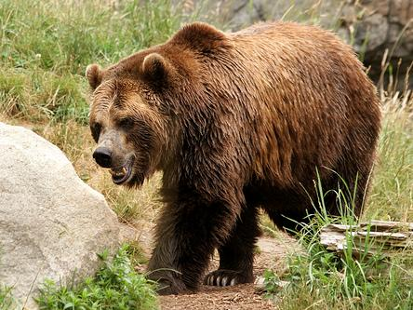
Bär
Bear

Slide 7
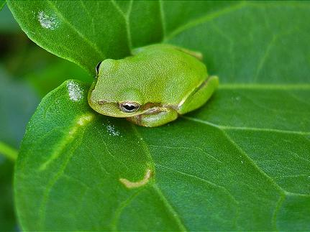
Frosch
Frog

Slide 8
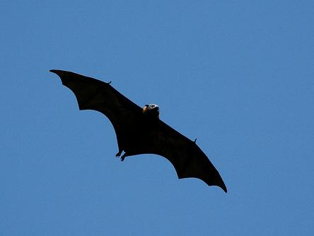
Fledermaus
Bat

Slide 9
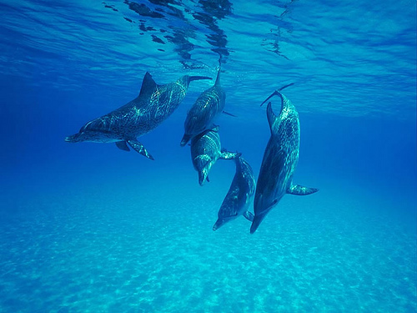
Delfin
Dolphin

Slide 10
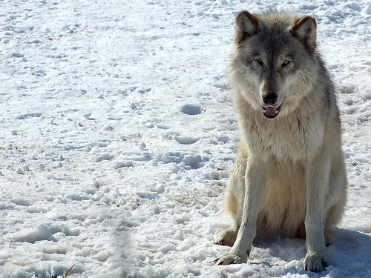
Wolf
Wolf

Slide 11
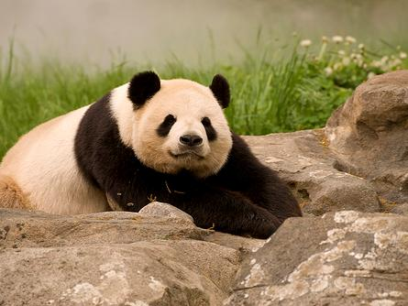
Pandabär
Panda

Slide 12
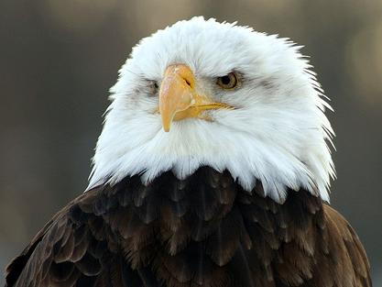
Adler
Eagle

Slide 13
















Join us again!

