Slide 1

Handy Animals Vocab 3
Farm Animals
with Mr Angry Cloud-Ghost

Slide 2
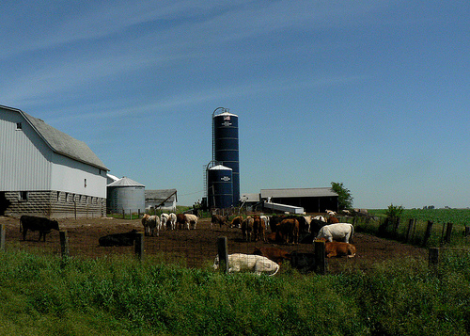


By night, I am Mr Angry Cloud-Ghost. By day, I’m secretly a farmer.

Slide 3
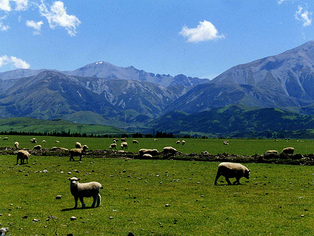
Schafe
Sheep

Slide 4
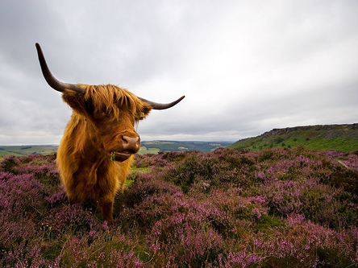
Kuh
Cow

Slide 5
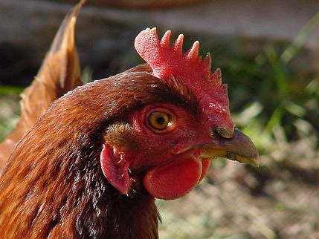
Huhn
Chicken

Slide 6
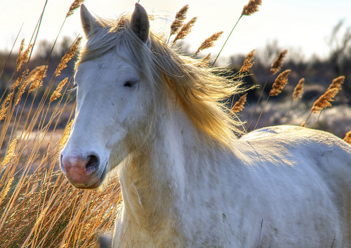
Pferd
Horse

Slide 7
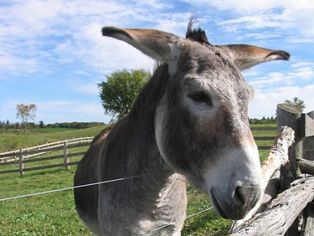
Esel
Donkey

Slide 8
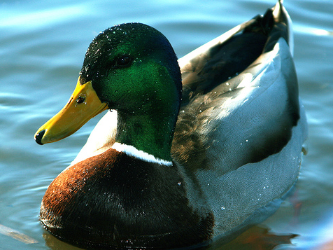
Ente
Duck

Slide 9
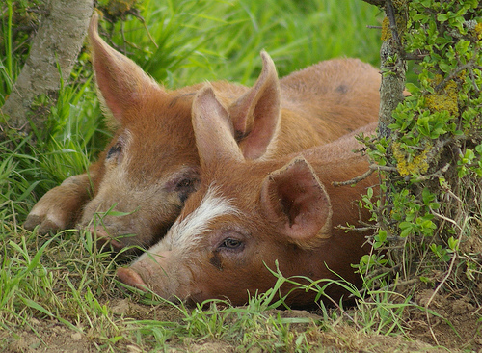
Schwein
Pig

Slide 10
















Join us again!

