Slide 1

Handy Animals Vocab 4
Young Animals
with Mr Angry Cloud-Ghost

Slide 2
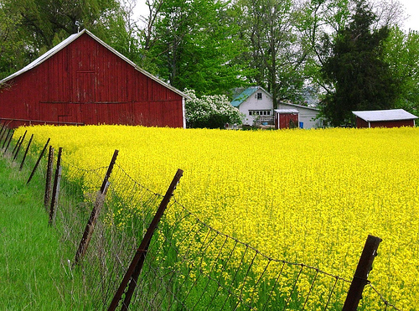

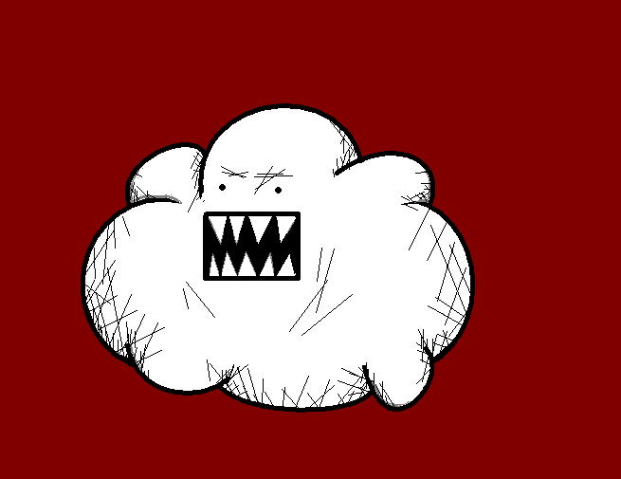
If I were a lesser Cloud-Ghost, baby animals would make me go all gooey and say “aah!”

Slide 3
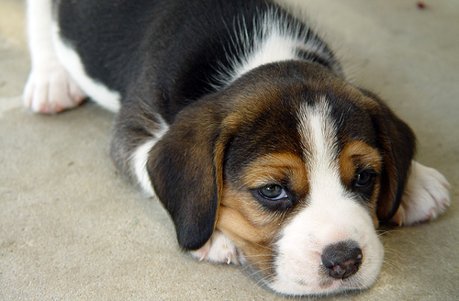
Welpe
Puppy

Slide 4
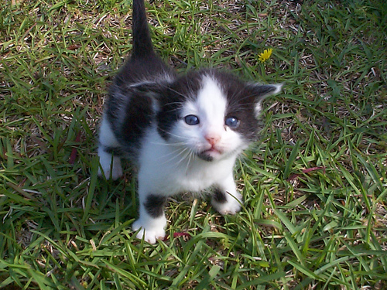
Kätzchen
Kitten

Slide 5
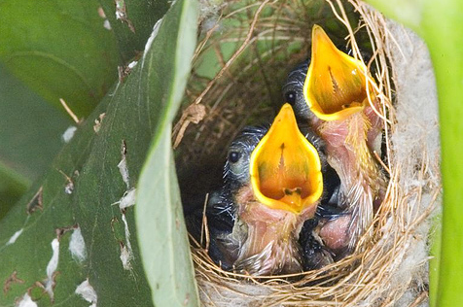
Küken
Chick

Slide 6
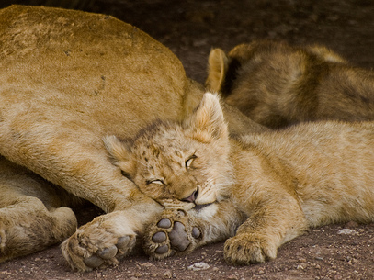
Löwenjunges
Lion cub

Slide 7
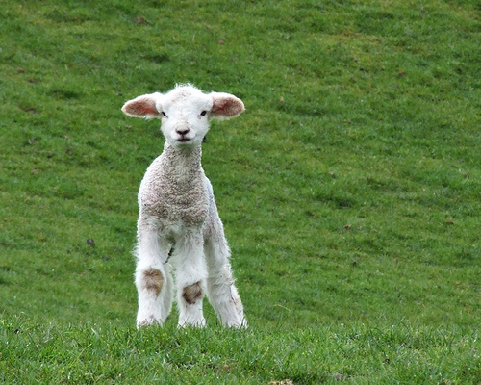
Lamm
Lamb

Slide 8
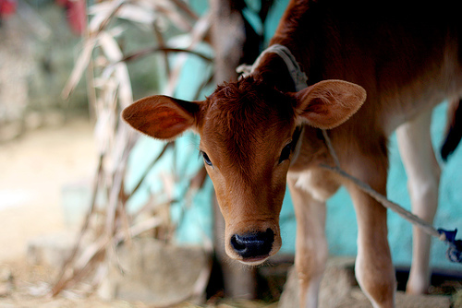
Kalb
Calf

Slide 9
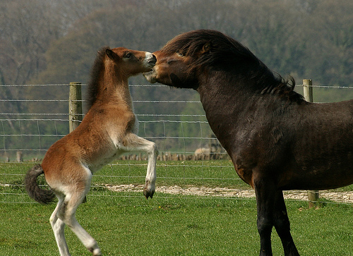
Fohlen
Foal

Slide 10
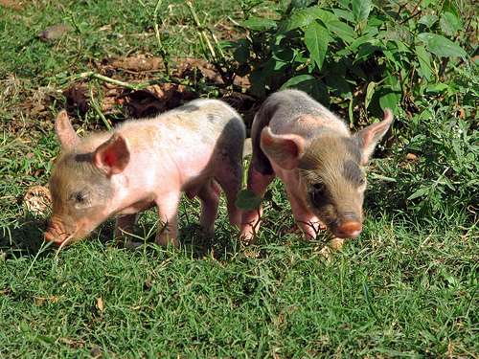
Ferkel
Piglet

Slide 11
















Join us again!

