Slide 1
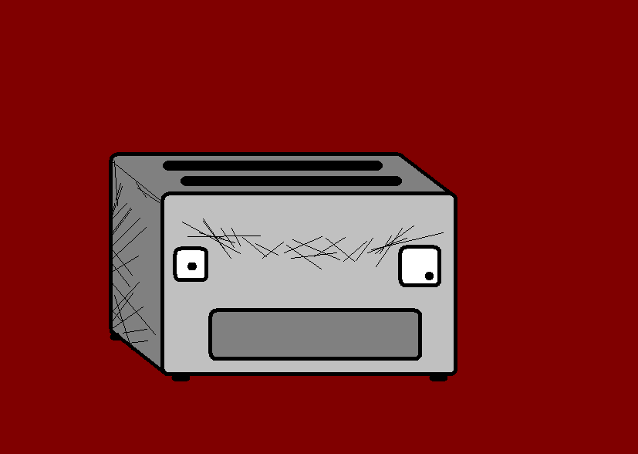

Handy BIG numbers 11 - 50
With the Angry Toaster-Brow

Slide 2
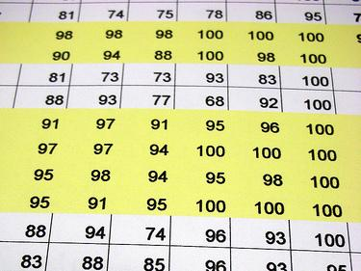
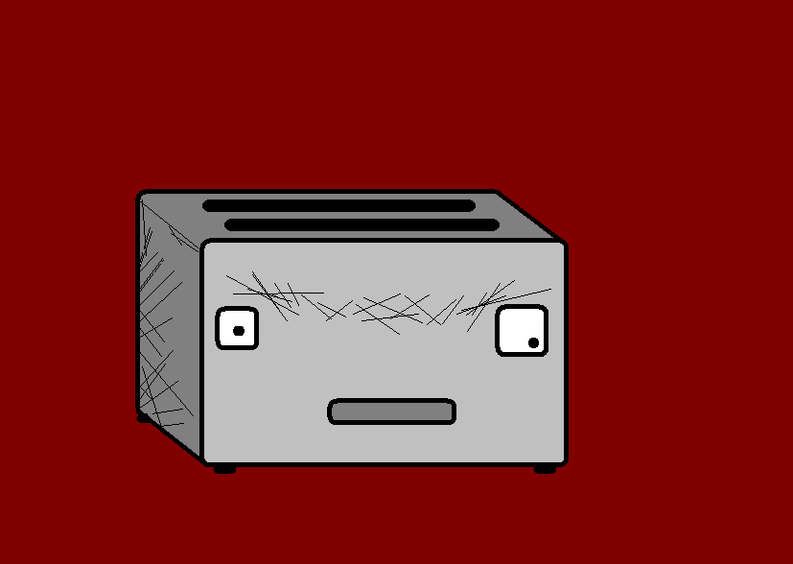
Hello again, I am still Angry Toaster-Brow, and now you know the wee numbers let’s get into some bigger ones. They aren’t too difficult either.

Slide 3
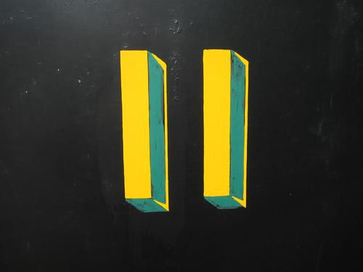

Eleven
Elf

Slide 4
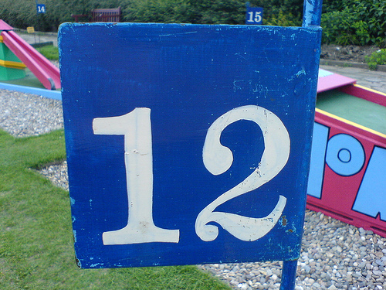
Twelve
Zwölf

Slide 5
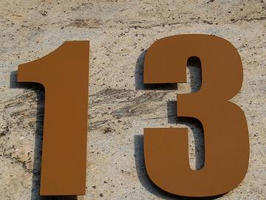
Thirteen
Dreizehn

Slide 6
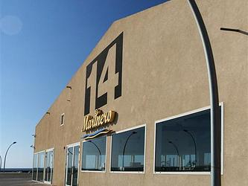
Fourteen
Vierzehn

Slide 7
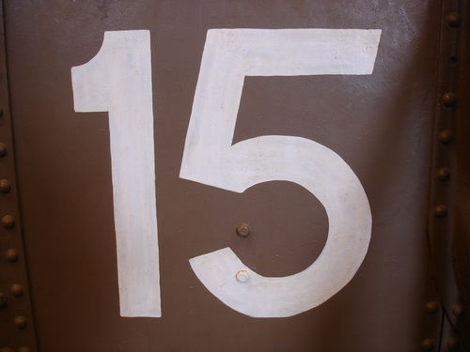
Fifteen
Fünfzehn

Slide 8
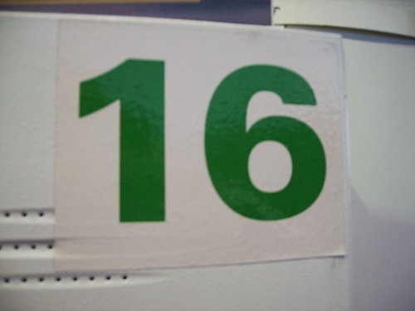
Sixteen
Sechzehn

Slide 9
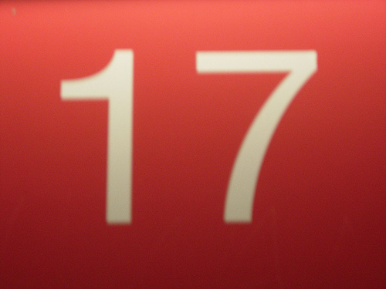
Seventeen
Siebzehn

Slide 10
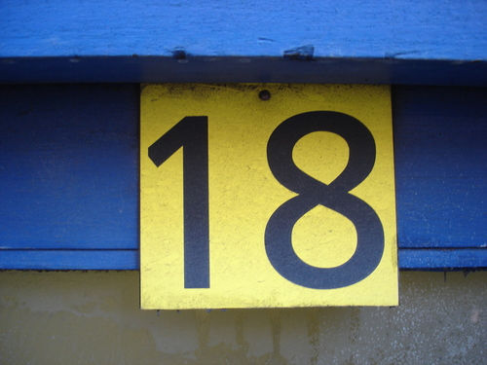
Eighteen
Achtzehn

Slide 11
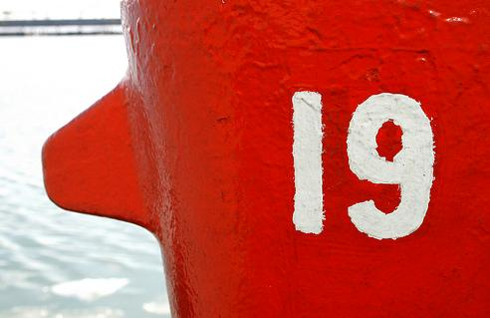
Nineteen
Neunzehn

Slide 12
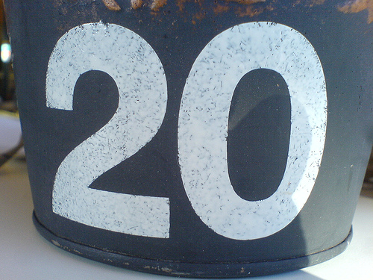
Twenty
Zwanzig

Slide 13
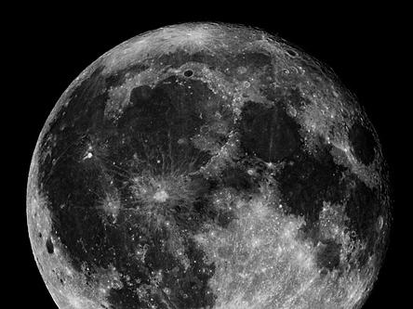
Onwards and upwards!

Slide 14
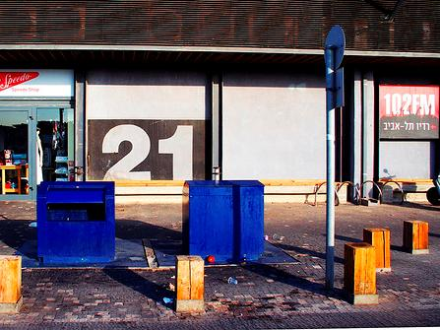
Twenty One
Einundzwanzig

Slide 15
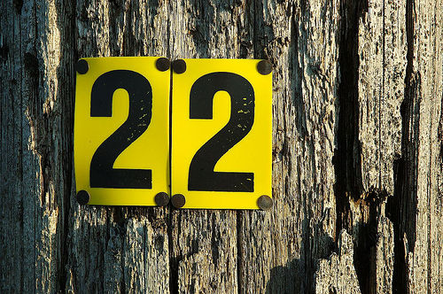
Twenty Two
Zweiundzwanzig

Slide 16
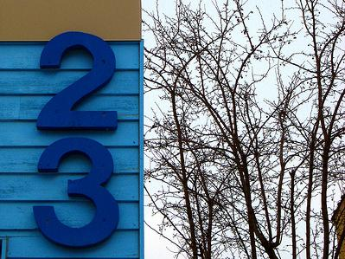
Twenty Three
Dreiundzwanzig

Slide 17
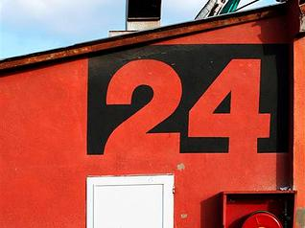
Twenty Four
Vierundzwanzig

Slide 18
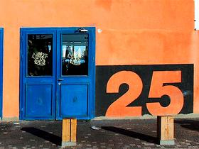
Twenty Five
Fünfundzwanzig

Slide 19
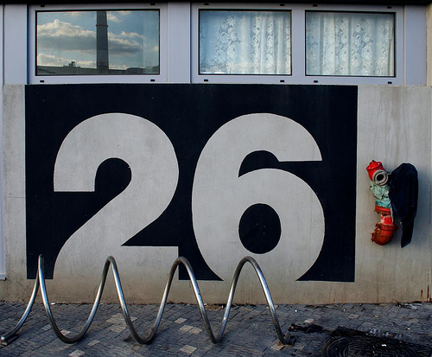
Twenty Six
Sechsundzwanzig

Slide 20
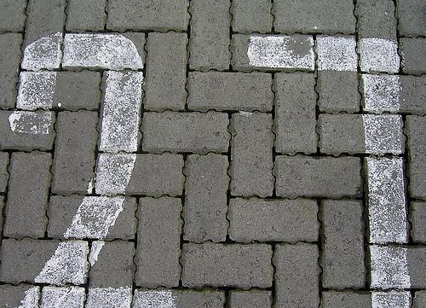
Twenty Seven
Siebenundzwanzig

Slide 21
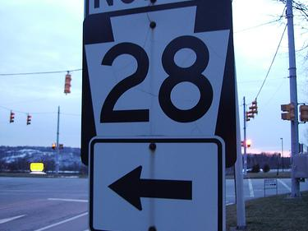
Twenty Eight
Achtundzwanzig

Slide 22
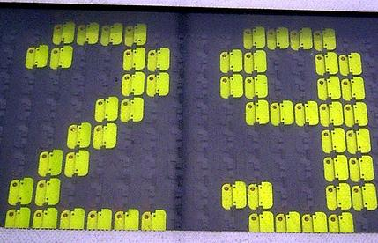
Twenty Nine
Neunundzwanzig

Slide 23
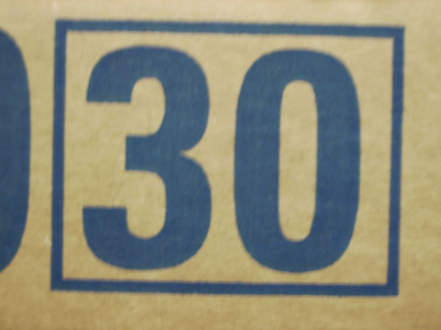
Thirty
Dreißig

Slide 24
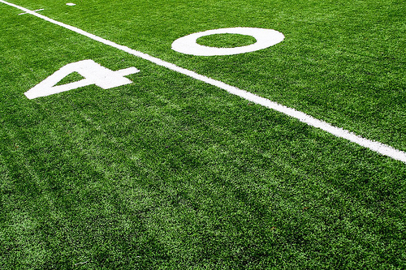
Forty
Vierzig

Slide 25
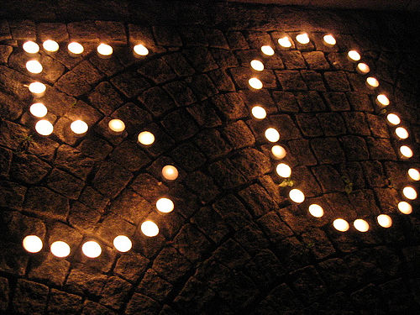
Fifty
Fünfzig

Slide 26
There you go, that wasn’t too difficult, now try handy bigger numbers and handy numbers practice.

Slide 27
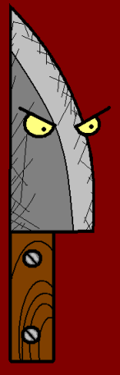















Join us again!

