Slide 1


Handy Body Vocab 1
The Body
With Mr. Angry Potato Head?

Slide 2
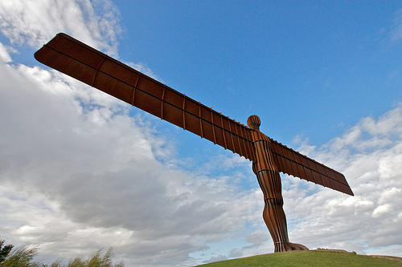

I am Mr. Angry Potato Head and today we are going to talk about body parts!
I have...

Slide 3
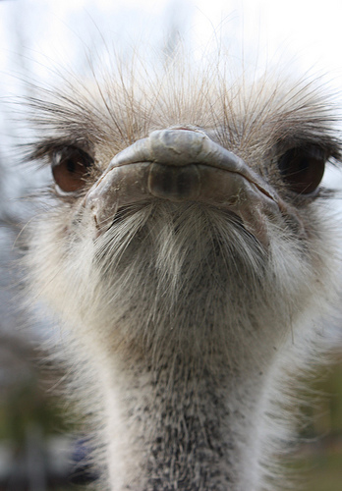
der Kopf
Yes, I’m very clever!
Head

Slide 4
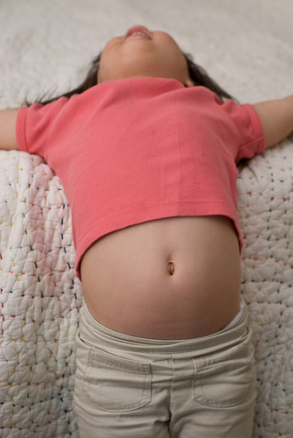
der Bauch
Mine is a bit too fat.
Stomach

Slide 5
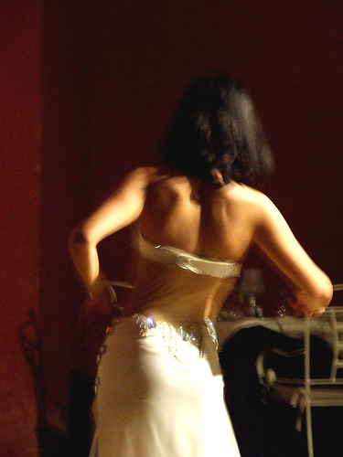
der Rücken
Back

Slide 6
I wish I had…

Slide 7
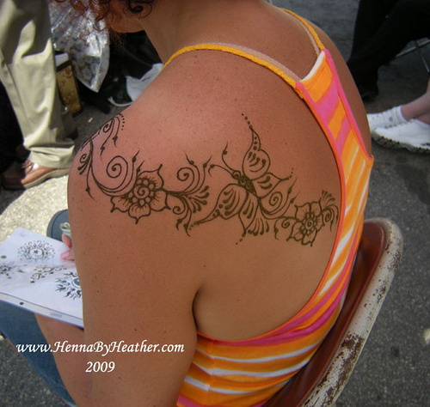
die Schulter
die Schultern
Shoulder - Shoulders
Shoulder - Shoulders

Slide 8
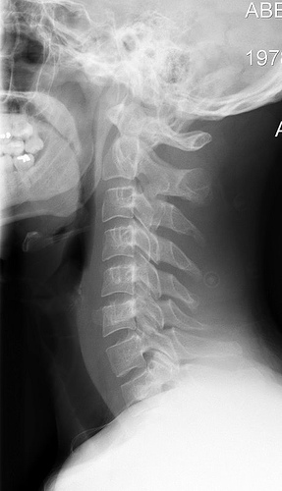
der Hals
Neck

Slide 9
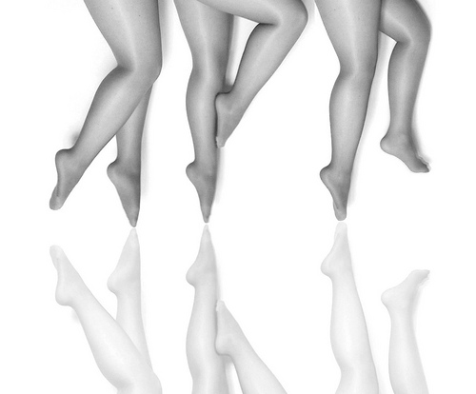
Yeah, I have legs!
das Bein
die Beine
Leg - Legs
Leg - Legs

Slide 10
Oh no, I don’t want such big feet!
der Fuß
die Füße
Foot - Feet
Foot - Feet

Slide 11
Aaaaah, they’re awful!!!
und die Zehen!
And toes!

Slide 12
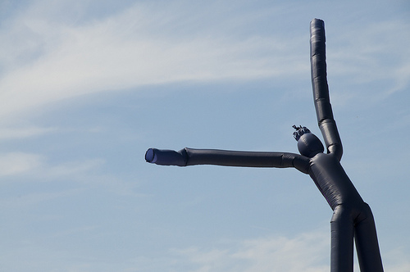
der Arm
die Arme
Yoo-hoo!!!
Arm - Arms
Arm - Arms

Slide 13
die Hand
die Hände
Hand - Hands
Hand - Hands

Slide 14
Aaaah, I’m a monster!!
und die Finger!
And fingers!

Slide 15
Where are all my new body parts now?!
Well, go to part 2 to learn more...

Slide 16
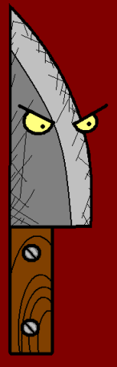

















Join us again!

