Slide 1

Handy Body Vocab 2
The Face
with Mr. Angry Potato Head
and Mr. Confused and Angry Wolfman

Slide 2
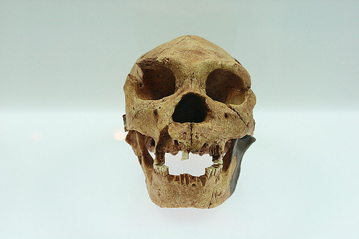


I am Mr. Angry Potato Head again, and now I’m going to introduce you to parts of…

Slide 3
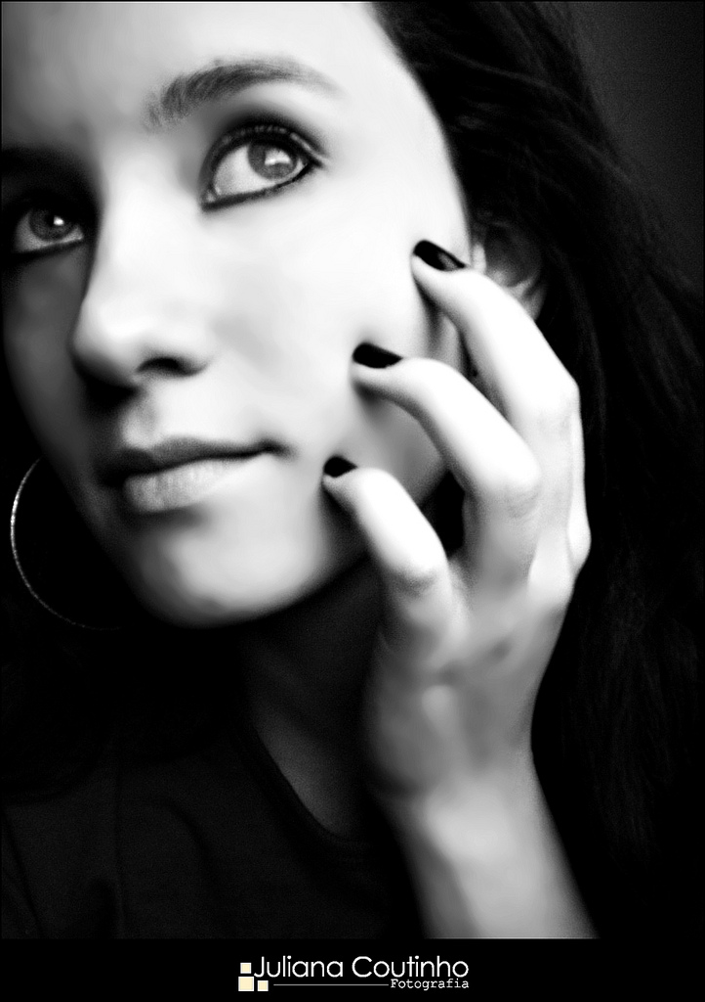


das Gesicht!!
the face!!

Slide 4
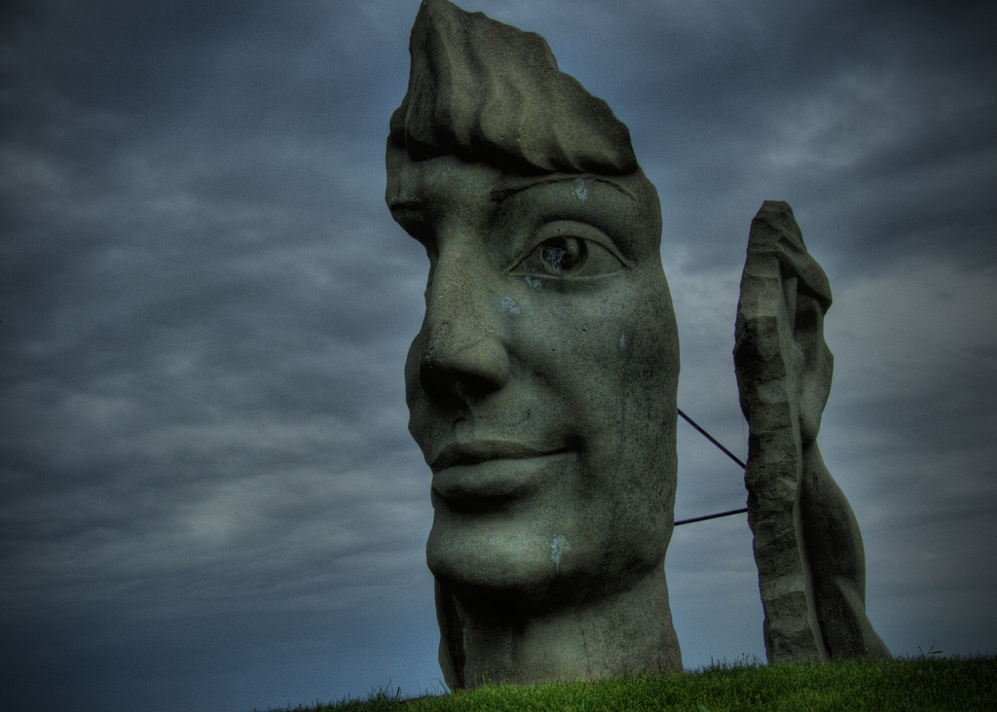
Such as...

Slide 5
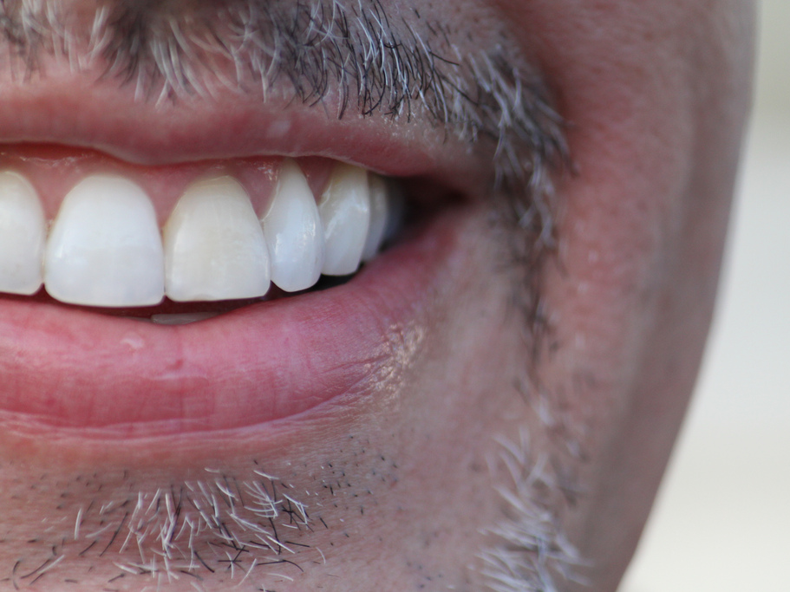
der Mund
Mouth

Slide 6
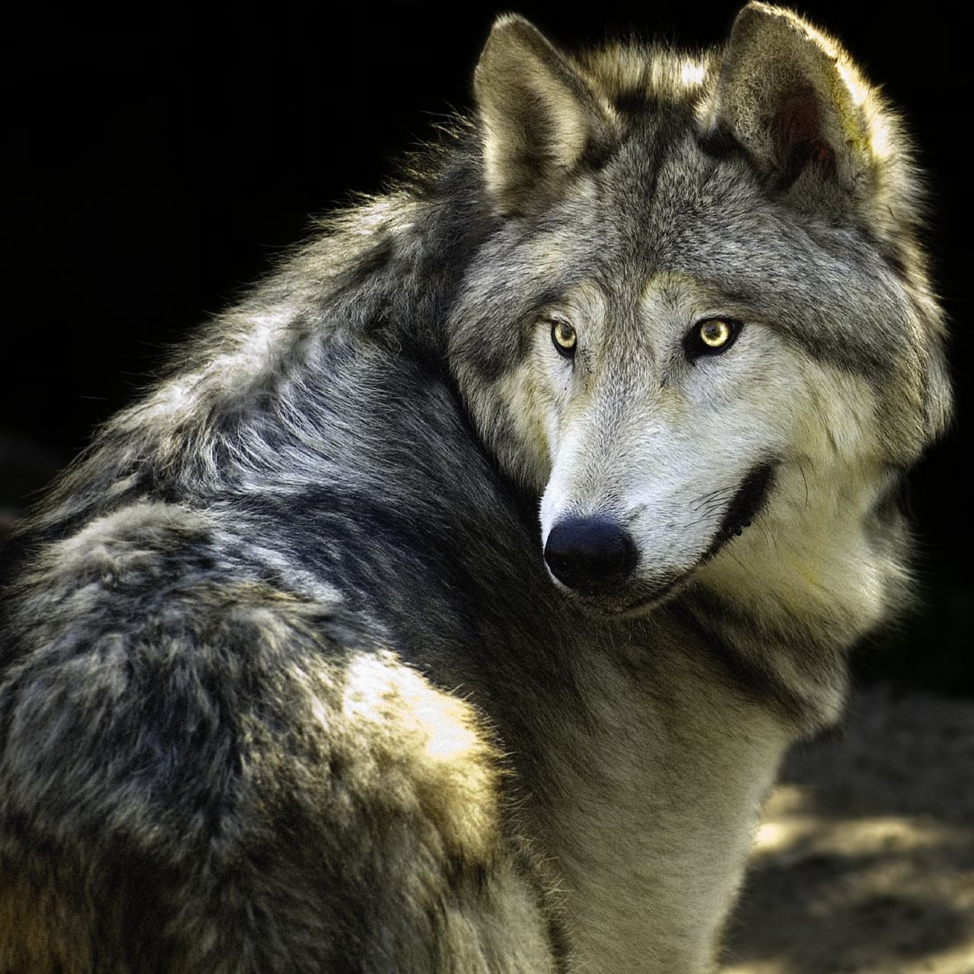
Hmm, he looks familiar...
die Augen
Eyes

Slide 7
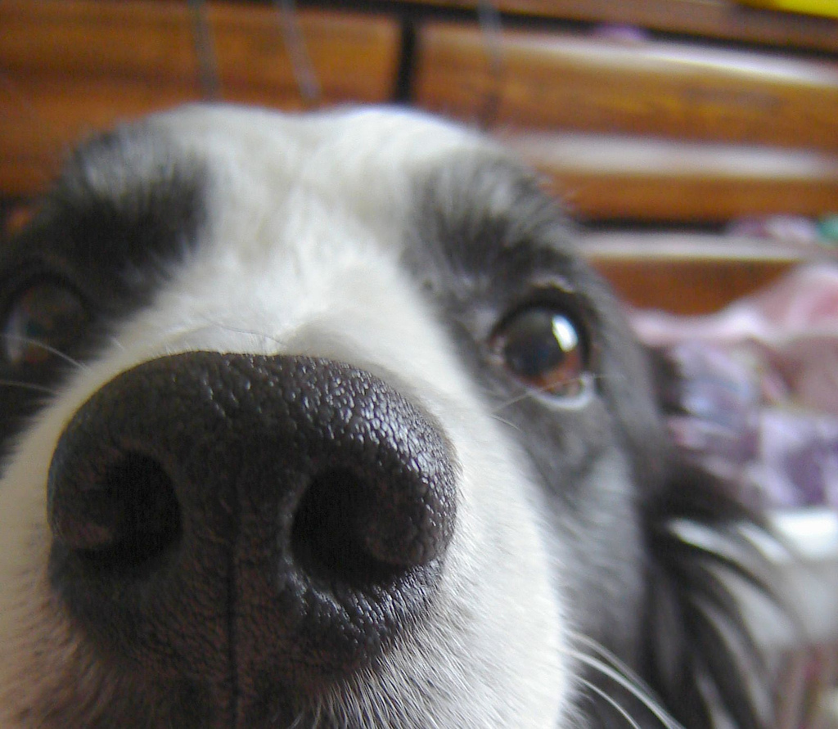
die Nase
Nose

Slide 8
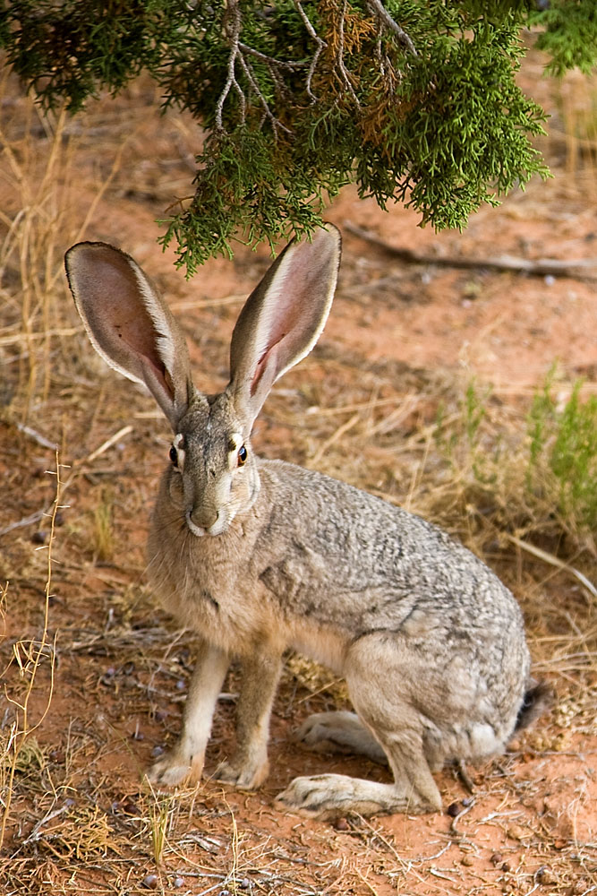
die Ohren
Look at me!
I have ears!
Haha!!
Ears

Slide 9
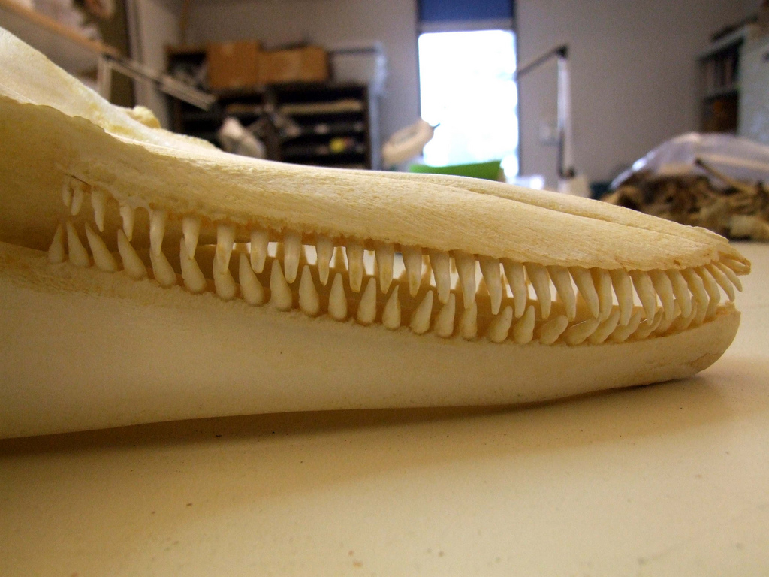
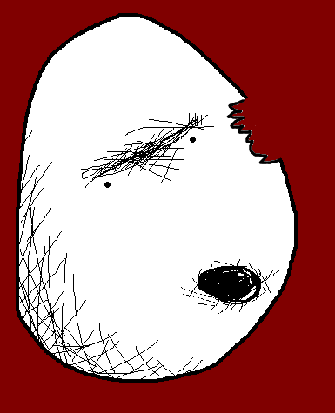

die Zähne
What big teeth you have!
Teeth

Slide 10
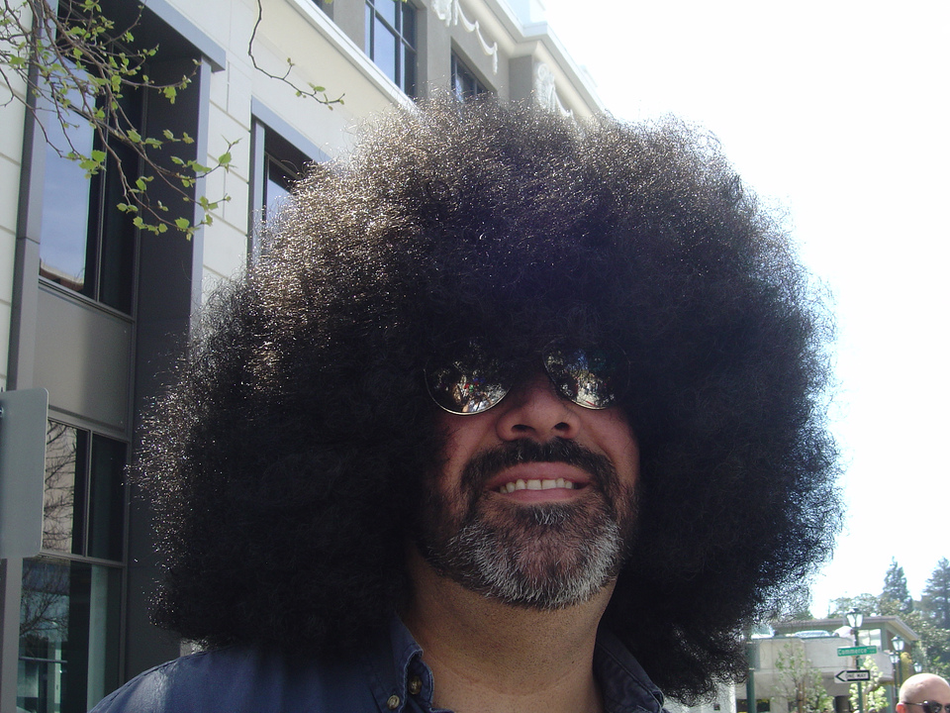
die Haare
Hair

Slide 11
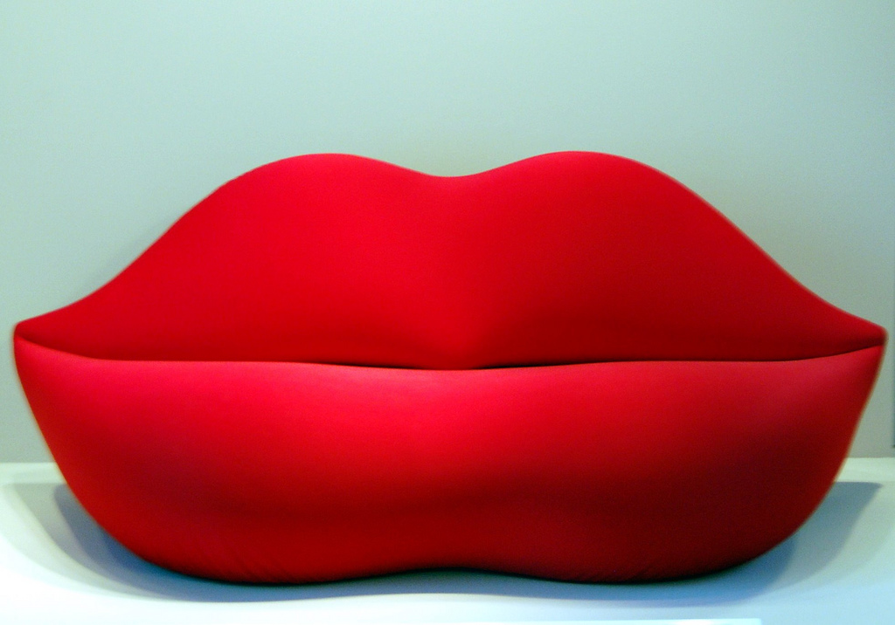
die Lippen
Lips

Slide 12
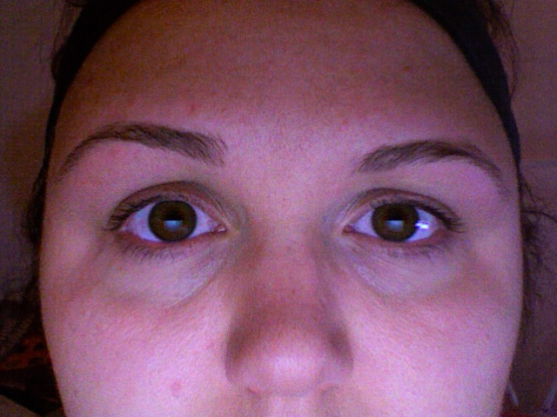
die Augenbrauen
Eyebrows

Slide 13
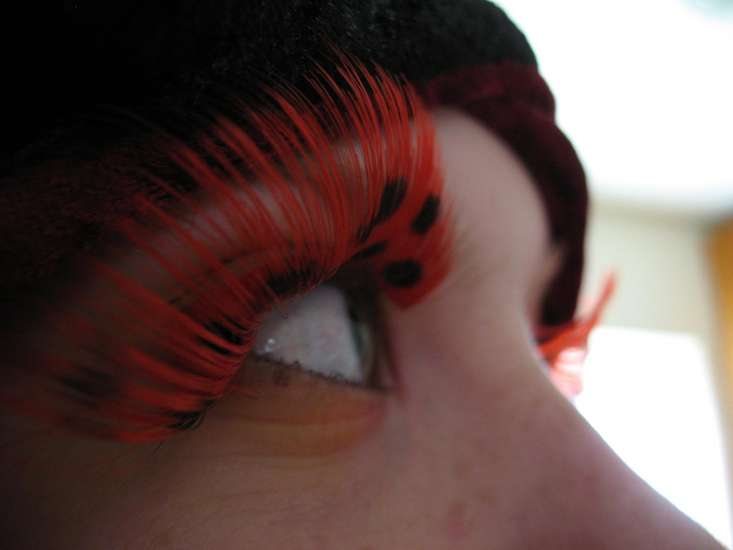
die Wimpern
Eyelashes

Slide 14
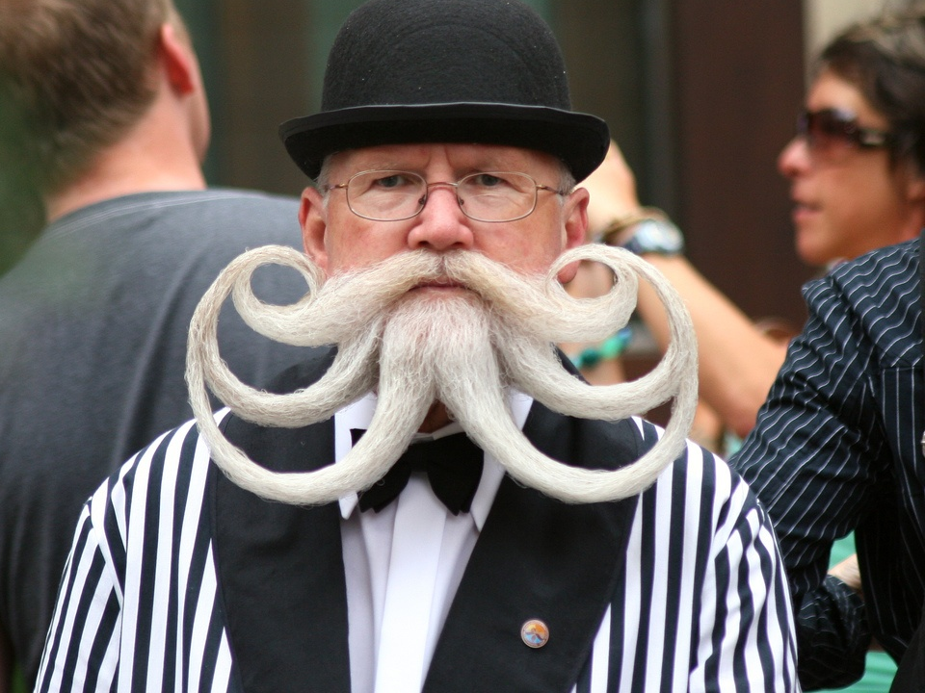


der Bart
I wonder if I look good with a beard?
Hmm, I like it!
Nice beard!
Beard

Slide 15
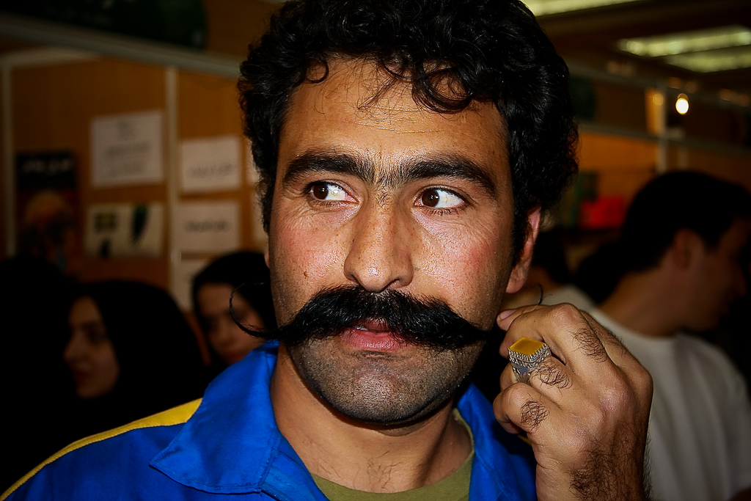
der Schnurrbart
Moustache

Slide 16
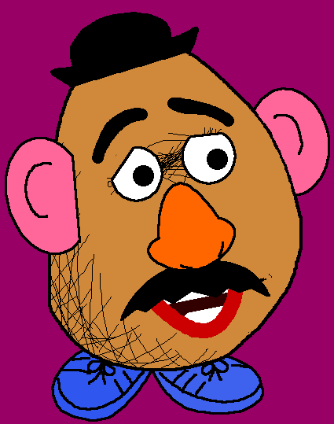
Ta-dah! Let’s go and show the others our new look!
So, there you have the parts of the face. I have decided to add some to mine...

Slide 17
















Join us again!

