Slide 1

Handy Buildings Vocab 1
Shops
with Mr. Angry Toaster-Brow

Slide 2
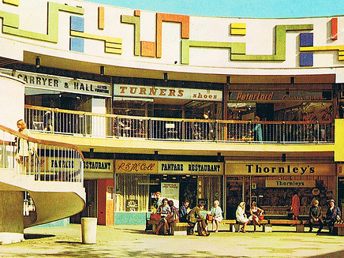
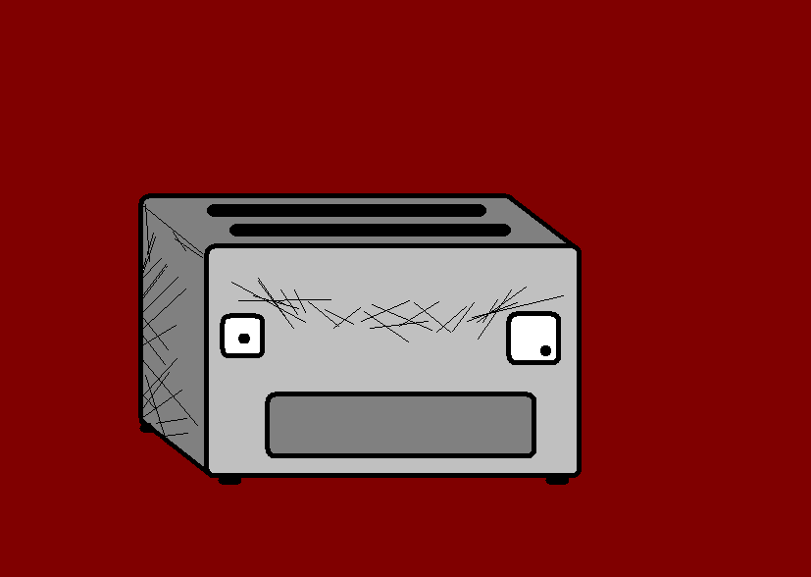
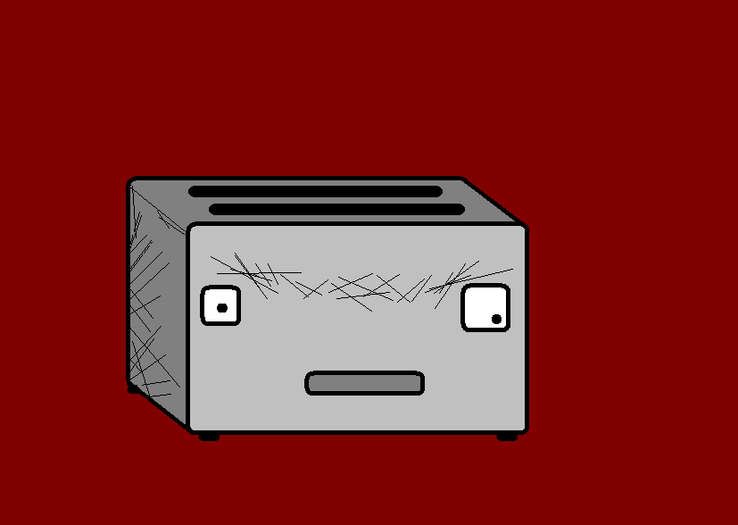
I am Mr Angry Toaster-Brow. I just love shopping. Why not join me as I go to the…

Slide 3
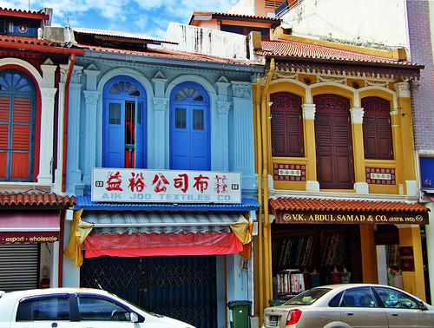
Läden (Geschäfte)
Shops

Slide 4
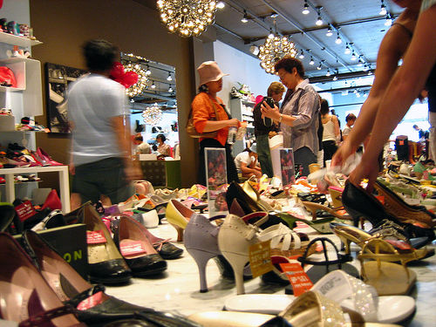
Schuhladen
Shoe Shop

Slide 5
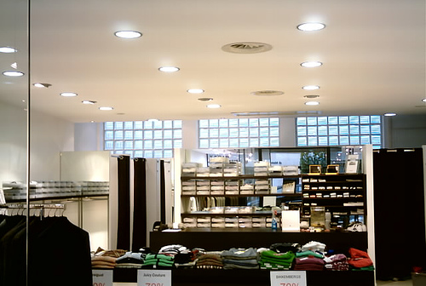
Kleidungsgeschäft
Clothes Shop

Slide 6
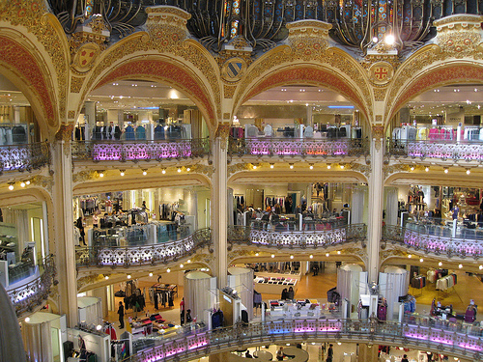
Kaufhaus
Department Store

Slide 7
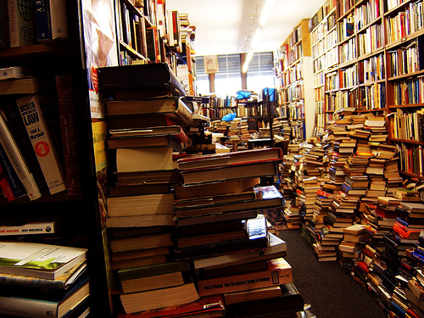
Buchhandlung
Book Shop

Slide 8
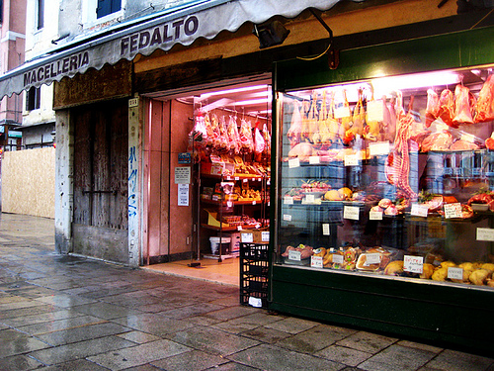
Metzgerei
Butcher’s

Slide 9
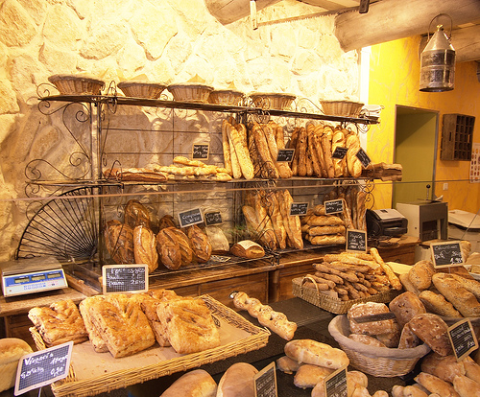
Bäckerei
Bakery

Slide 10
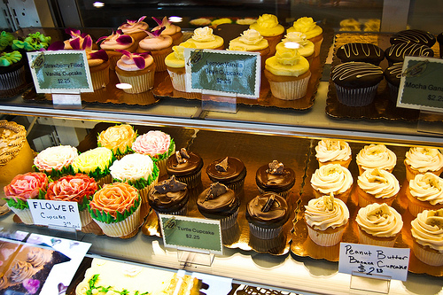
Konditorei
Cake Shop

Slide 11
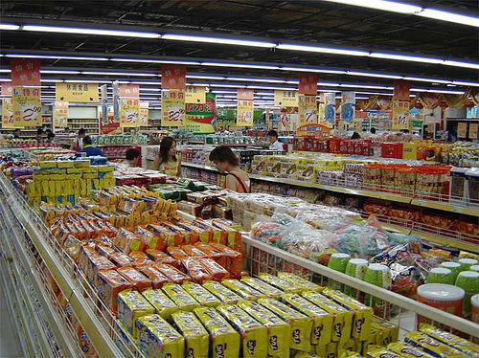
Supermarkt
Supermarket

Slide 12
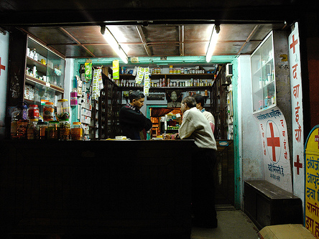
Apotheke
Chemist

Slide 13
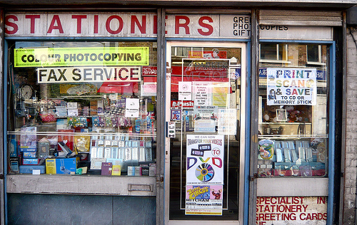
Schreibwarengeschäft
Stationery Shop

Slide 14
















Join us again!

