Slide 1

Handy Buildings Vocab 2
Public Buildings
with Mr Angry Toaster-Brow

Slide 2
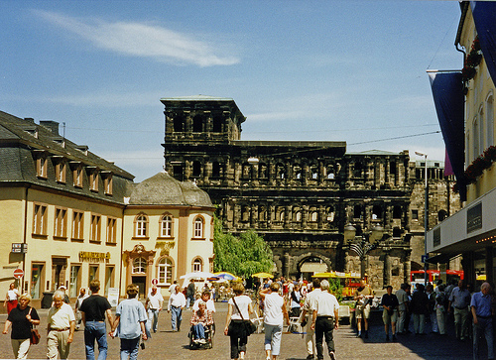
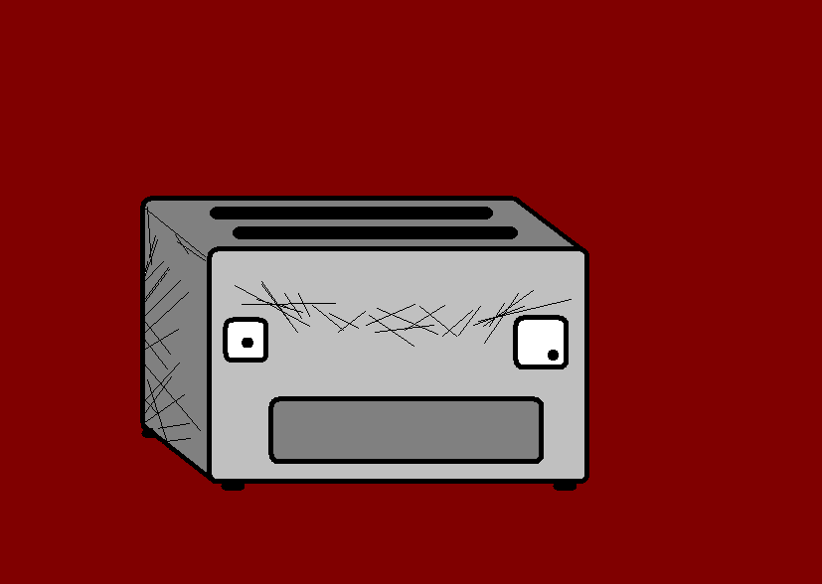
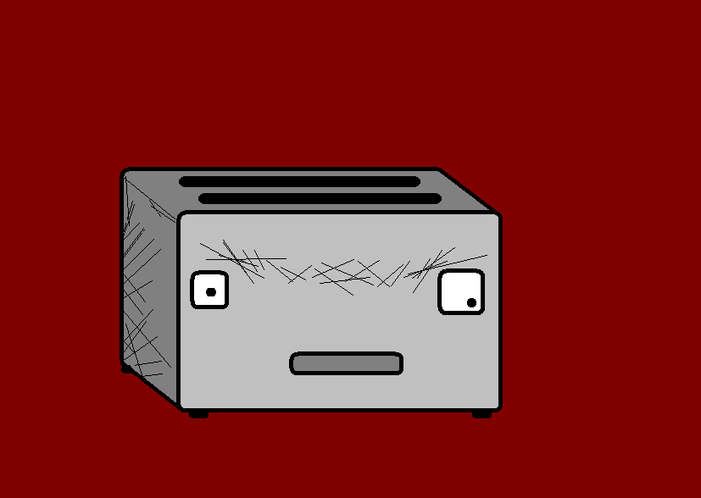
I am Mr Angry Toaster-Brow, I am going to have a look around the town. You’re coming, too.

Slide 3
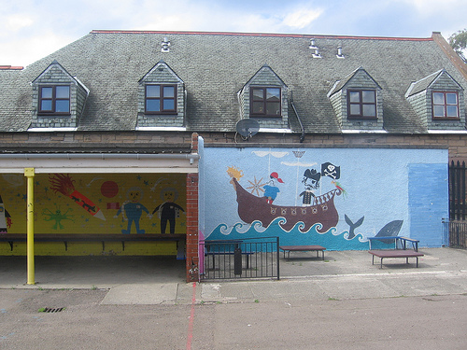
Schule
School

Slide 4
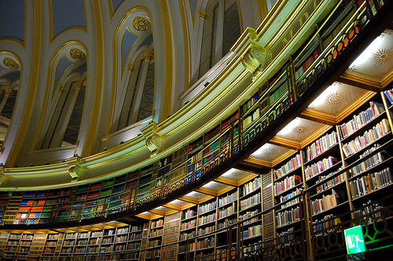
Bibliothek (Bücherei)
Library

Slide 5
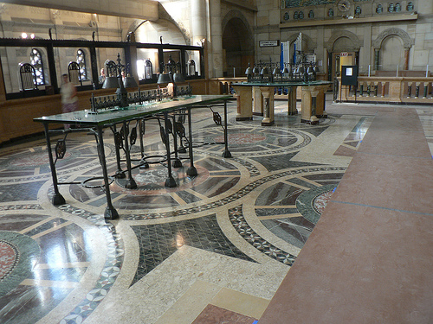
Bank
Bank

Slide 6
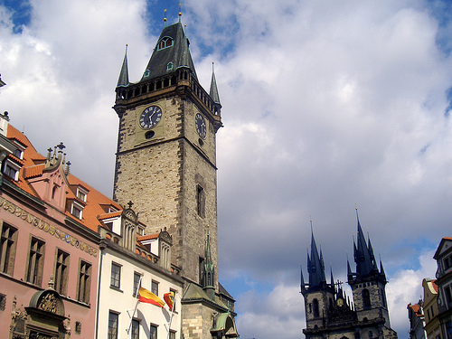
Rathaus
Town Hall

Slide 7
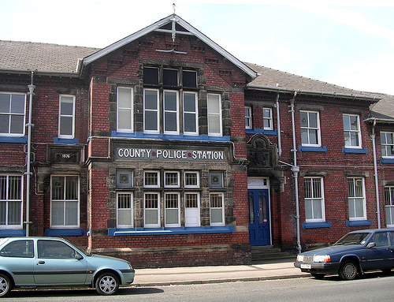
Polizeistation
Police Station

Slide 8
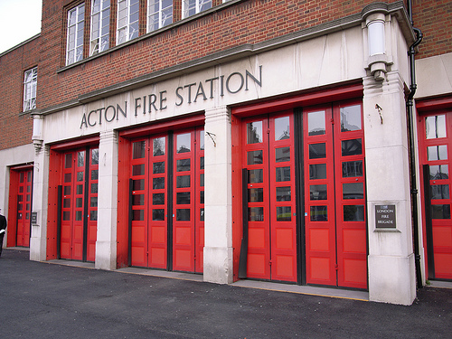
Feuerwehr
Fire Station

Slide 9
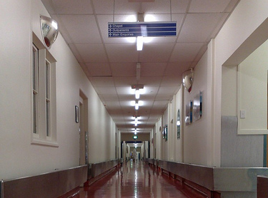
Krankenhaus
Hospital

Slide 10
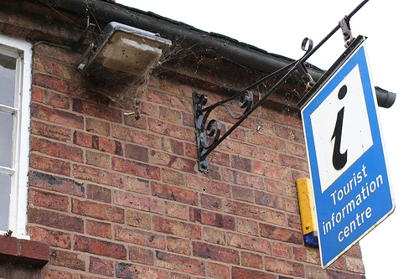
Touristeninformation
Tourist Information

Slide 11
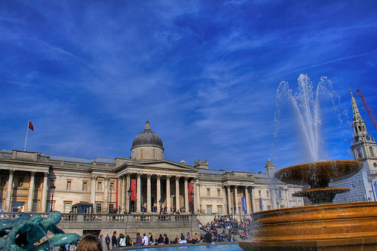
Museum
Museum

Slide 12
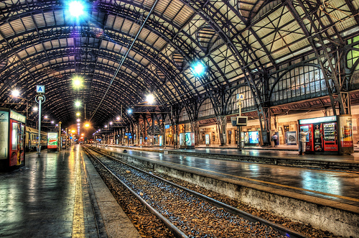
Bahnhof
Station

Slide 13
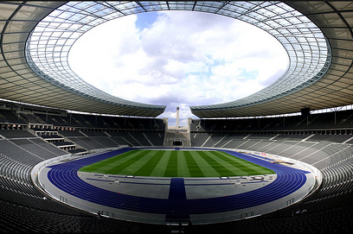
Stadion
Stadium

Slide 14
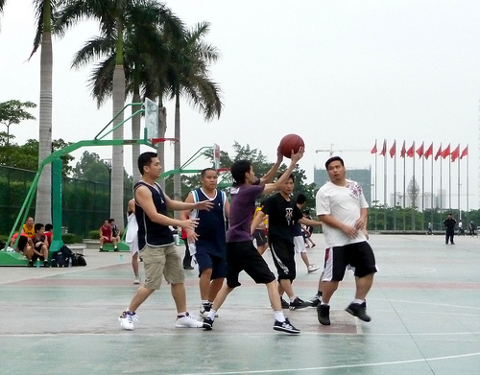
Sportzentrum
Sports Centre

Slide 15
















Join us again!

