Slide 1

Handy Buildings Vocab 3
Describing Buildings
with Mr Angry Toaster-Brow

Slide 2
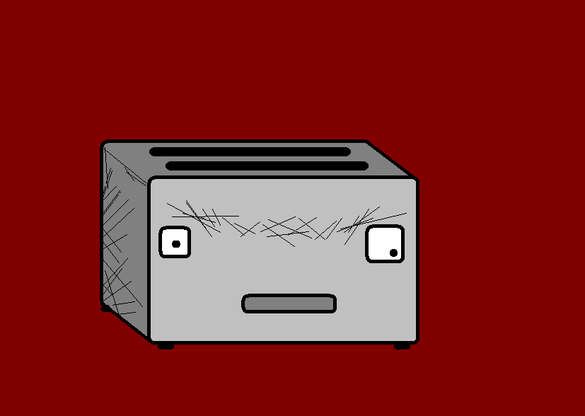
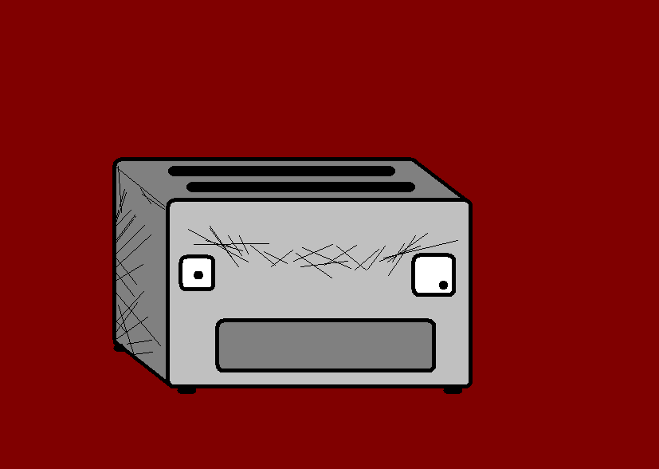
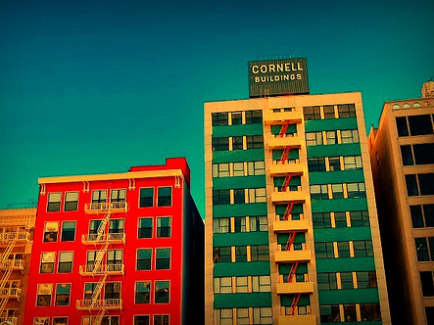
I am Mr Angry Toaster-Brow. Here are some handy words for describing buildings.

Slide 3
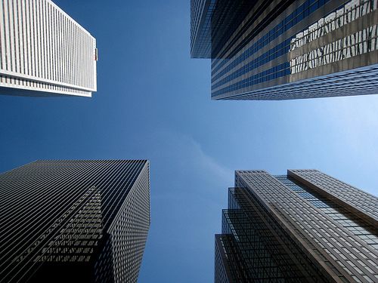
hoch
tall

Slide 4
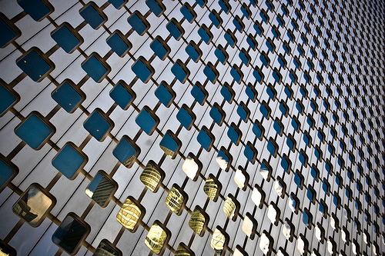
breit
wide

Slide 5
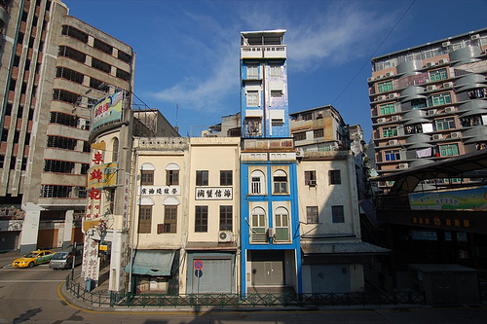
schmal
narrow

Slide 6
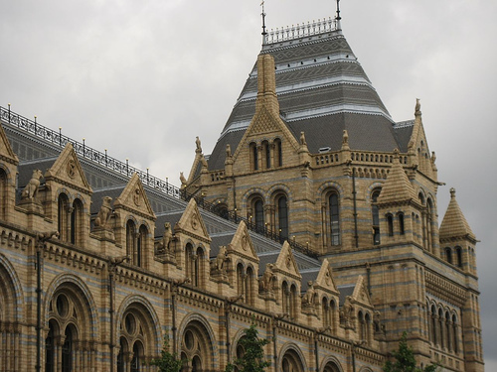
groβ
big

Slide 7
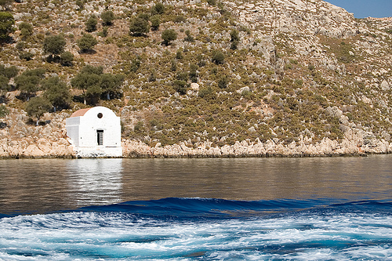


klein
Small

Slide 8
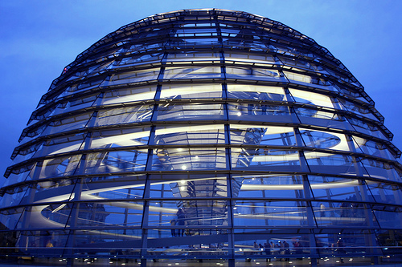
modern
modern

Slide 9
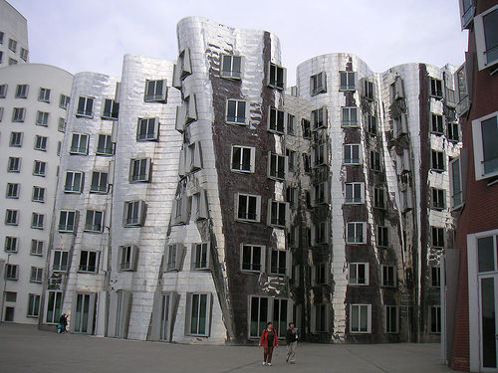
neu
new

Slide 10
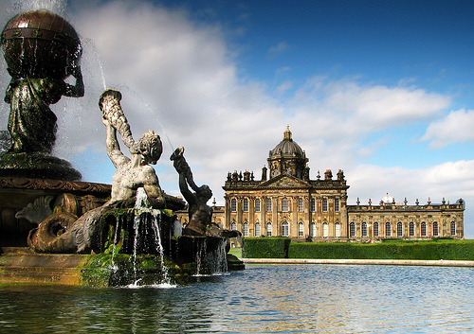
traditionell
traditional

Slide 11
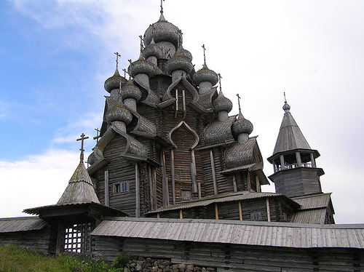
alt
old

Slide 12
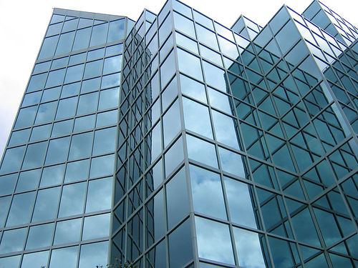
schön
beautiful

Slide 13
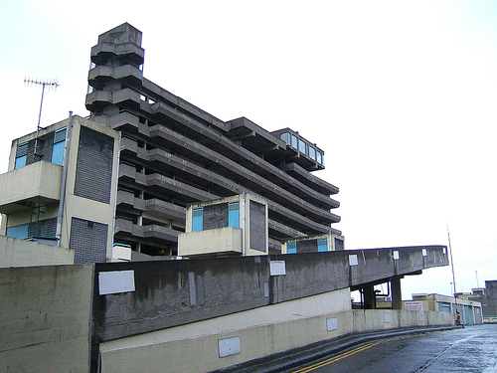
hässlich
ugly

Slide 14
















Join us again!

