Slide 1

Handy Clothes Vocab 4
Style
with Miss Remotely Angry Lightening Bulb

Slide 2
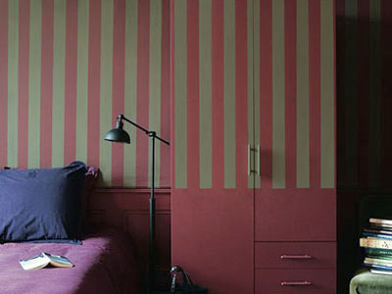

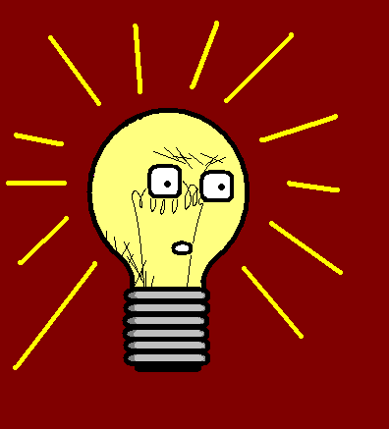
I’m Miss Remotely Angry Lightening Bulb. Let’s talk about clothes.

Slide 3
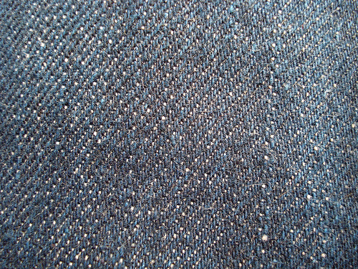
der Jeansstoff
Denim

Slide 4

das Leder
Leather

Slide 5
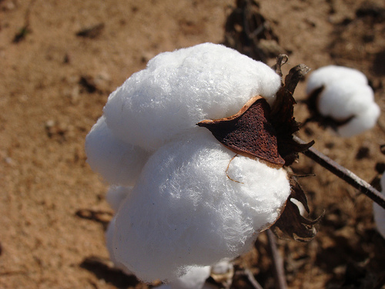
die Baumwolle
Cotton

Slide 6
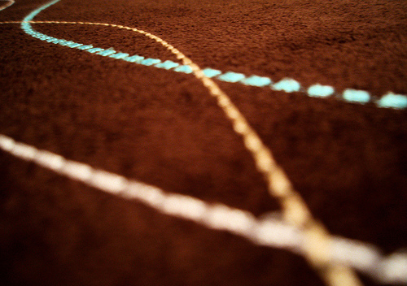
das Wildleder
Suede

Slide 7
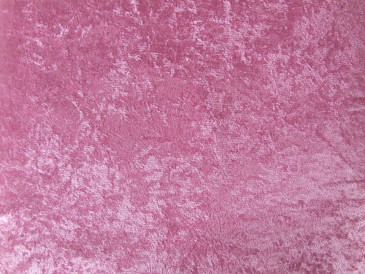
der Samt
Velvet

Slide 8
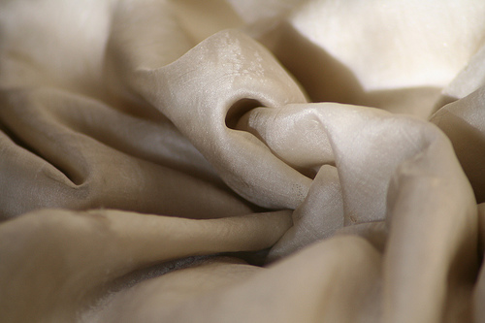
die Seide
Silk

Slide 9
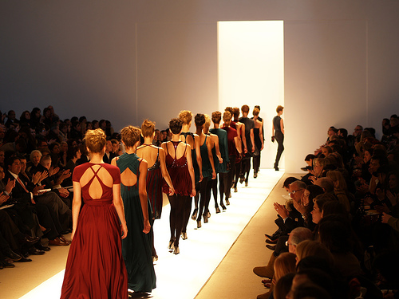
modisch
Fashionable

Slide 10
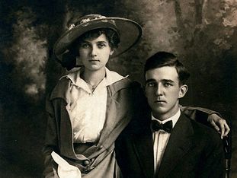
altmodisch
Old-fashioned

Slide 11
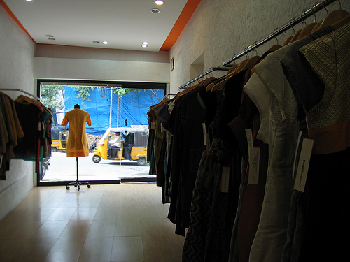
die Designer-Marke
Designer label

Slide 12
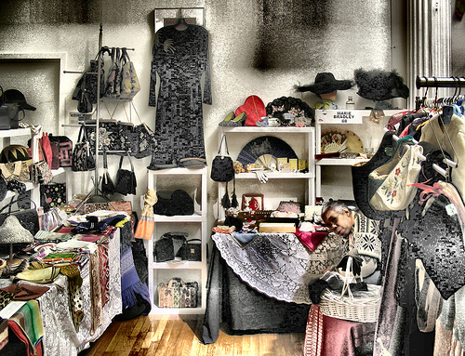
klassisch
Vintage

Slide 13
















Join us again!

