Slide 1

Handy Clothes Vocab 5
Describing Clothes
with Miss Remotely Angry Lightening Bulb

Slide 2
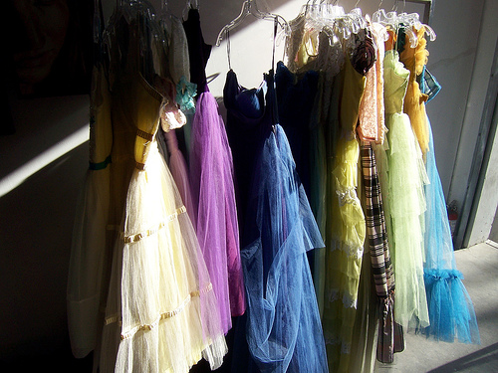


I’m still Miss Remotely Angry Lightening Bulb. Let’s talk about some more clothes.

Slide 3
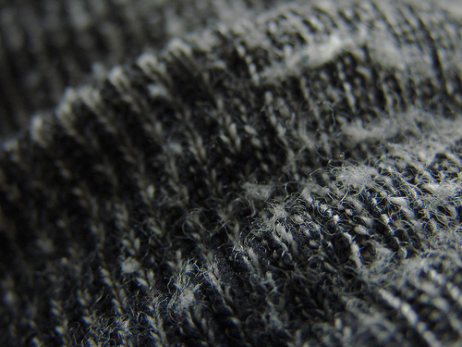
dick
Thick

Slide 4
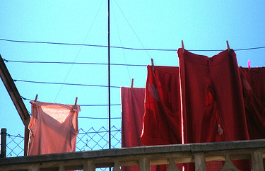
dünn
Thin

Slide 5
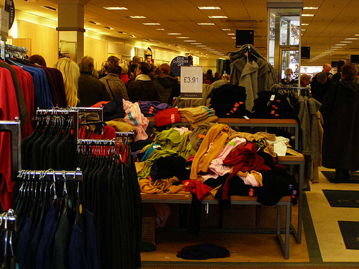
billig
Cheap

Slide 6
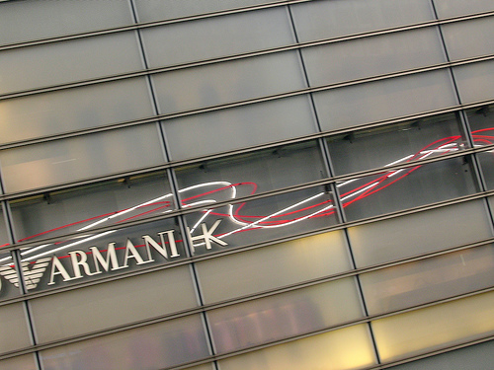
teuer
Expensive

Slide 7
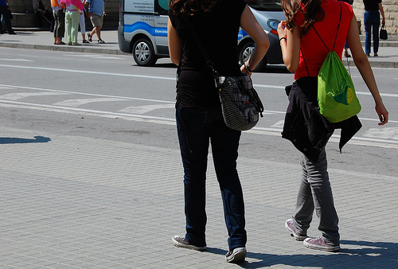
eng
Tight

Slide 8
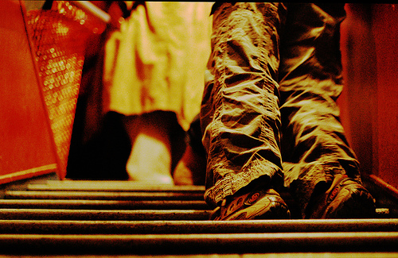
weit
Loose

Slide 9
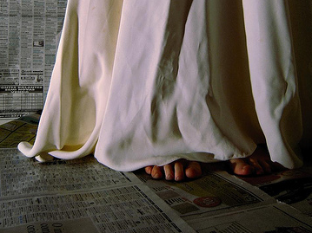
lang
Long

Slide 10
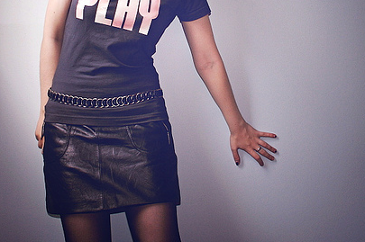
kurz
Short

Slide 11
















Join us again!

