Slide 1

Handy Colours
With the Angry family

Slide 2


Hello. I’m Miss Remotely Angry Lightening Bulb. I’m here to teach you colours today. Remember without light there would be no colours. So think yourself Lucky.
Red
Silver
Yellow
Orange
Black
White
Purple
Pink
Grey
Blue
Green
Brown
Gold

Slide 3
rot
red

Slide 4
blau
blue

Slide 5
gelb
yellow

Slide 6


orange
orange

Slide 7
grün
green

Slide 8
lila
purple

Slide 9


schwarz
black

Slide 10


weiβ
white

Slide 11
grau
grey

Slide 12


rosa
pink

Slide 13
braun
brown

Slide 14

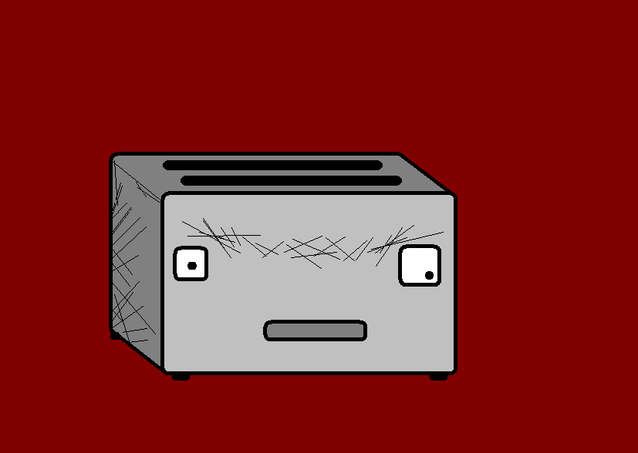
silber
silver

Slide 15
gold
gold

Slide 16
















Join us again!

