Slide 1

Handy Countries Vocab 1
Continents
with
Mrs. Mildly-Angry Carrot-Face

Slide 2
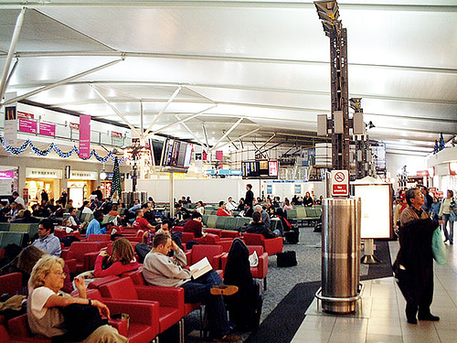


I’m Mrs. Mildly-Angry Carrot-Face. I’m going to take you exploring.

Slide 3

Europa
Europe

Slide 4
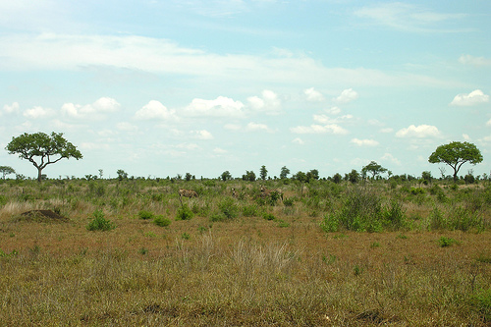
Afrika
Africa

Slide 5
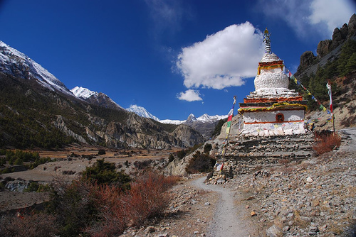
Asien
Asia

Slide 6
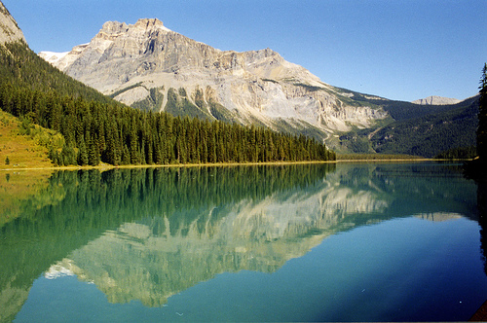
Nordamerika
North America

Slide 7
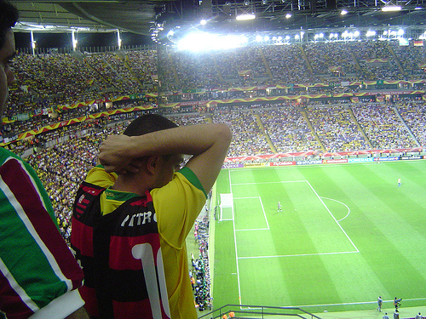
Südamerika
South America

Slide 8
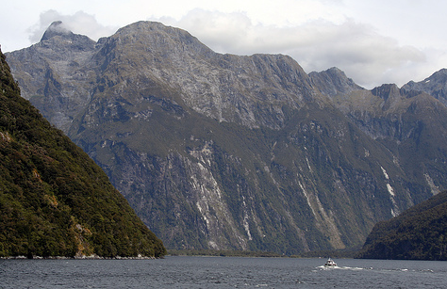


Australien
Australia

Slide 9
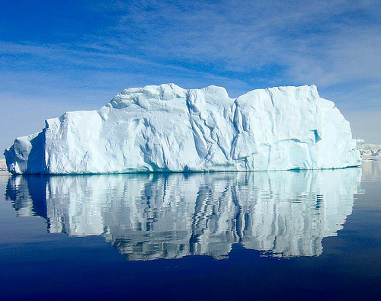
Antarktis
Antarctica

Slide 10
















Join us again!

