Slide 1

Handy Countries Vocab 4
Even more Countries
with
Mrs. Mildly-Angry Carrot-Face

Slide 2



I’m Mrs. Mildly-Angry Carrot-Face. Here are even more countries.

Slide 3
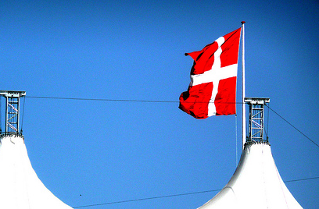
Dänemark
dänisch
Denmark - Danish
Denmark

Slide 4
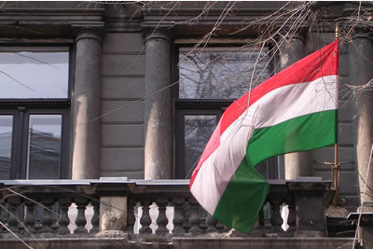
Ungarn
ungarisch
Hungary - Hungarian
Hungary

Slide 5
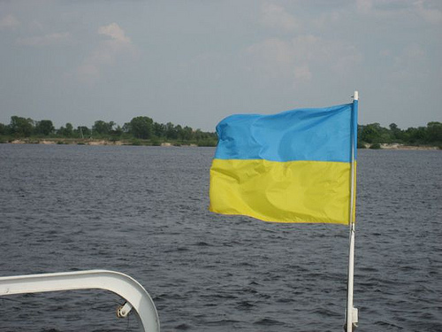
Ukraine
ukrainisch
Ukraine - Ukrainian
Ukraine

Slide 6
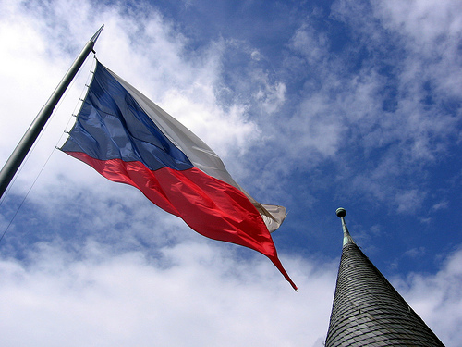
Tschechische Republik
tschechisch
Czech Republic - Czech
Czech Republic

Slide 7
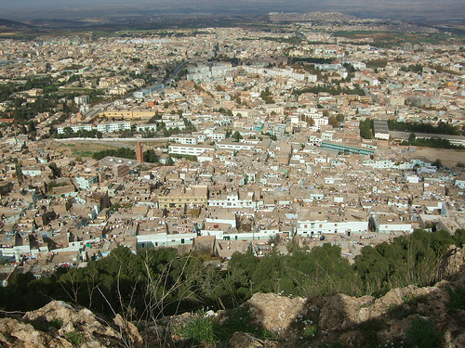
Algerien
algerisch
Algeria - Algerian
Algeria

Slide 8
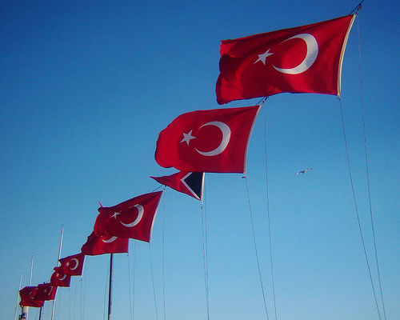
Türkei
türkisch
Turkey - Turkish
Turkey

Slide 9
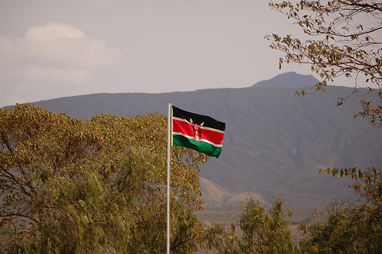
Kenia
kenianisch
Kenya - Kenyan
Kenya

Slide 10
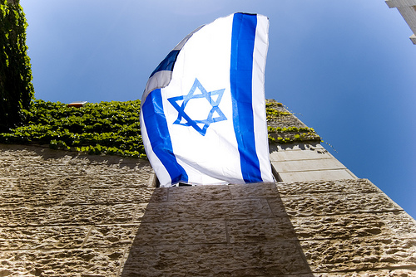
Israel
israelisch
Israel - Israeli
Israel

Slide 11
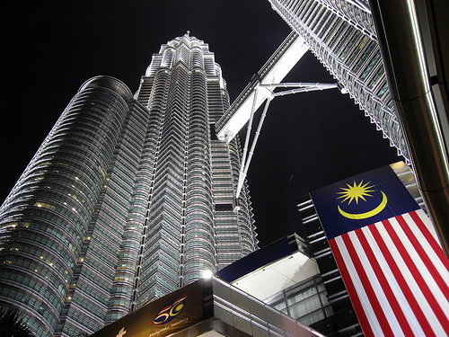
Malaysia
malaiisch
Malaysia - Malaysian
Malaysia

Slide 12
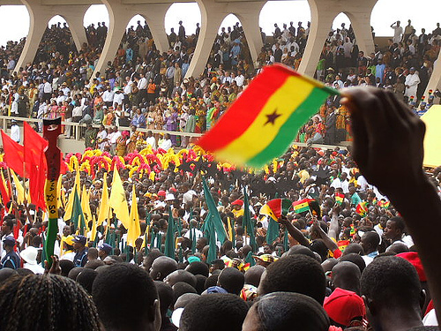
Ghana
ghanaisch
Ghana - Ghanaian
Ghana

Slide 13
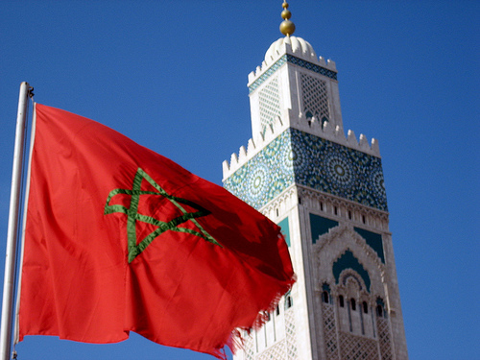
Marokko
marokkanisch
Morocco - Moroccan
Morocco

Slide 14

Chile
chilenisch
Chile - Chilean
Chile

Slide 15
















Join us again!

