Slide 1

Handy Family Vocab 1
Family Members
with Miss Happy Balloon

Slide 2



Hello! I am Miss Happy Balloon. You are lucky, you have a family, I am just a blue balloon but I am happy to teach you some useful words.

Slide 3
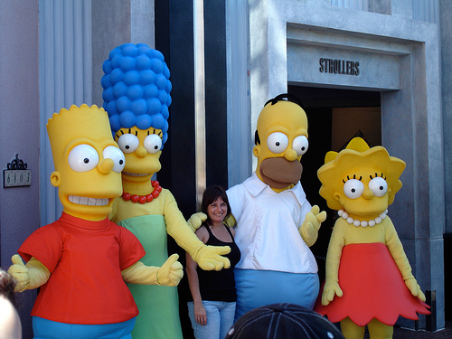
die Familie
Family

Slide 4
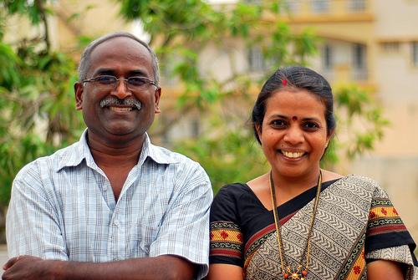
die Mutter
family
Mother

Slide 5
family
der Vater
Father

Slide 6
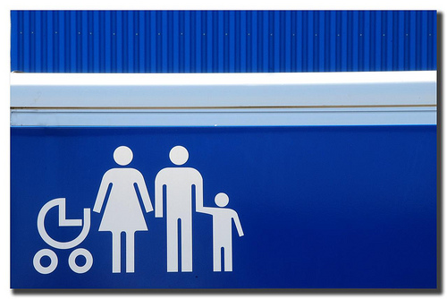
die Eltern
Parents

Slide 7
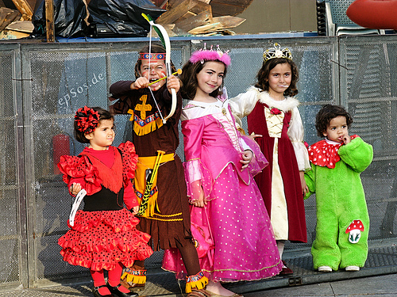
das Kind
die Kinder
Child - Children
Child - Children

Slide 8
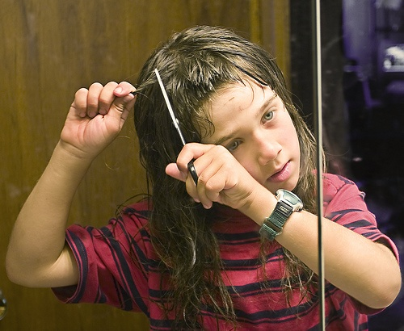
der Sohn
Son

Slide 9
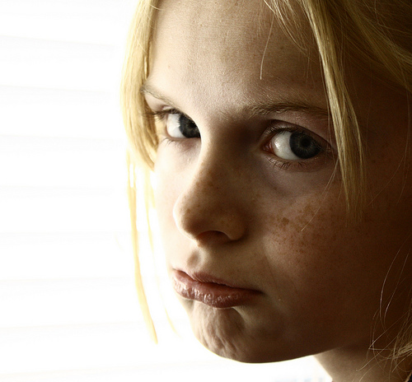
die Tochter
Daughter

Slide 10
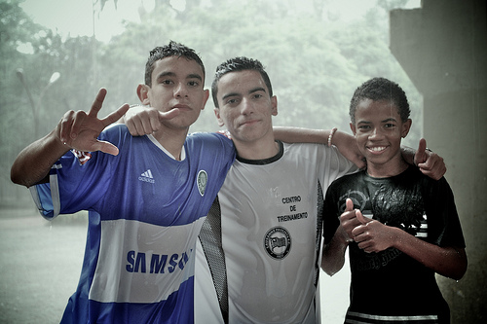
die Brüder
der Bruder
Brothers - Brother
Brothers - Brother

Slide 11
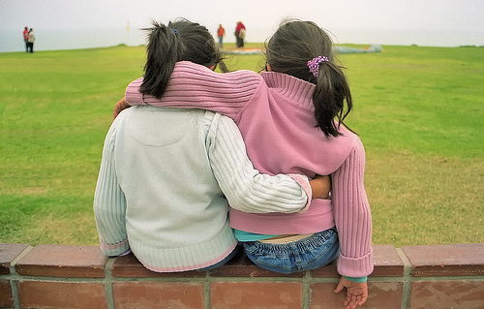
die Schwestern
die Schwester
Sisters - Sister
Sisters - Sister

Slide 12
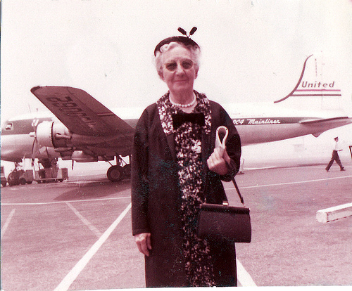
die Großmutter
Grandmother

Slide 13
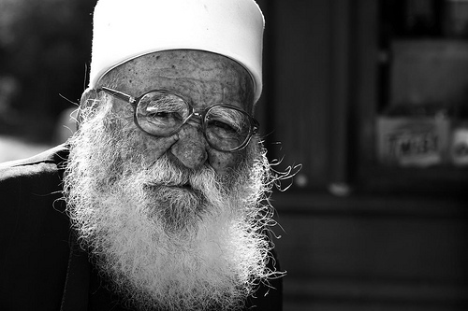
der Großvater
Grandfather

Slide 14
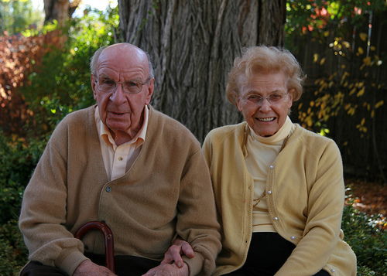
die Großeltern
Grandparents

Slide 15


















Join us again!

