Slide 1

Handy Food Vocab 1
Meals with the Angry Family

Slide 2
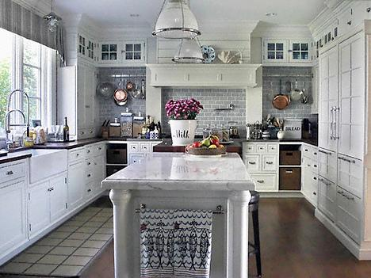


I am Mr Confused and Angry Wolfman. What can I have to eat today?

Slide 3
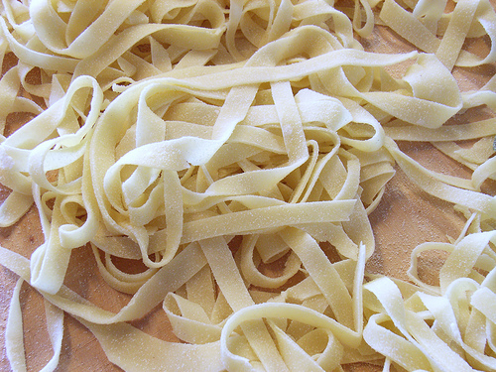
Die Nudeln
Pasta

Slide 4
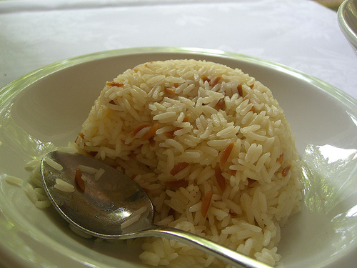
Der Reis
Rice

Slide 5
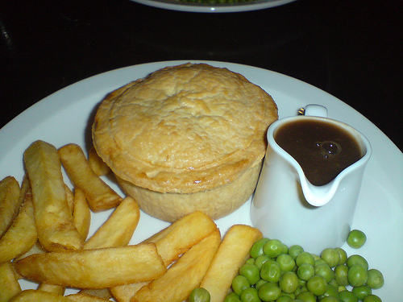
Die Pastete
Pie

Slide 6
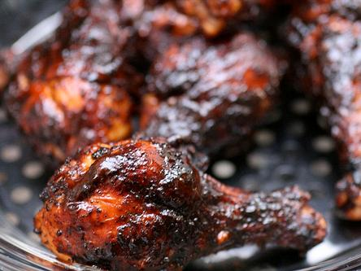
Das Hühnchen
Chicken

Slide 7
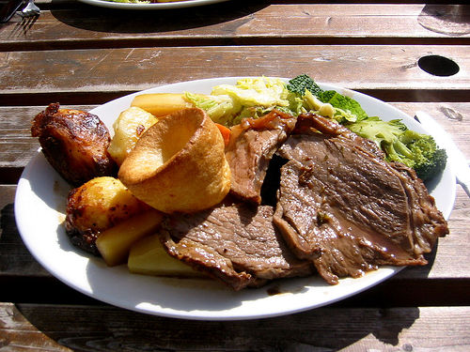
Das Rindfleisch
Beef

Slide 8
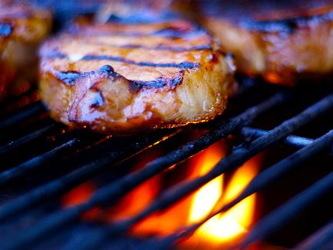
Das Schweinefleisch
Pork

Slide 9
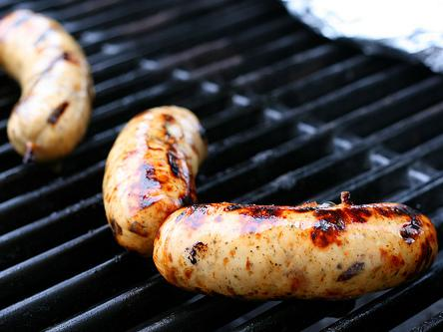
Die Wurst
Sausage

Slide 10
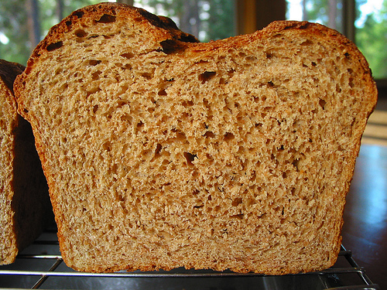
Das Brot
Bread

Slide 11
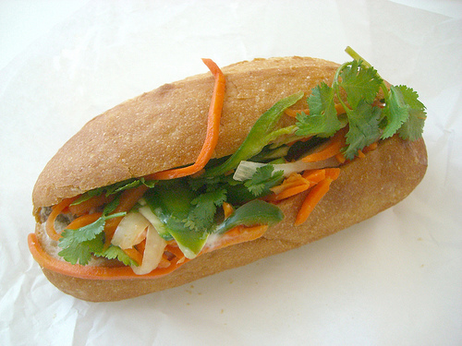
Das Sandwich
Sandwich

Slide 12
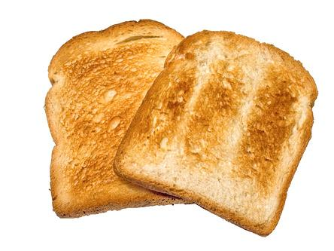
Das Toastbrot
Toast

Slide 13
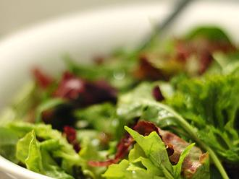
Der Salat
Salad

Slide 14
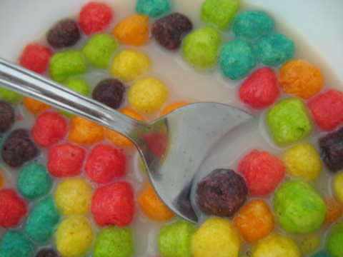
Die Zerealien
Cereal

Slide 15
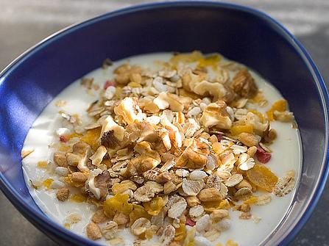
Das Müsli
Muesli

Slide 16
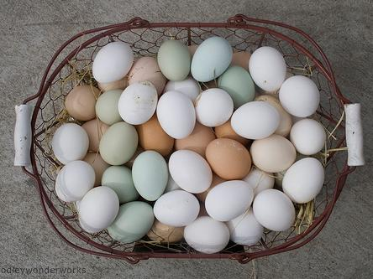
Die Eier
Eggs

Slide 17
I am the confused and hungry Wolfman.
I’ll eat anything.

Slide 18















Join us again!

