Slide 1

Handy Food Vocab 2
Desserts with the Angry Family

Slide 2
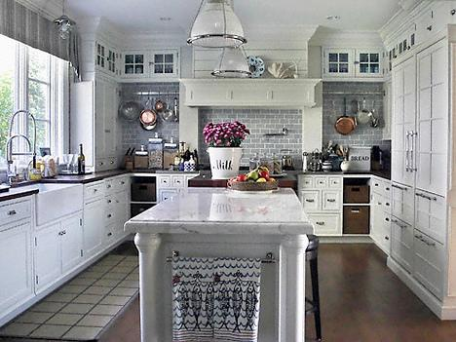


I am still the Confused and Angry Wolfman. Now I need dessert.

Slide 3
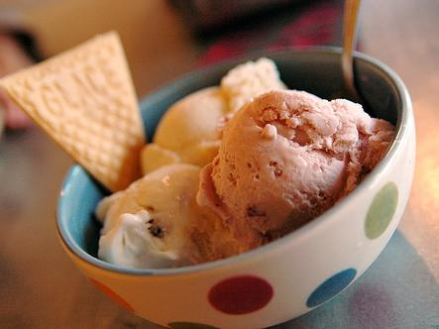
Die Eiscreme
Ice cream

Slide 4
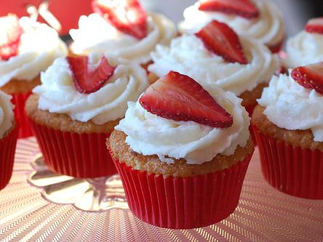
Der Kuchen
Cake

Slide 5
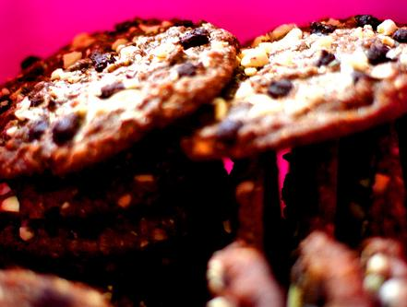
Der Keks
Cookie

Slide 6
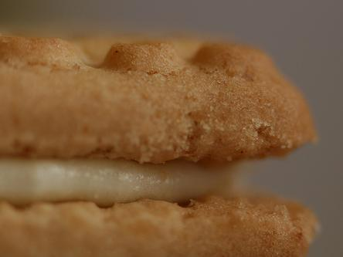
Das Plätzchen
Biscuit

Slide 7
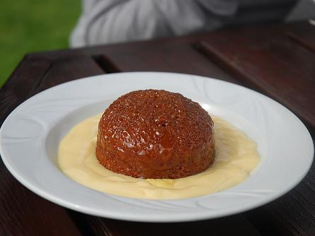
Der Pudding
Pudding

Slide 8
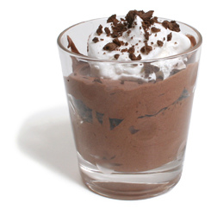
Das Schokoladen-Mousse
Chocolate Mousse

Slide 9
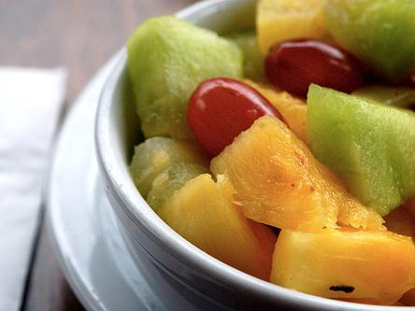
Der Fruchtsalat
Fruit salad

Slide 10
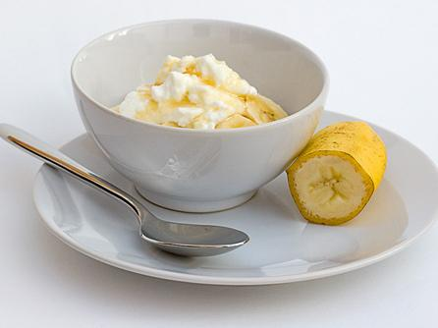
Der Bananen- Joghurt
Banana yoghurt

Slide 11
Remember these words or I’ll eat your feet.

Slide 12















Join us again!

