Slide 1

Handy Food Vocab 3
Fruits with the Angry Family

Slide 2
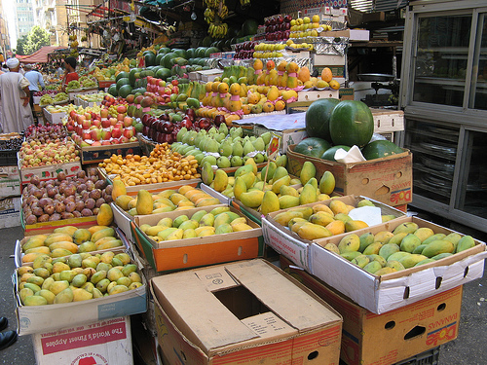


I am Mr Angry and Confused Wolfman, but fruit makes me happy.

Slide 3
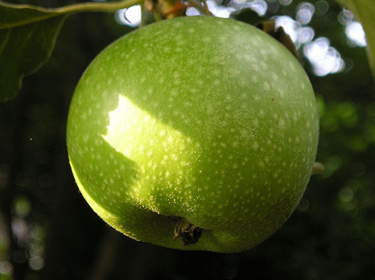
Der Apfel
Apple

Slide 4
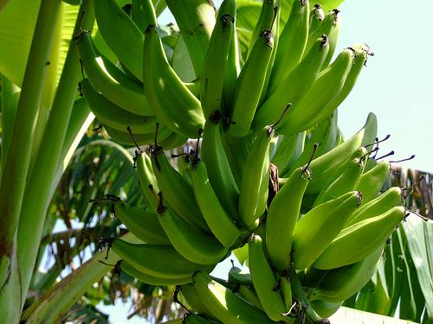
Die Banane
Banana

Slide 5
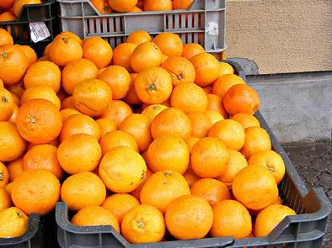
Die Orange
Orange

Slide 6
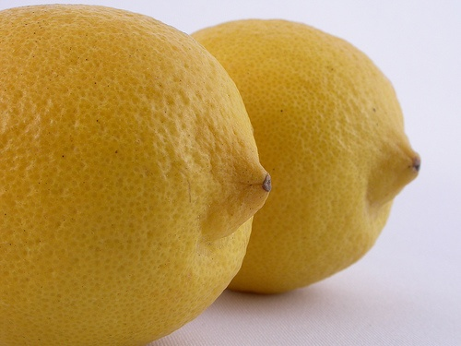
Die Zitrone
Lemon

Slide 7
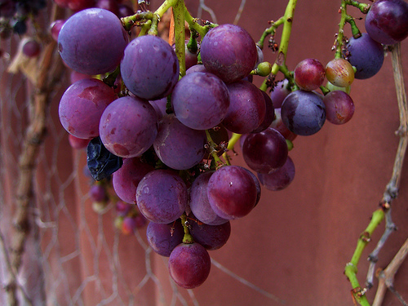
Die Weintrauben
Grapes

Slide 8
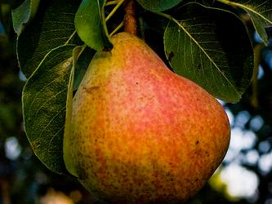
Die Birne
Pear

Slide 9
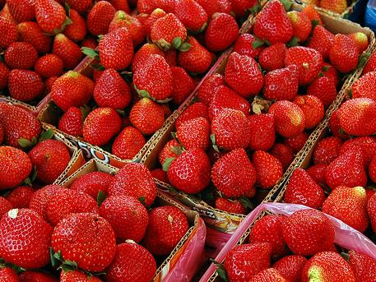
Die Erdbeere
Strawberry

Slide 10
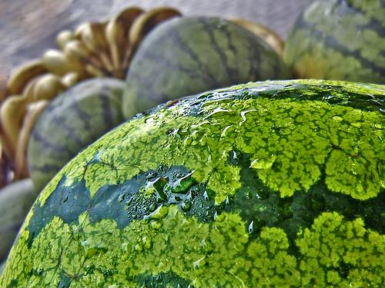
Die Wassermelone
Watermelon

Slide 11
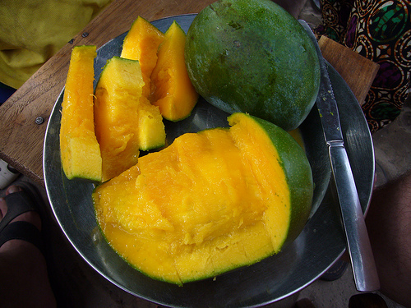
Die Mango
Mango

Slide 12
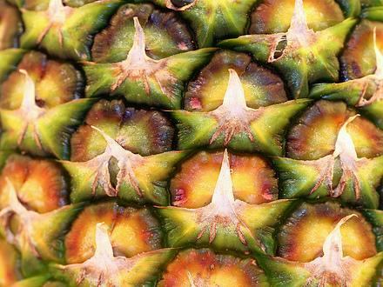
Die Ananas
Pineapple

Slide 13
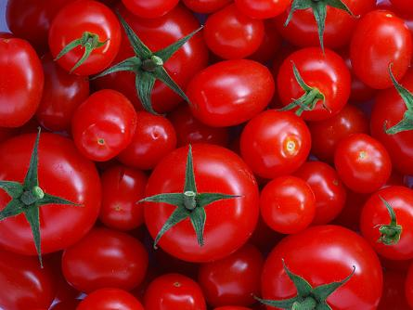

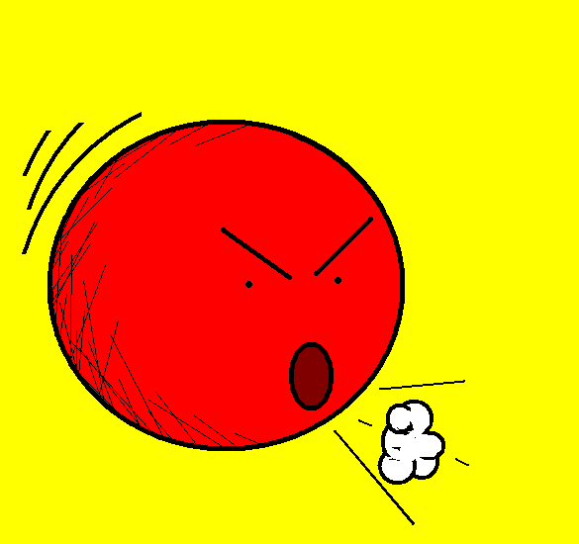
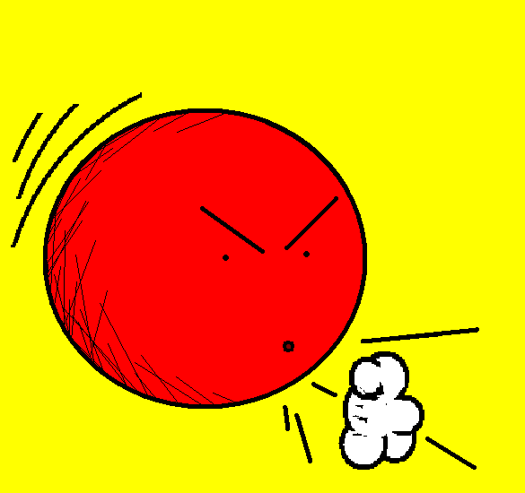
Die Tomate
Was?!
Tomato
(Tomato) What!?

Slide 14

Yes, yes tomato is a fruit, I promise. Don’t argue! You’ll make me angry again.

Slide 15














Join us again!

