Slide 1

Handy Food Vocab 4
Vegetables with the Angry Family

Slide 2
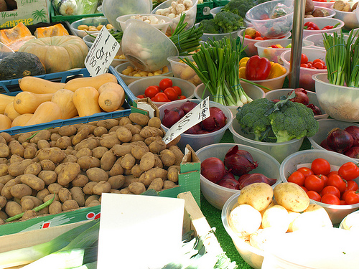


I am Mr Angry and Confused Wolfman and I eat vegetables, so you should, too.

Slide 3

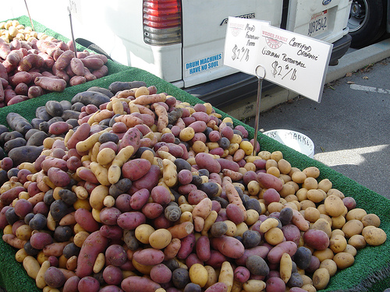


Die Kartoffel
Ja?
Potato
Yes?

Slide 4
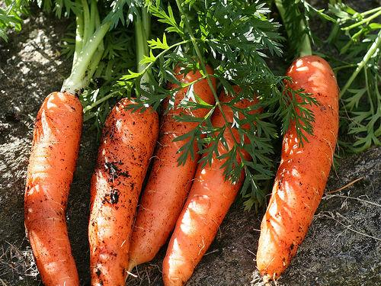


Die Karotte
Das bin ich!
Carrot
That’s me!

Slide 5
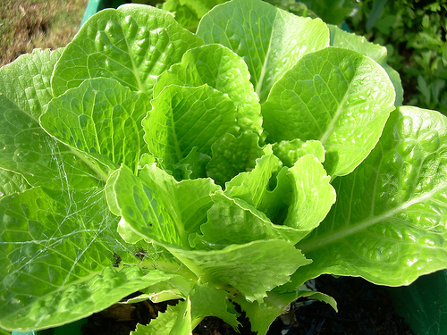
Der Salat
Lettuce

Slide 6
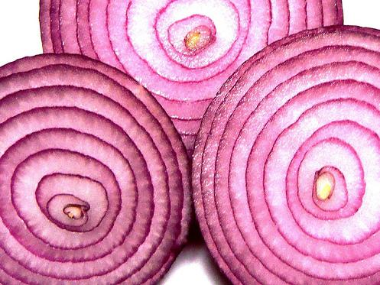
Die Zwiebel
Onion

Slide 7
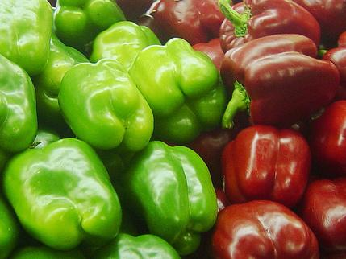
Die Paprika
Pepper

Slide 8
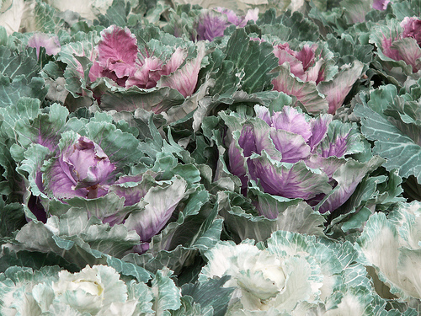
Der Kohl
Cabbage

Slide 9
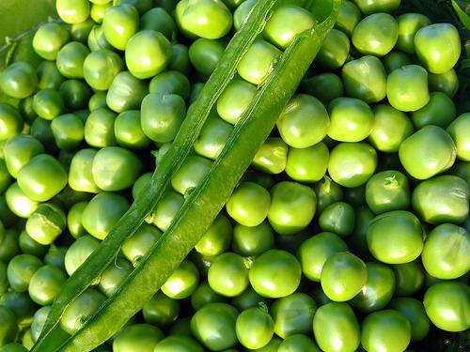
Die Erbsen
Peas

Slide 10
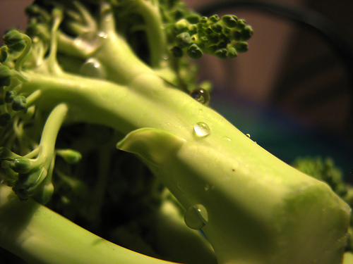
Der Broccoli
Broccoli

Slide 11

Mmmmmm, angry potato.

Slide 12















Join us again!

