Slide 1

Handy Food Vocab 6
Drinks with the Angry Family

Slide 2
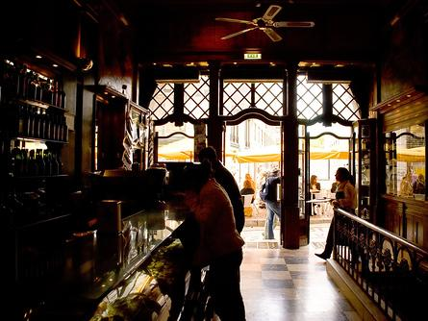


I am still Mr Angry and Confused Wolfman and I am thirsty now.

Slide 3

Das Wasser
Water

Slide 4
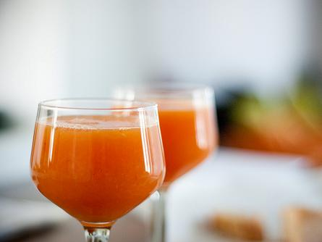
Der Orangensaft
Orange juice

Slide 5
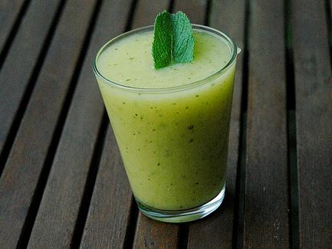
Der Fruchtshake
Smoothie

Slide 6
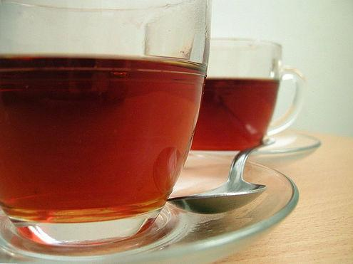
Der Tee
Tea

Slide 7
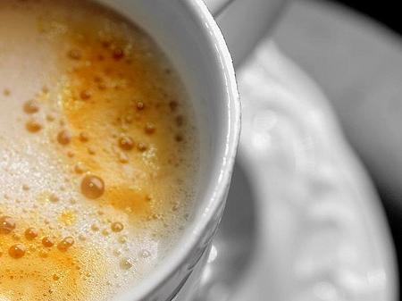
Der Kaffee
Coffee

Slide 8
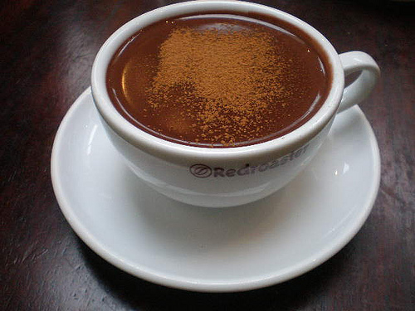
Die heiße Schokolade
Hot chocolate

Slide 9
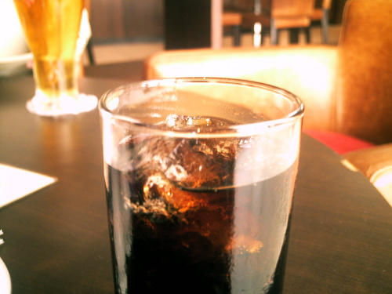
Die Cola
Cola

Slide 10
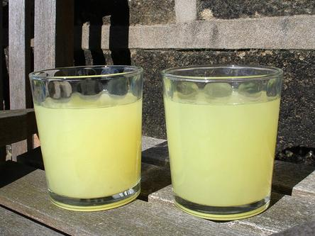
Die Limonade
Lemonade

Slide 11
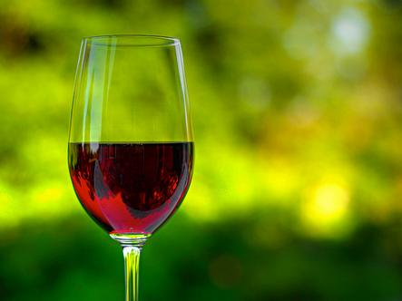
Der Wein
Wine

Slide 12
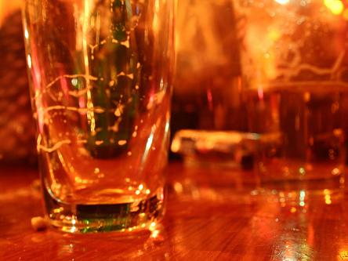
Das Bier
Beer

Slide 13
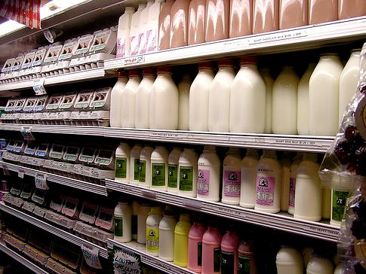
Die Milch
Milk

Slide 14
I can’t drink coffee, because I get too excited, this makes me sad and angry … and confused.

Slide 15















Join us again!

