Slide 1

Handy Food Vocab 7
Food Adjectives with the Angry Family

Slide 2
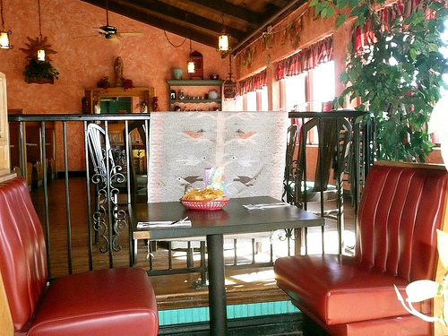


I am still Mr Angry and Confused Wolfman. I’m full, and my meal was…

Slide 3
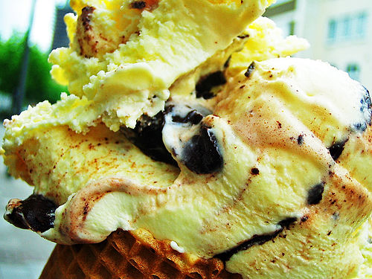

lecker
delicious

Slide 4
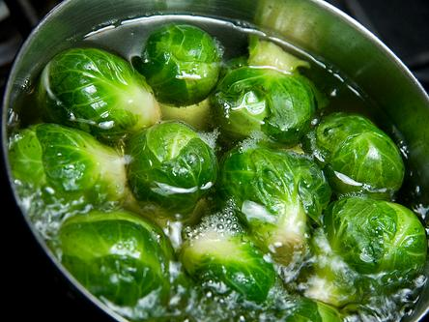
ekelhaft
disgusting

Slide 5
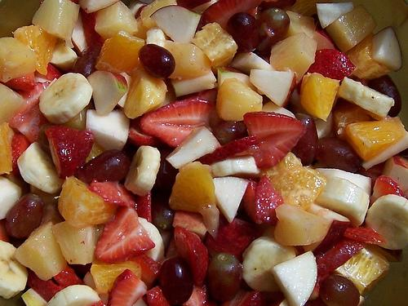
gesund
healthy

Slide 6
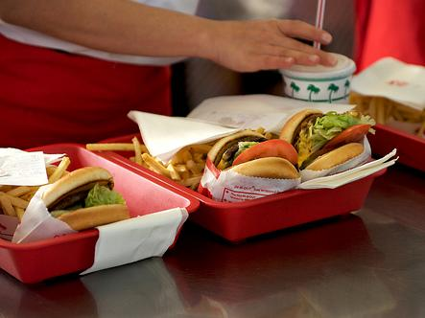
dick machend
fattening

Slide 7
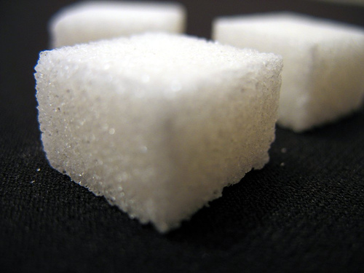
süß
sweet

Slide 8
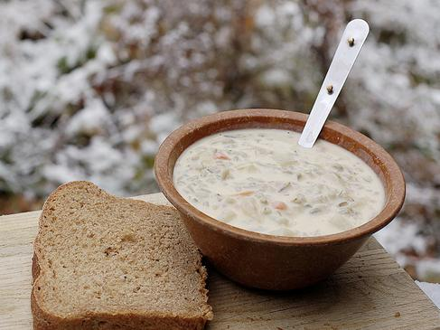
herzhaft
savoury

Slide 9
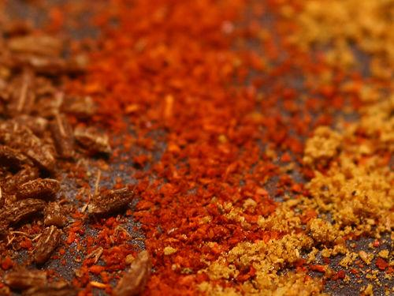
würzig
spicy

Slide 10
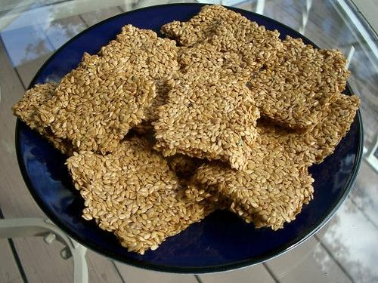
fad
bland

Slide 11
Now you know all the words for food, you should practice them, or I’ll eat you!

Slide 12















Join us again!

