Slide 1

Handy Holiday Vocab 1
Holidays
with the Wandering Spanish Omelette

Slide 2



Hello. I am the Wandering Spanish Omelette, and I really love…

Slide 3
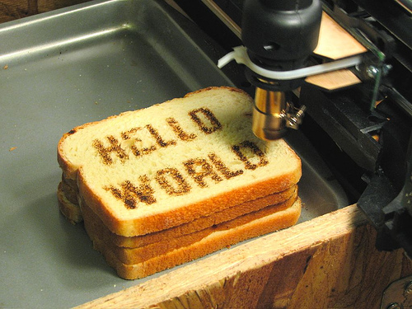
Reisen und…
travelling and…

Slide 4
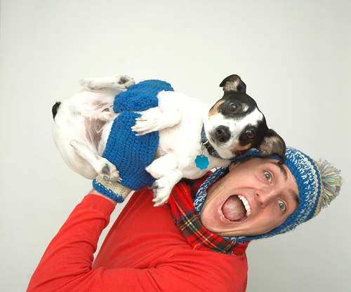
Urlaub
holidays

Slide 5
I really love going away…

Slide 6
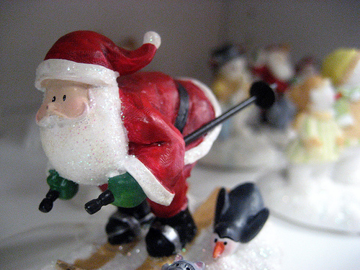
an Weihnachten
for Christmas

Slide 7

an meinem Geburtstag
for my birthday

Slide 8
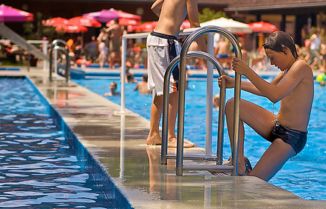
in den Sommerferien
for the summer holiday

Slide 9
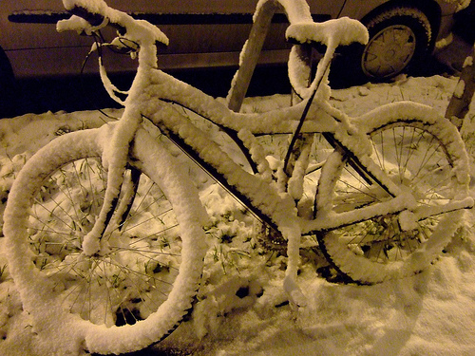
in den Winterferien
for the winter holiday

Slide 10
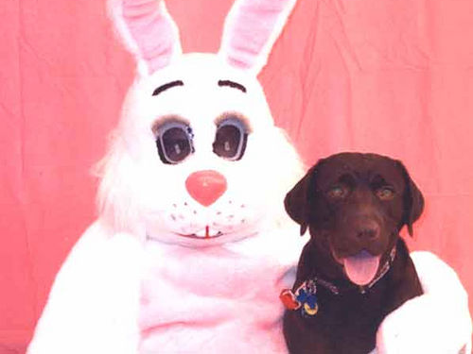
an Ostern
for Easter

Slide 11
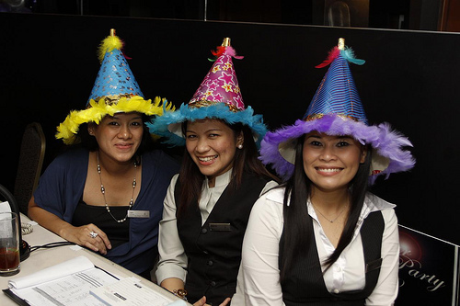
an Neujahr
for New Year

Slide 12
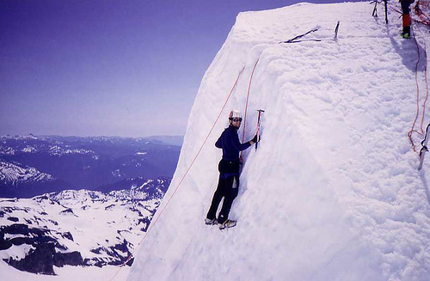
am Feiertag
for the bank holiday

Slide 13
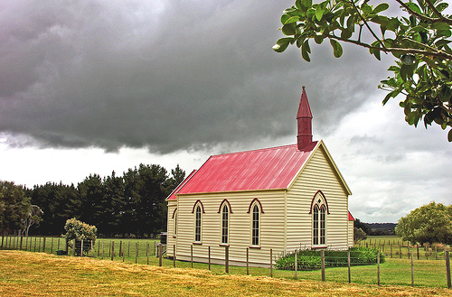
an meinem Namenstag
for my saint’s day

Slide 14
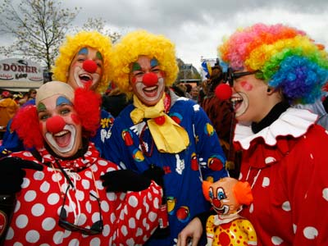
an Karneval
for Karneval

Slide 15
Speaking of holidays, I’m off.

Slide 16

















Join us again!

