Slide 1

Handy House Vocab 2
Furniture
with Mr. Angry Potato Head
(in his lucky bikini)

Slide 2
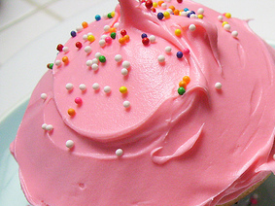


Hello. I am Mr. Angry Potato Head and I am going to show you some nice furniture wearing my lucky bikini!!

Slide 3
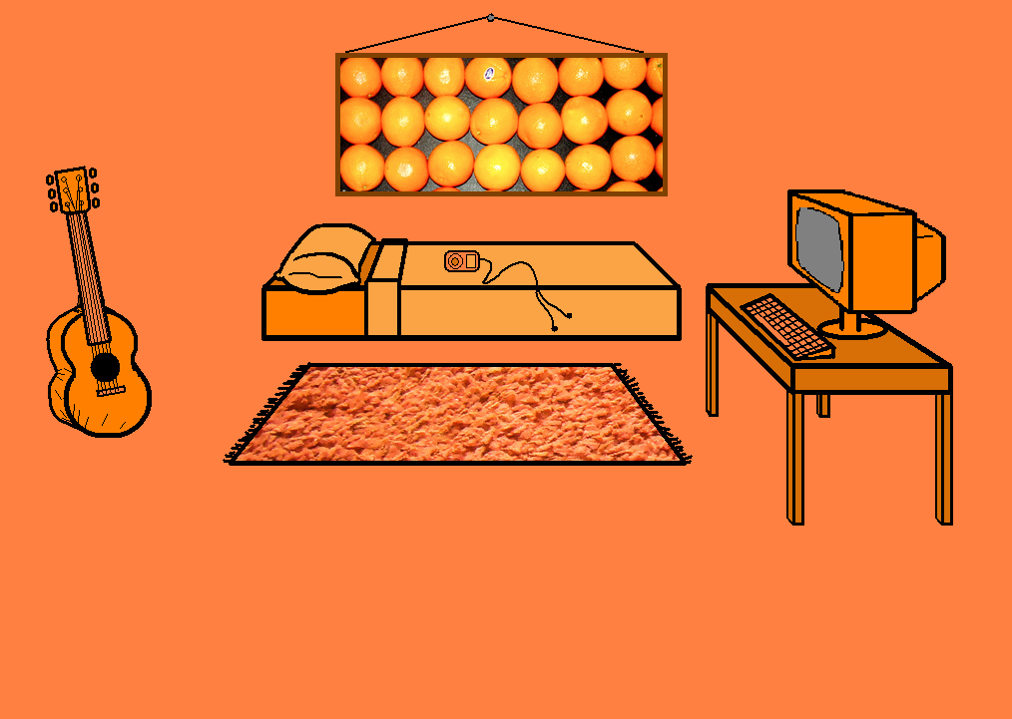
das Bett
Bed

Slide 4
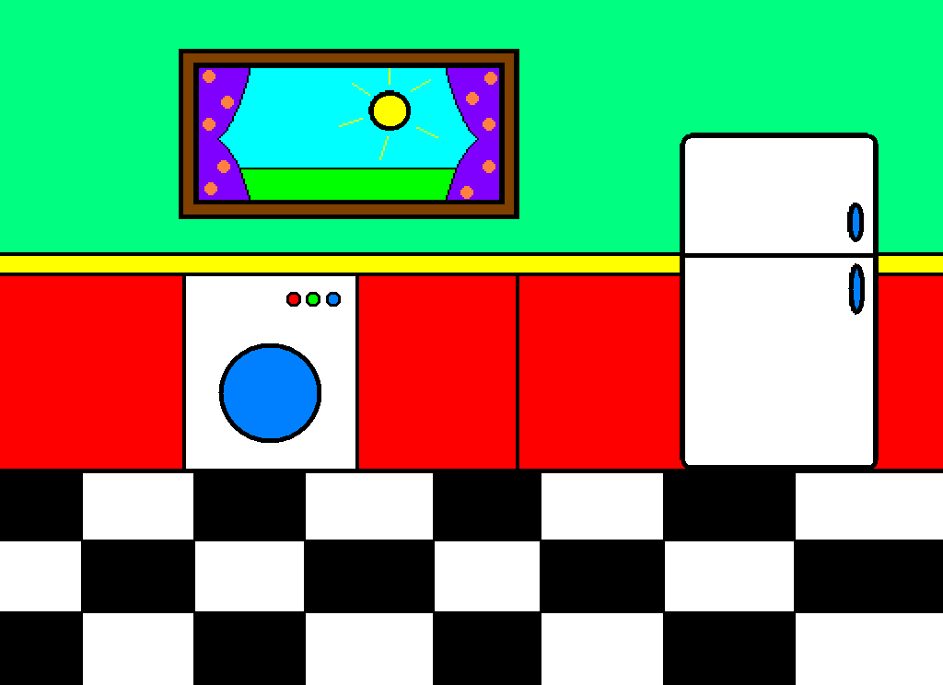
die Vorhänge
Curtains

Slide 5


die Lampe
Lamp

Slide 6
das Bild
Picture

Slide 7

der Abfalleimer
Bin

Slide 8
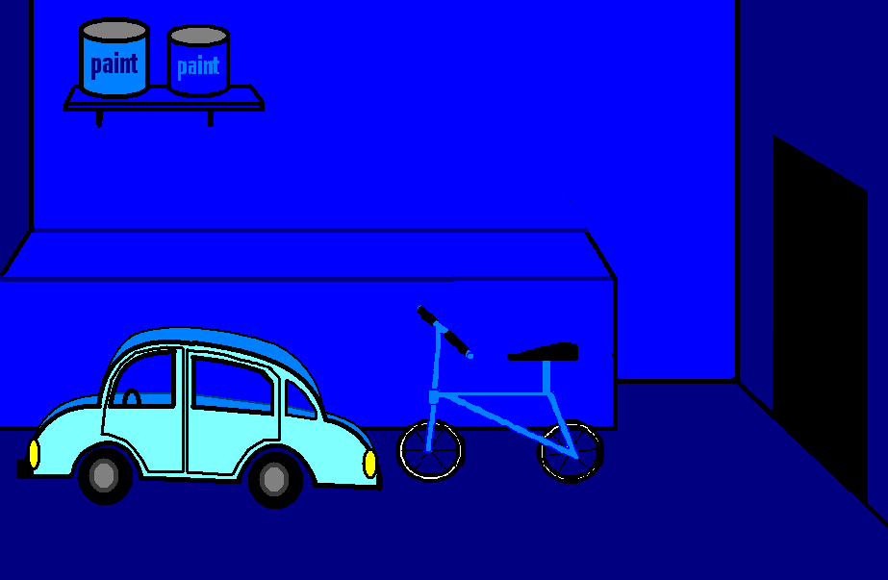
das Regal
Shelf

Slide 9

der Sessel
Armchair

Slide 10
das Sofa
Sofa

Slide 11
der Tisch
Table

Slide 12
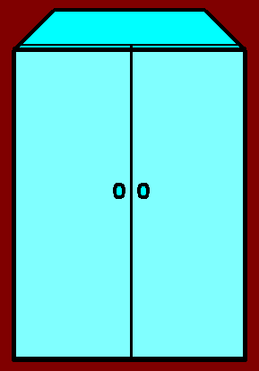
der Schrank
Wardrobe

Slide 13
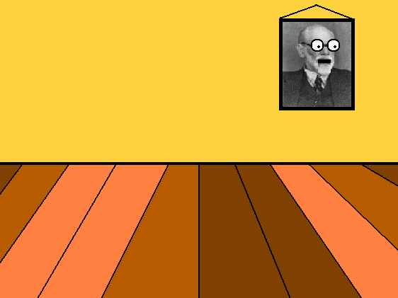
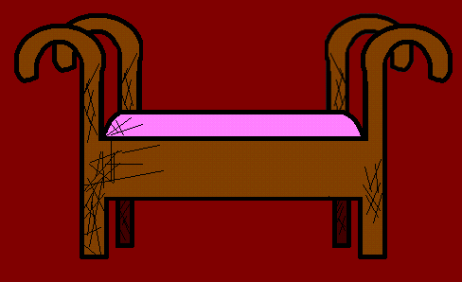
der Stuhl
Chair

Slide 14
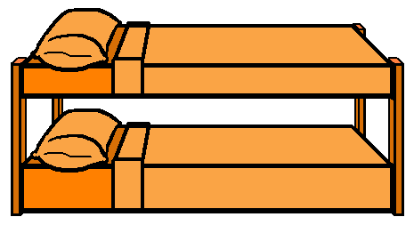
das Etagenbett
Bunk bed

Slide 15


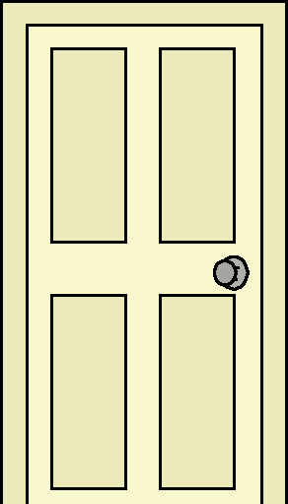
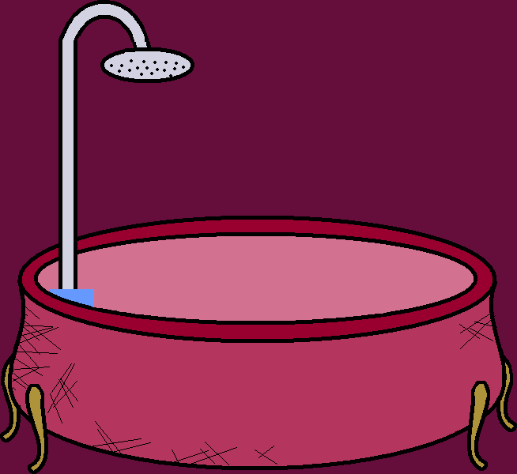
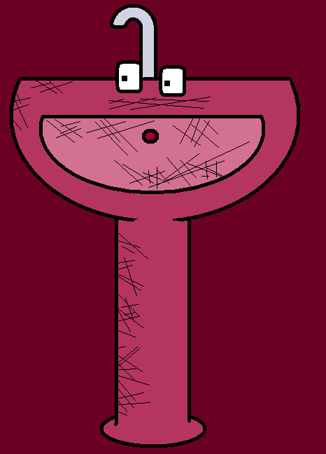


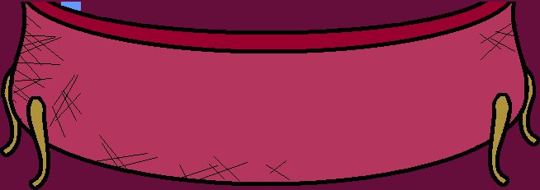
der Spiegel
Mirror

Slide 16
der Teppich
Carpet

Slide 17
I will also introduce you to…

Slide 18
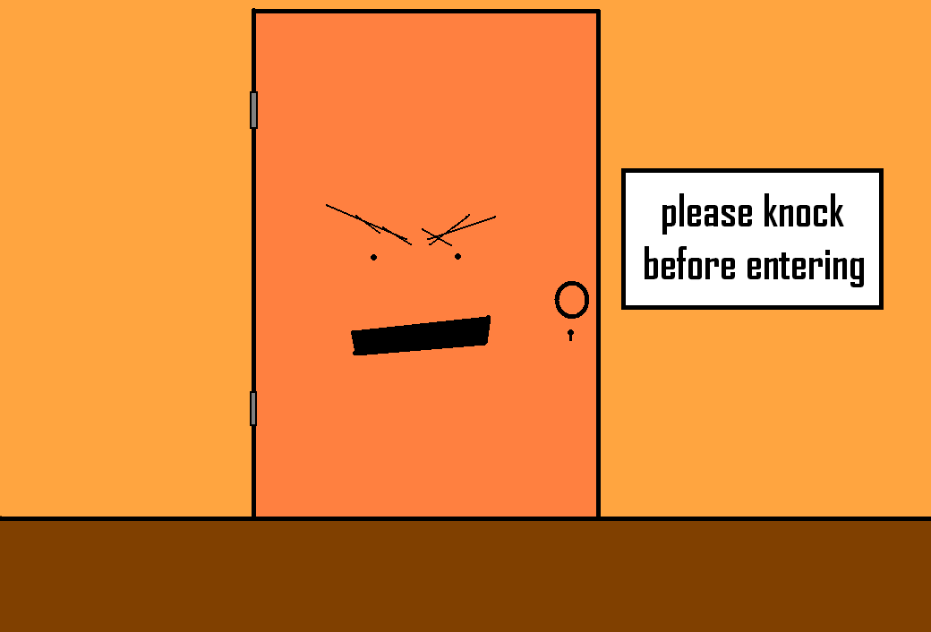
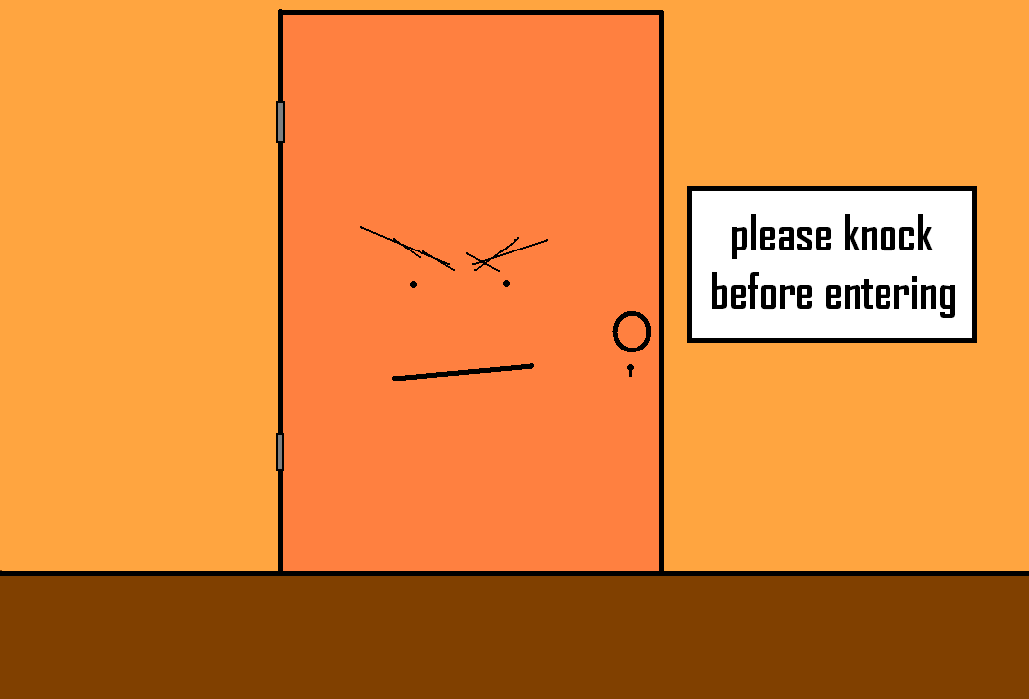
die Tür
The door
Notes:
Narrator is the door

Slide 19
das Fenster
The window

Slide 20
der Fußboden
The floor

Slide 21

das Licht
The light

Slide 22
die Wand
The wall

Slide 23
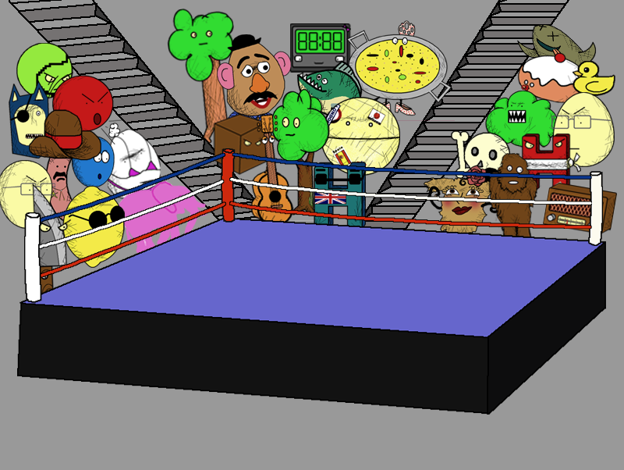
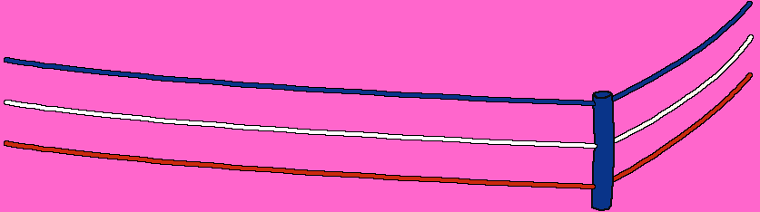
die Treppe
The stairs

Slide 24
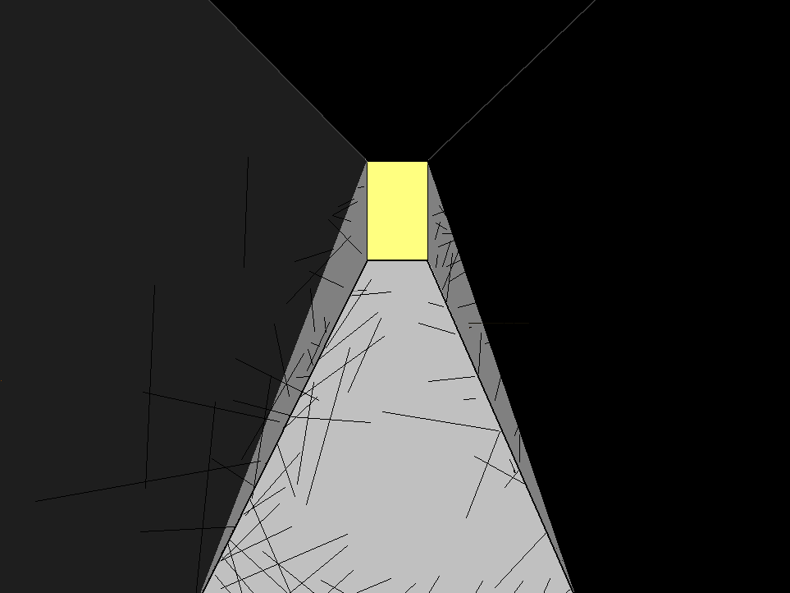

der Flur
The corridor

Slide 25
They make great conversation.

Slide 26
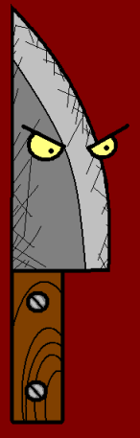

















Join us again!

