Slide 1

Handy House Vocab 3
Cutlery and Crockery
with Mr. Angry Potato Head
(in his lucky bikini)

Slide 2
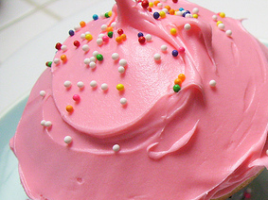
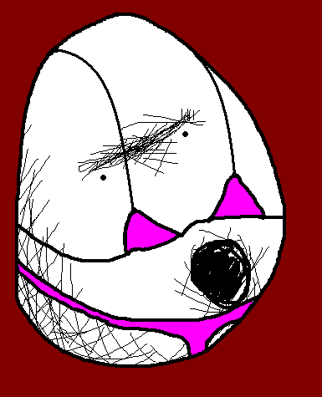

Hello. I am Mr. Angry Potato Head and I am going to show you some nice cutlery and crockery wearing my lucky pink bikini!!

Slide 3
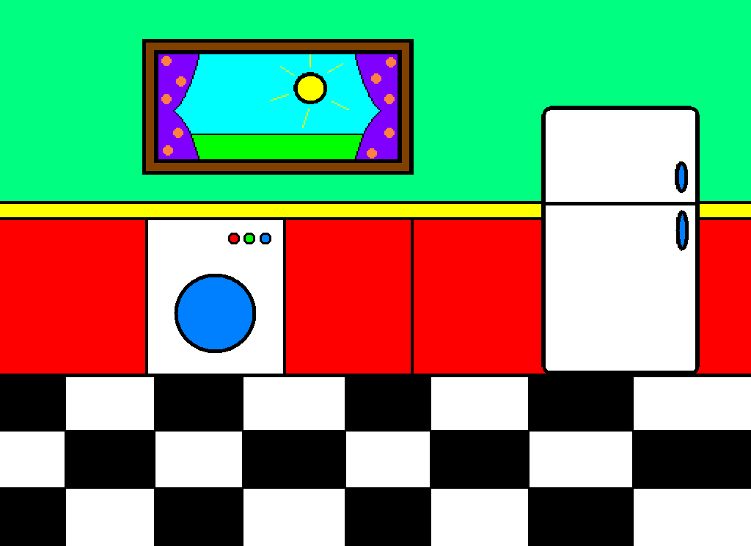
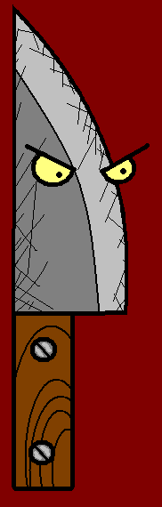


das Messer
Knife

Slide 4

die Gabel
Fork

Slide 5

der Löffel
Spoon

Slide 6

der Teller
Plate

Slide 7
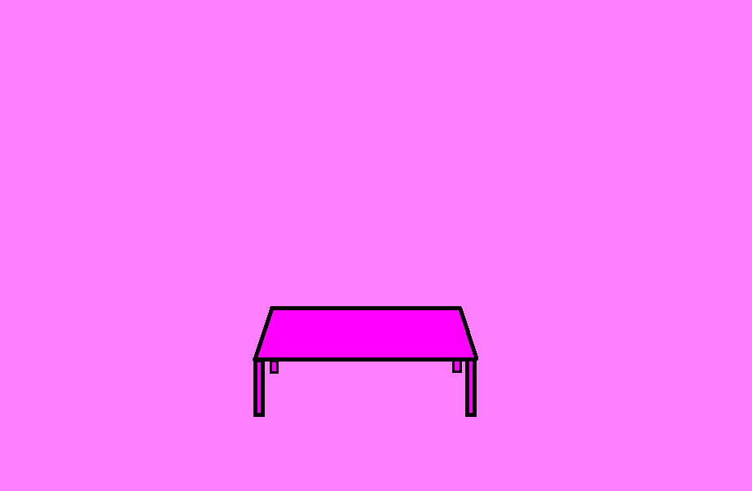
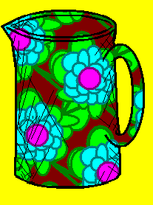
der Krug
Jug

Slide 8

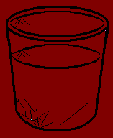
das Glas
Glass

Slide 9
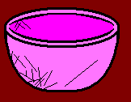
die Schale
Bowl

Slide 10

tea
die Teetasse
Teacup

Slide 11

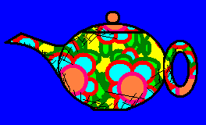
die Teekanne
Teapot

Slide 12

die Tasse
Cup/ Mug

Slide 13
die Stäbchen
Chopsticks

Slide 14
I don’t know how to use any of those things.

Slide 15











Join us again!

