Slide 1

Handy House Vocab 4
Appliances and Facilities
with Mr. Angry Potato Head
(in his lucky bikini)

Slide 2
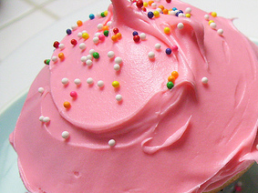


Hello. I am Mr. Angry Potato Head and technology confuses me, especially…

Slide 3

der Fernseher
The television

Slide 4






der Staubsauger
The hoover

Slide 5
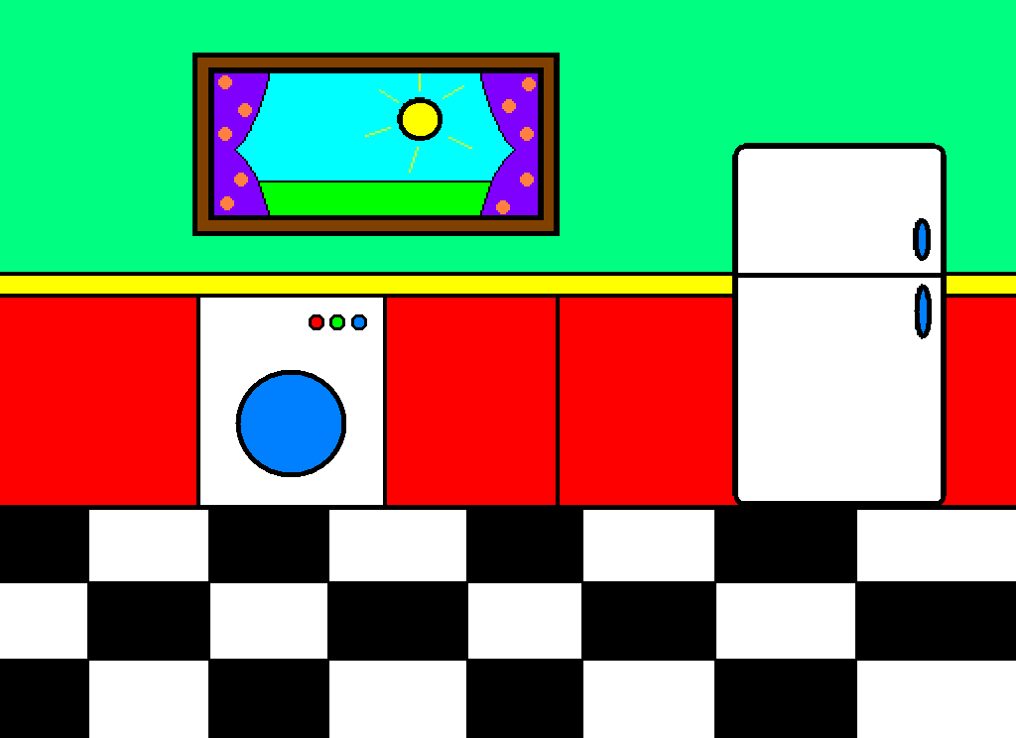
die Waschmaschine
The washing machine

Slide 6
der Kühlschrank
The fridge

Slide 7
der Tiefkühlschrank
The freezer

Slide 8
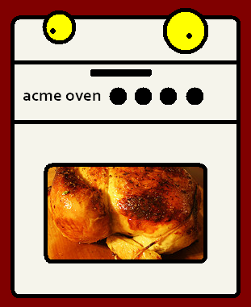
der Ofen
The oven

Slide 9
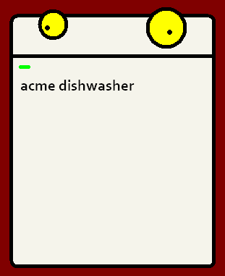
die Spülmaschine
The dishwasher

Slide 10

der Toaster
The toaster

Slide 11
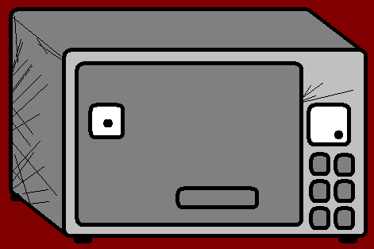
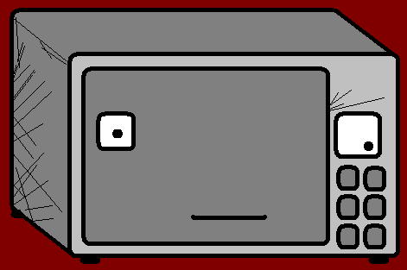
die Mikrowelle
The microwave

Slide 12
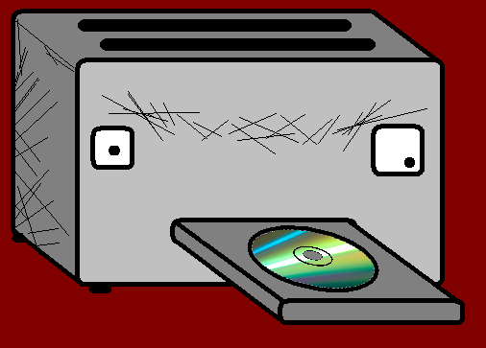
der DVD-Player
The DVD player

Slide 13
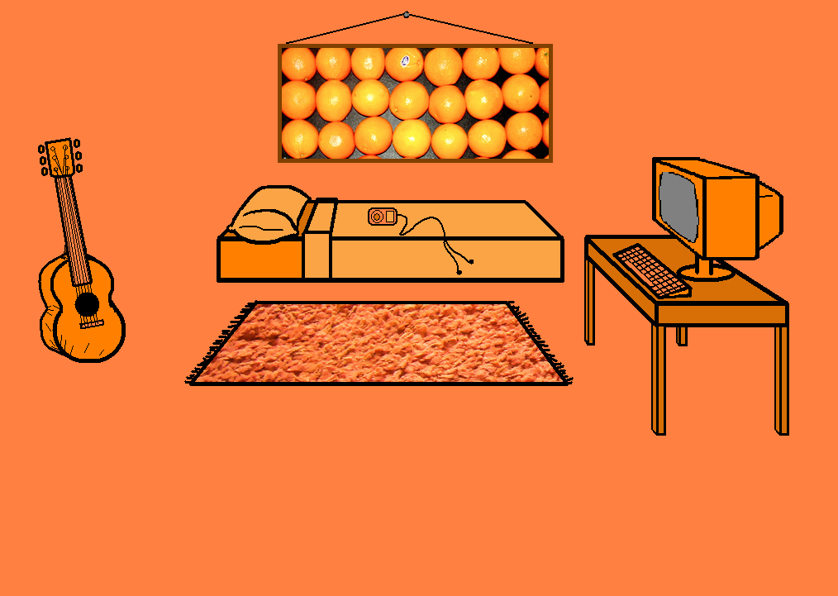
der Computer
The computer

Slide 14

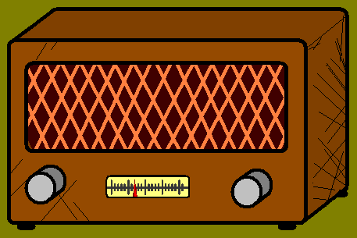
die Stereoanlage
The hi-fi

Slide 15
…and then there’s facilities like…

Slide 16








die Toilette
The toilet

Slide 17
das Waschbecken
The sink

Slide 18
die Dusche
The shower

Slide 19
die Badewanne
The bath

Slide 20
I just hope none of them break.

Slide 21

















Join us again!

