Slide 1

Handy School Vocab 1
Parts of the School
with Mr. Evil, Very Evil, Parsnip-Face

Slide 2
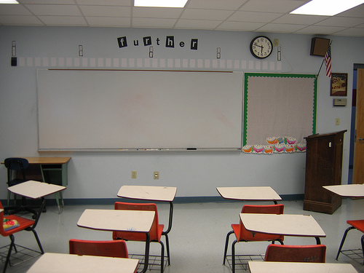


Hello my little friends! Today I’m going to talk about school whether you like it or not!!

Slide 3
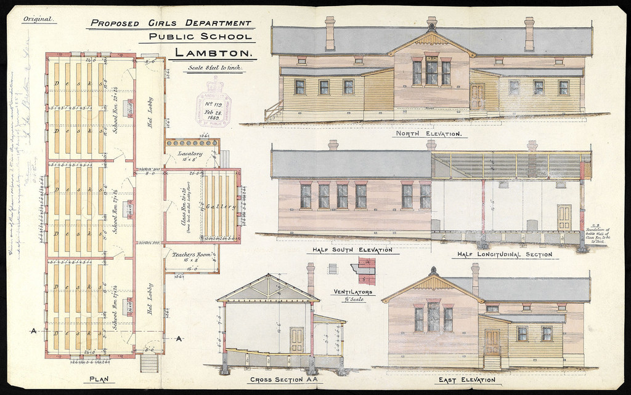
die Schule
School

Slide 4
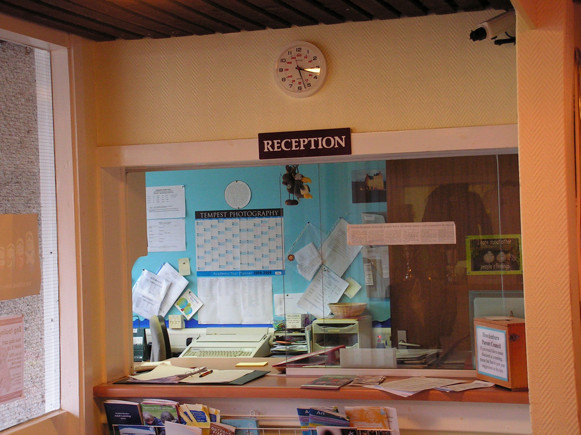
der Empfang
Reception

Slide 5
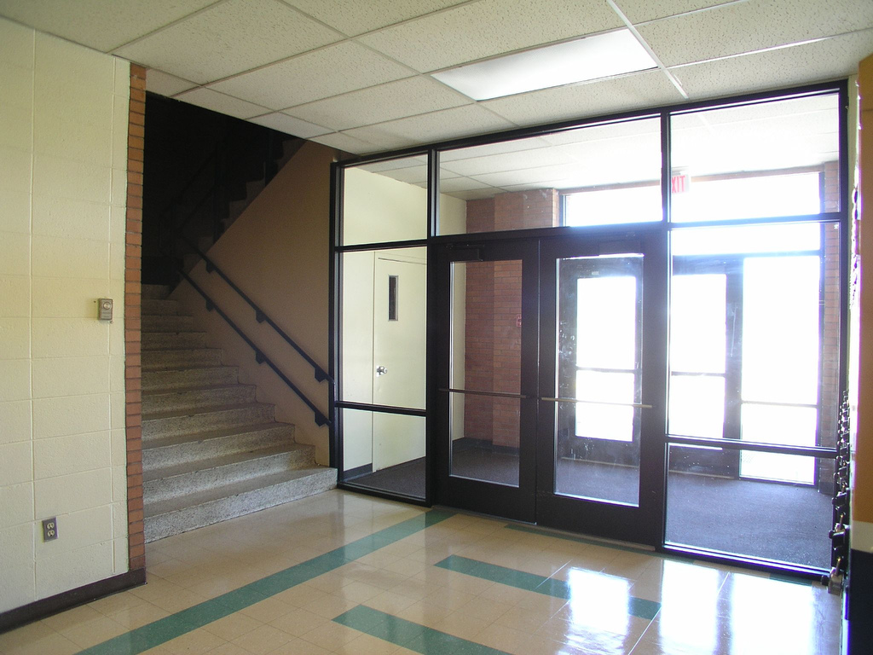
das Erdgeschoss
Ground floor

Slide 6
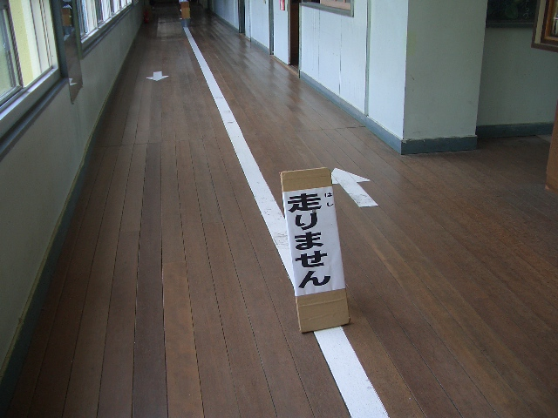
der Flur
Corridor

Slide 7
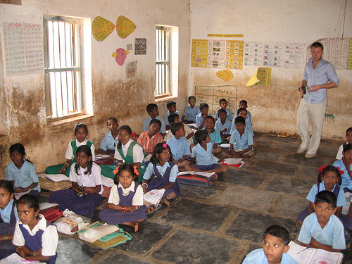
das Klassenzimmer
Classroom

Slide 8
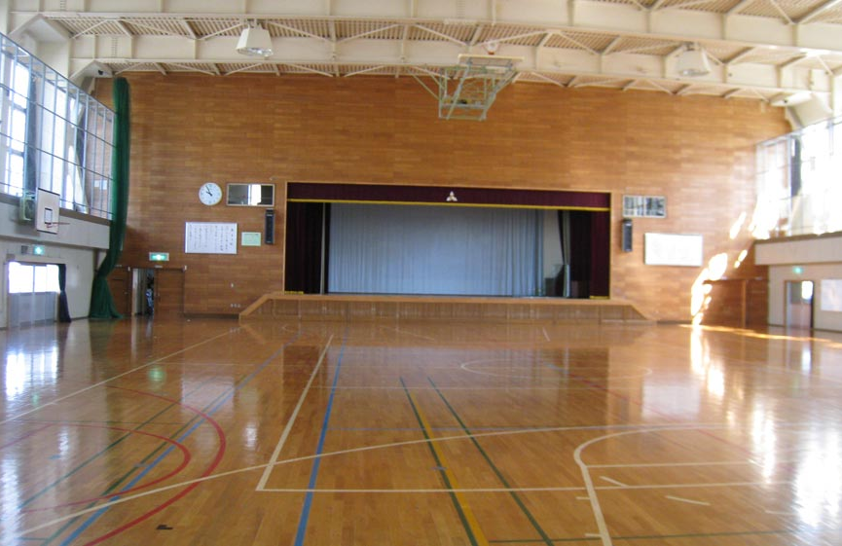
die Sporthalle
Gymnasium

Slide 9
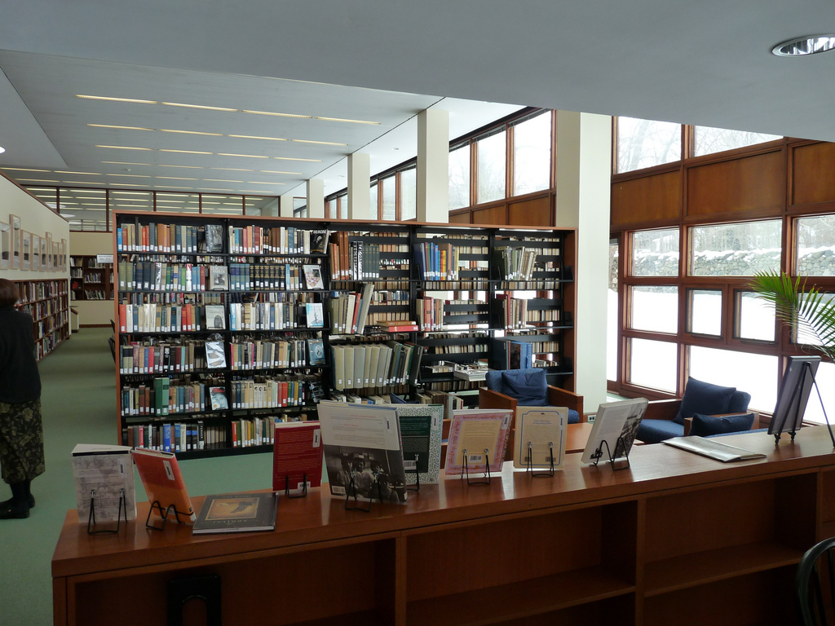
die Bücherei
Library

Slide 10
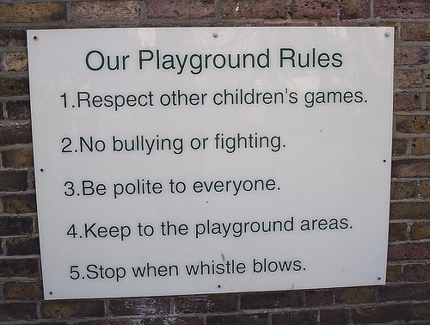
der Spielplatz
Playground

Slide 11
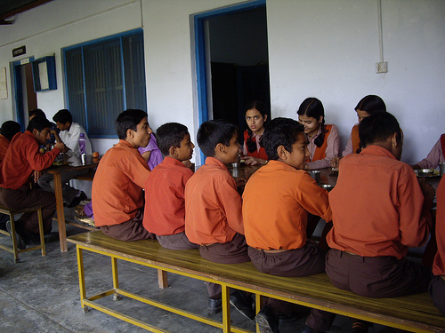
die Kantine
Canteen

Slide 12
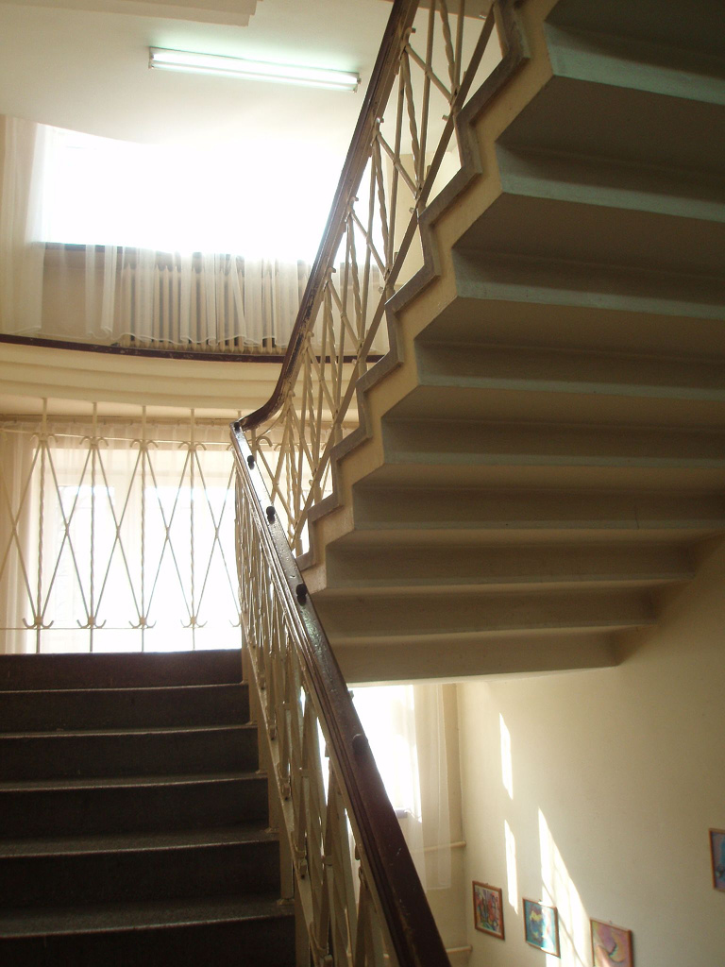
das Treppenhaus
Stairs

Slide 13
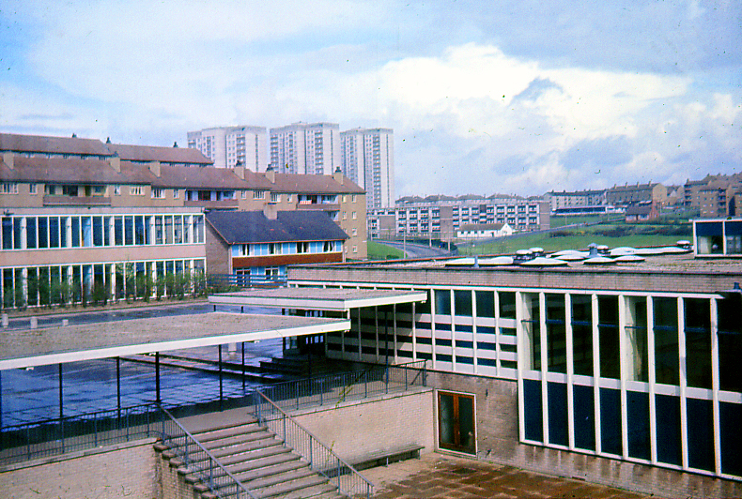
der erste Stock
First floor

Slide 14
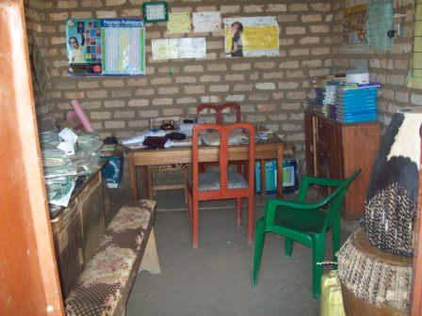
das Büro
Office

Slide 15
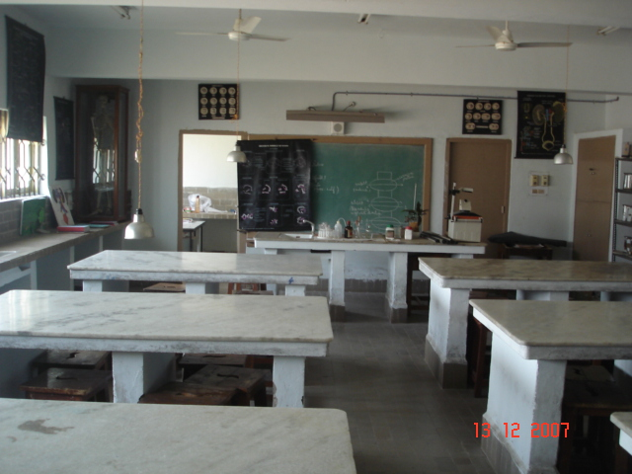
das Labor
Laboratory

Slide 16
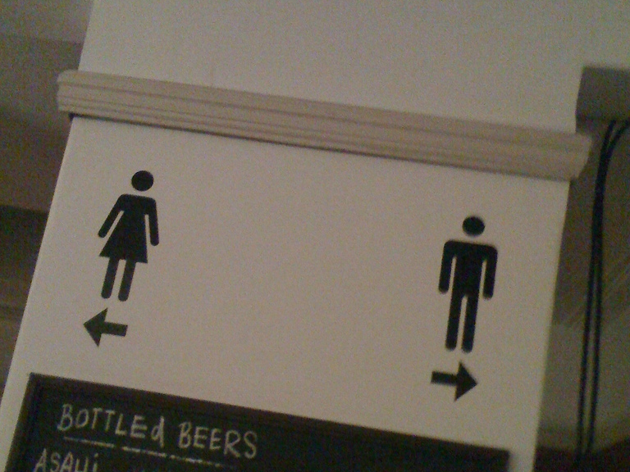
die Toilette
Toilet

Slide 17
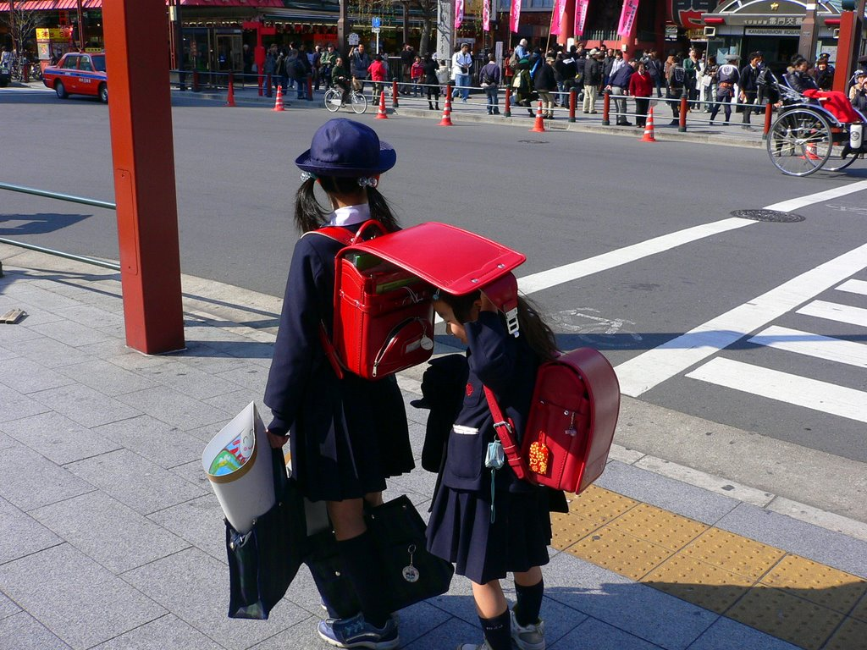
Well, now you know all about the parts of school, let’s learn more, we’ve only just started!!!

Slide 18
















Join us again!

