Slide 1

Handy School Vocab 4
Basic Subjects
with Mrs Angry Carrot-know-it-all-Face
and Mr. Evil, Very Evil Parsnip-Face

Slide 2
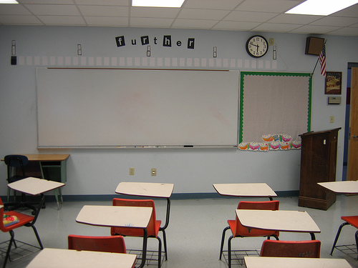
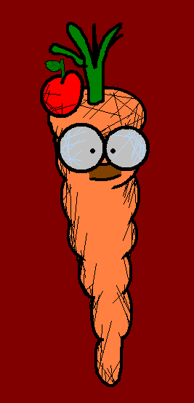
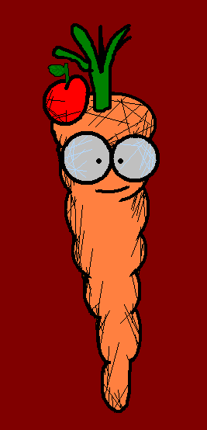
Hello, my little friends. Today I am going to talk about something I like more than anything... school subjects!!

Slide 3
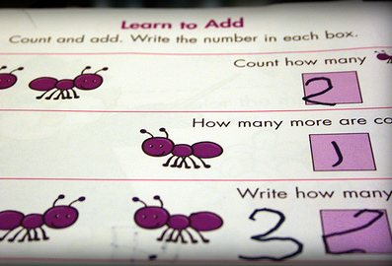
Mathe
Maths

Slide 4

Englisch
English

Slide 5
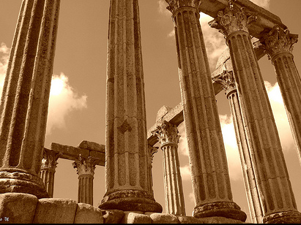
Geschichte
History

Slide 6
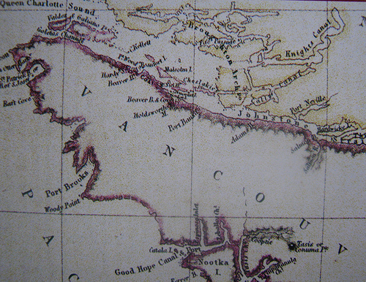
Geografie
Geography

Slide 7
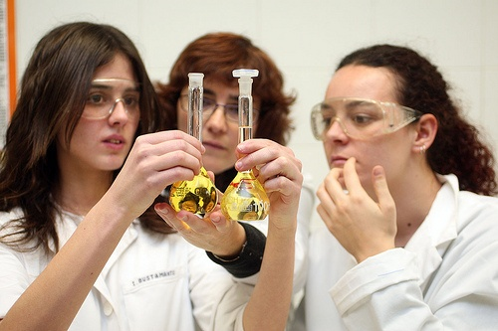
Naturwissenschaft
Science

Slide 8
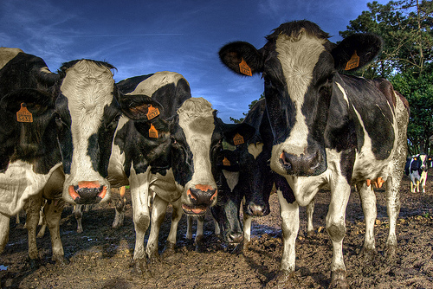
Muh!
Biologie
Biology

Slide 9
Muuhh!
Physik
Physics

Slide 10
Muuuhh!
Chemie
Chemistry

Slide 11
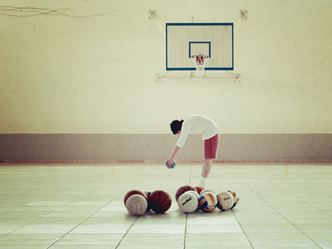
Sport
PE (Physical Education)

Slide 12

Kunst
Art

Slide 13
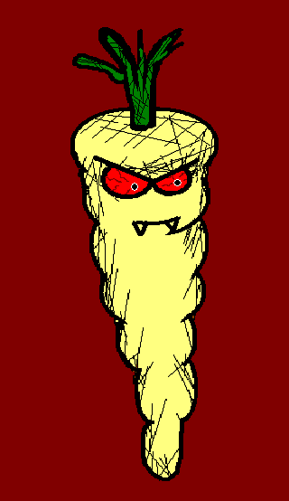

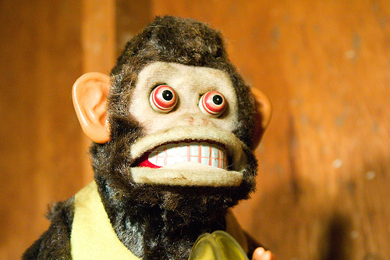
It was in my school.
Hey! That is not a school subject!
das Böse
Evil

Slide 14

Musik
Music

Slide 15
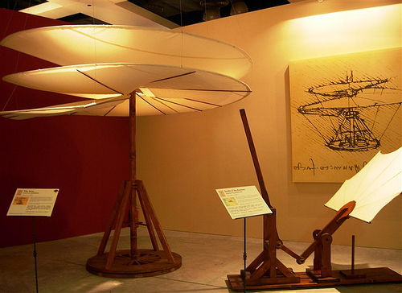
Technik
Technology

Slide 16
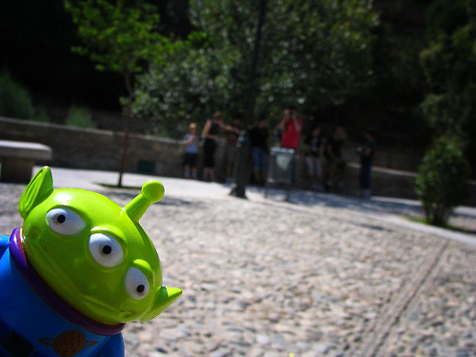
moderne Fremdsprachen
Modern Foreign Languages

Slide 17

Deutsch
German

Slide 18

Französisch
French

Slide 19
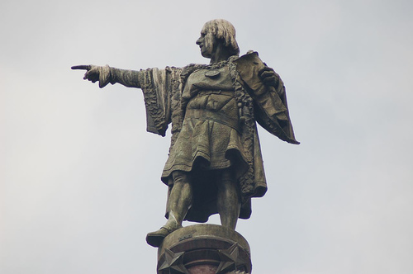
Spanisch
Spanish
Notes:
After the carrot says “espaNol” the parsnip appears from the right side, walks on the silhouette of Columbus until reaching his head, then he says “ah! I wish...”, afterwards it goes down and close to the “camera” and says “i’d be...”; now the carrot says “in your dreams!”

Slide 20
In your dreams!!
Ah! I wish I had paid more attention in school!
I’d be exerting my evilness and ruling the world by now!!
Notes:
After the carrot says “espaNol” the parsnip appears from the right side, walks on the silhouette of Columbus until reaching his head, then he says “ah! I wish...”, afterwards it goes down and close to the “camera” and says “i’d be...”; now the carrot says “in your dreams!”

Slide 21
















Join us again!

