Slide 1

Handy School Vocab 5
More Subjects
with Mrs Angry Carrot-know-it-all-Face
and Mr. Evil, Very Evil Parsnip-Face

Slide 2
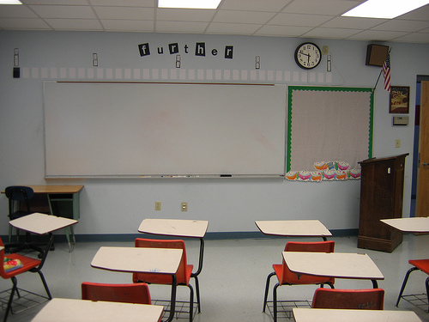
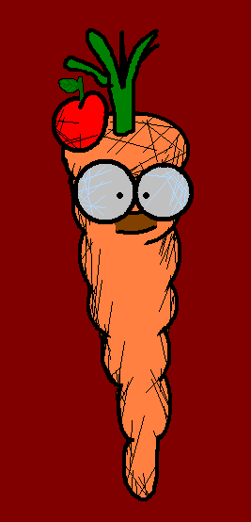
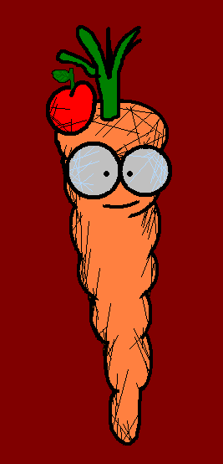
Hello again, my little friends! Today I’m going to carry on talking about school subjects!!

Slide 3
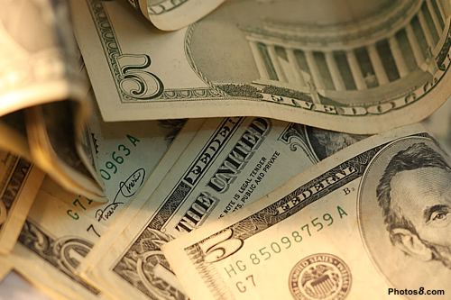
Wirtschaft
Economics

Slide 4
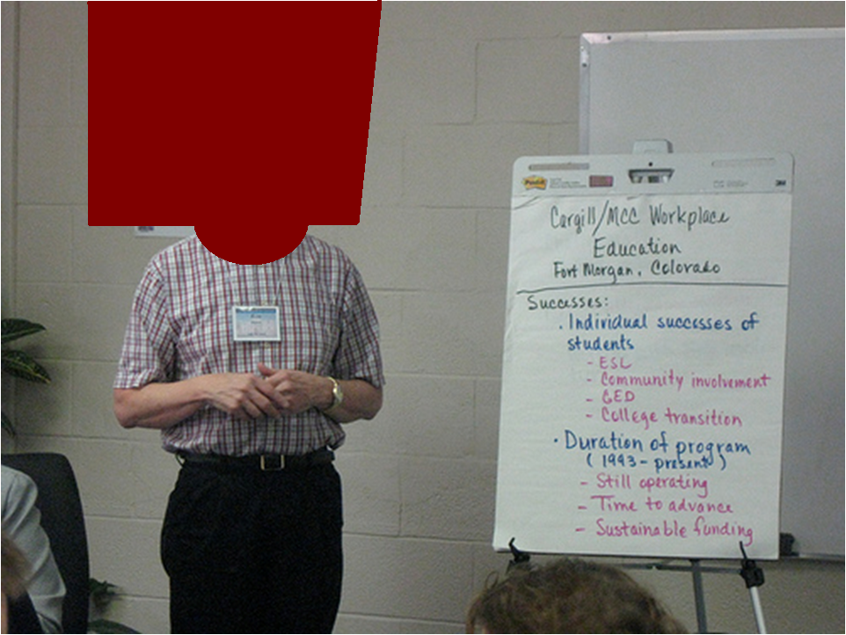
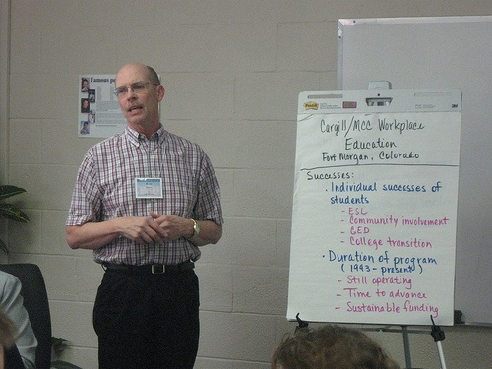
Betriebswirtschaft
Business

Slide 5
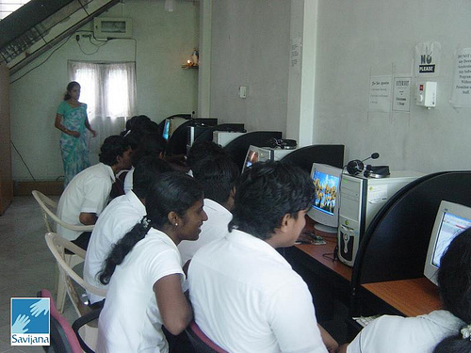
Informatik
ICT (Information and Communication Technologies)

Slide 6
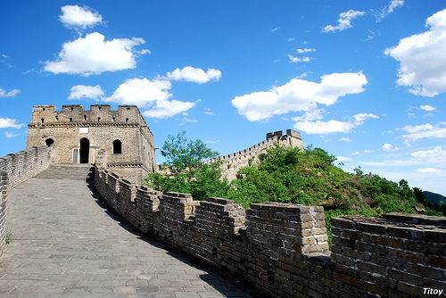
Chinesisch
Chinese

Slide 7

Japanisch
Japanese

Slide 8

Geisteswissenschaften
Humanities

Slide 9

Soziologie
Sociology

Slide 10

Religion
Religious Studies

Slide 11
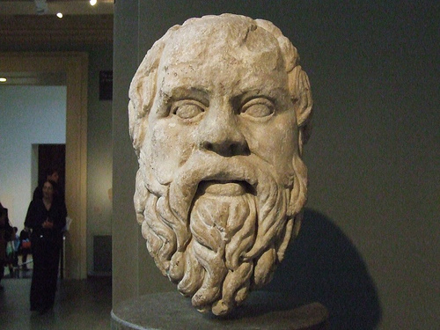
Philosophie und Ethik
Philosophy and Ethics

Slide 12
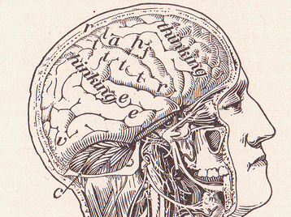
Psychologie
Psychology

Slide 13
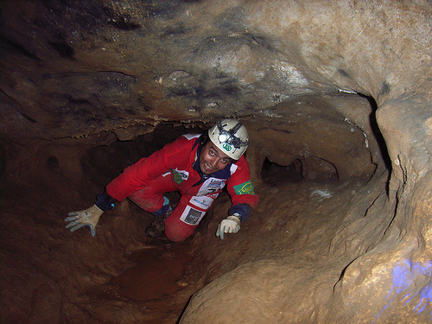
Geologie
Geology

Slide 14
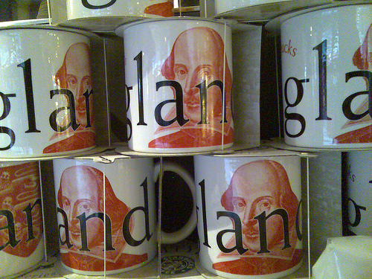
Literatur
Literature

Slide 15
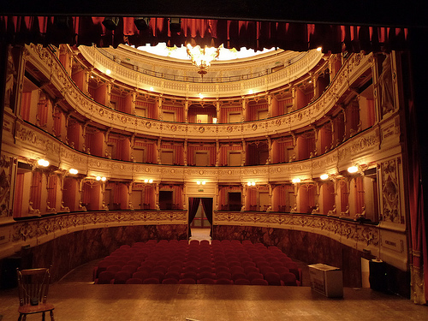
Schauspiel
Drama

Slide 16
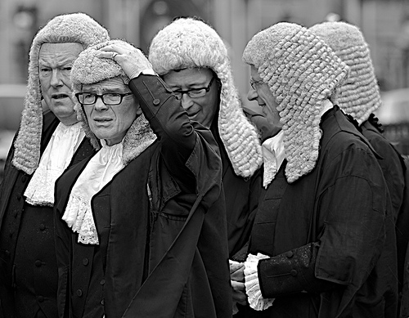
Recht
Law

Slide 17
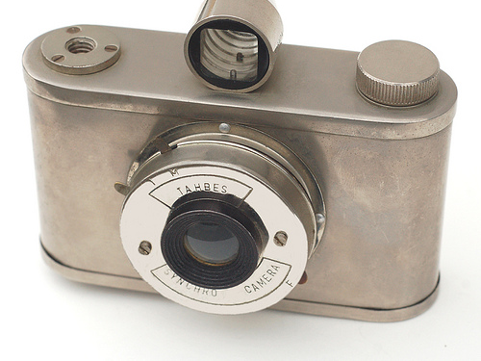
Fotografie
Photography

Slide 18
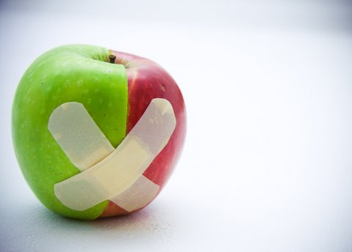
Design
Design
Notes:
Can we make the carrot flash after talking changing its colour from green to red a few times?

Slide 19
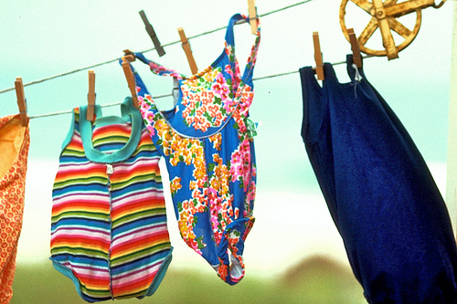

Aaaaahhhh!
Werken
Textiles

Slide 20
Well, that’s about it, just make sure you watch the next one and learn about stationery. It’s fascinating! Well for me anyway.

Slide 21
















Join us again!

