Slide 1

Handy School Vocab 6
Stationery
with Mr. Evil, Very Evil Parsnip-Face

Slide 2
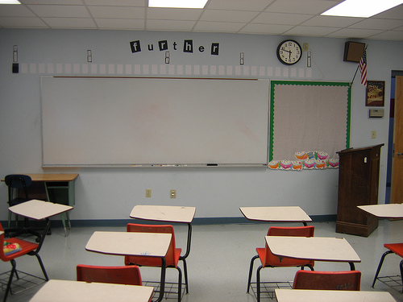

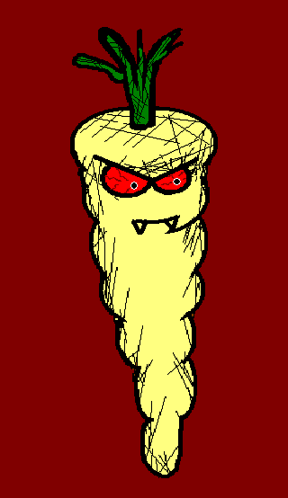
Well, all that’s missing now is stationery, no more waiting, here it is!

Slide 3
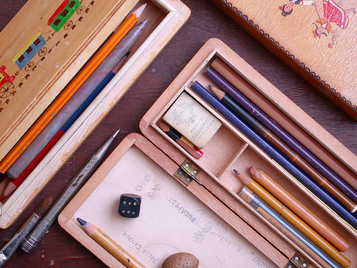
die Schreibwaren
Stationery

Slide 4
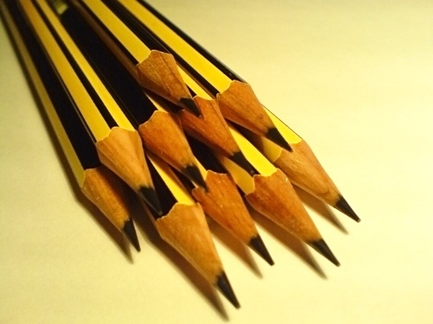
der Bleistift
Pencil

Slide 5
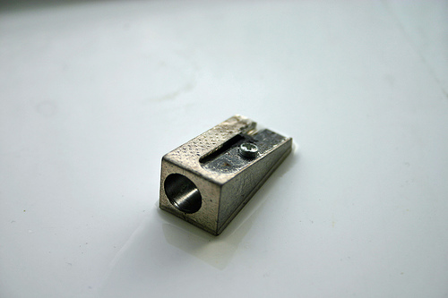
der Bleistiftspitzer
Pencil sharpener

Slide 6
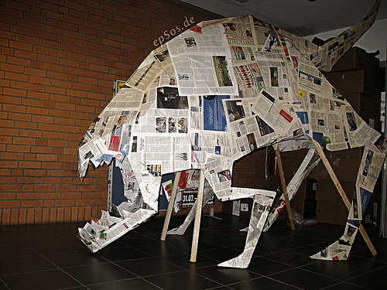
das Papier
Paper

Slide 7
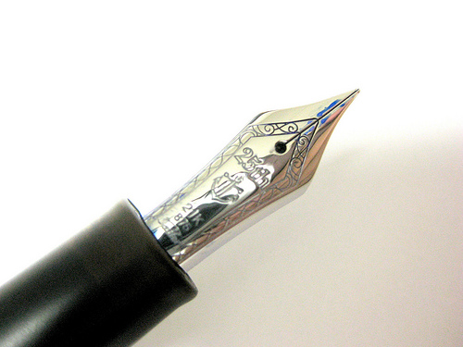
der Stift/der Füller
Pen

Slide 8
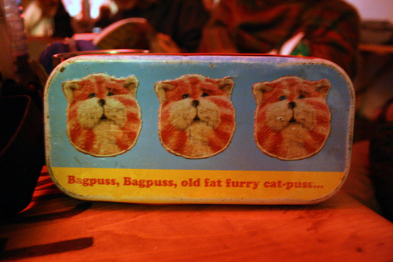
das Federmäppchen
Pencil case

Slide 9
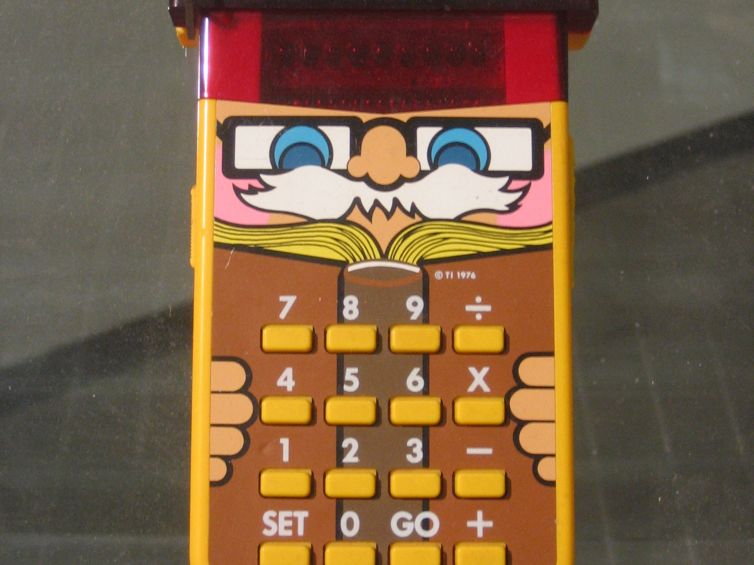
der Taschenrechner
Calculator

Slide 10
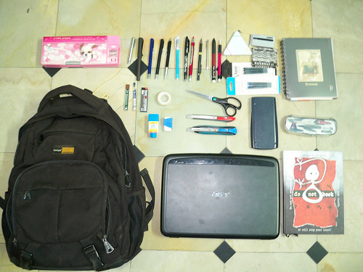
die Schultasche
School bag

Slide 11
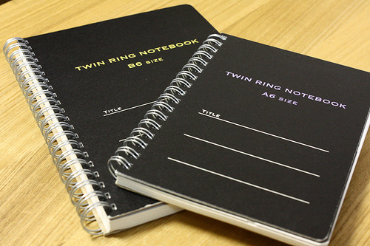
das Notizbuch
Notebook

Slide 12
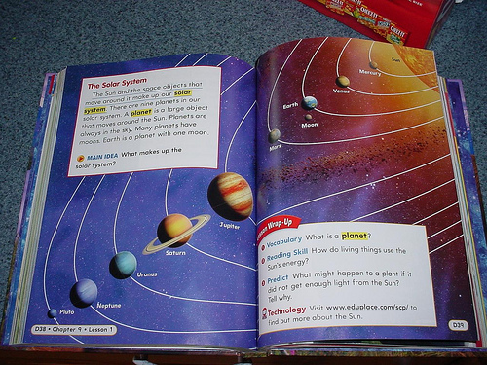
das Schulbuch
Textbook

Slide 13
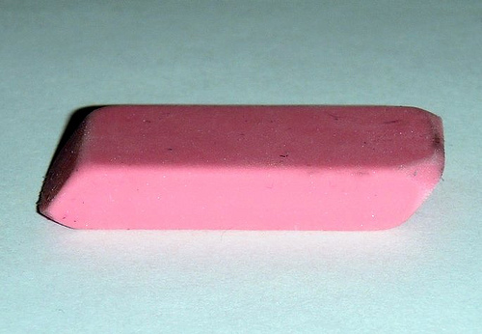
der Radiergummi
Rubber

Slide 14
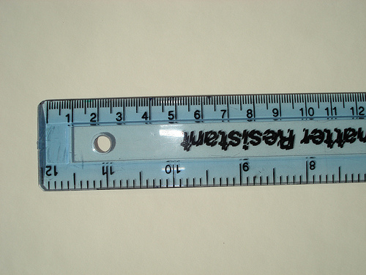
das Lineal
Ruler

Slide 15
These are things you use everyday. Don’t forget them, that would be silly.

Slide 16
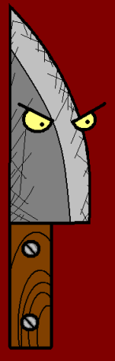















Join us again!

