Slide 1

Handy Sports Vocab 1
Sports
with Mr. Evil, Very Evil Parsnip-Face

Slide 2
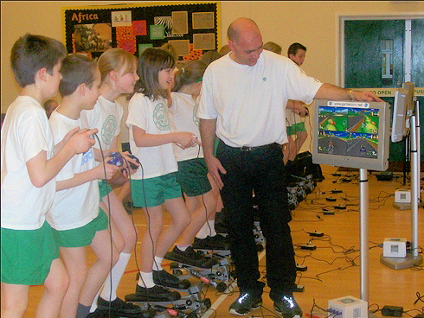


The following are all…

Slide 3
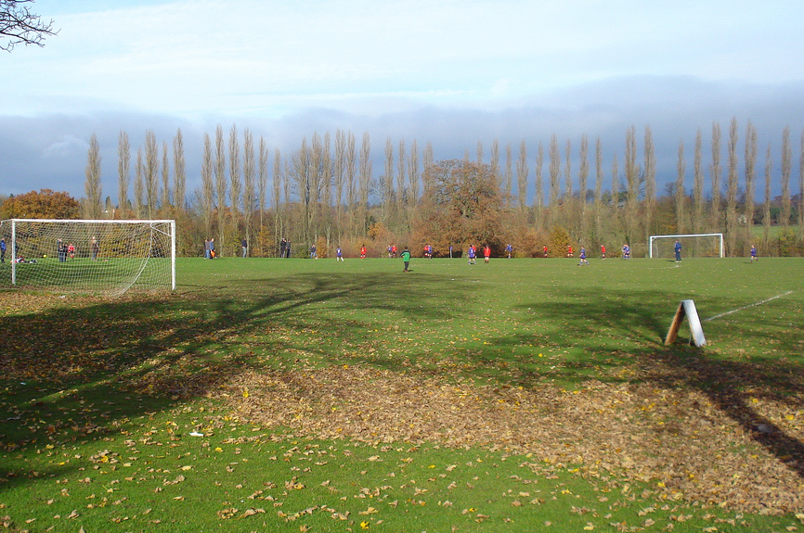
Sportarten
Sports

Slide 4
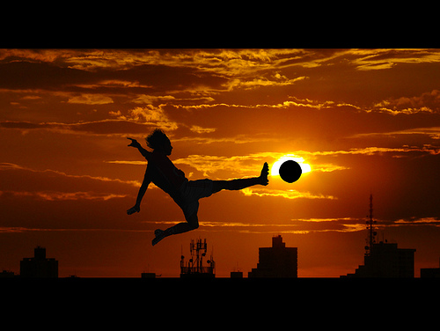
der Fußball
Football

Slide 5
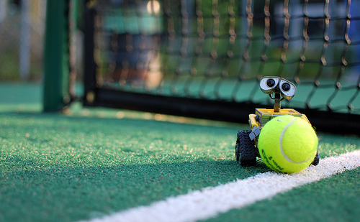
das Tennis
Tennis

Slide 6
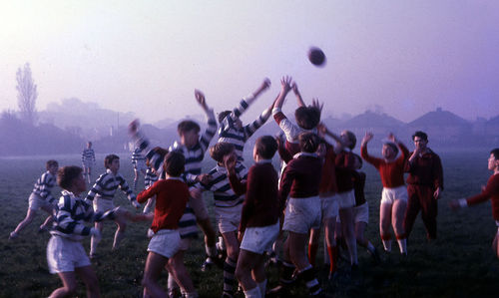
das Rugby
Rugby

Slide 7
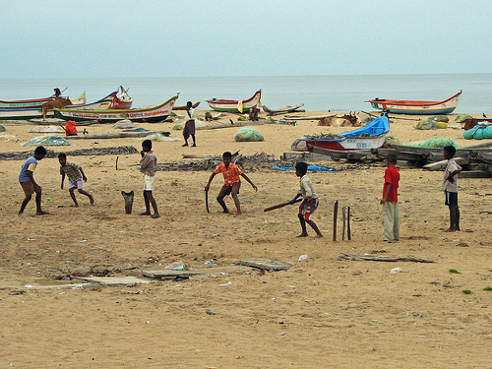
das Kricket
Cricket

Slide 8
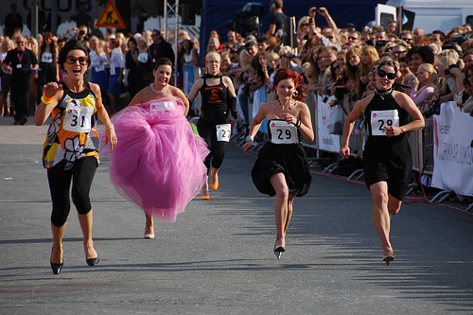
das Laufen
Running

Slide 9
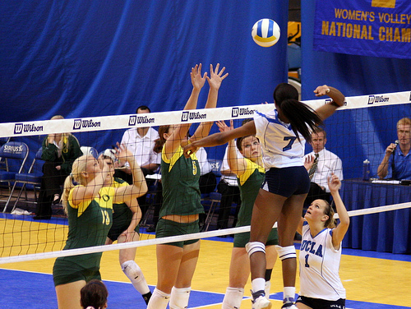
der Volleyball
Volleyball

Slide 10
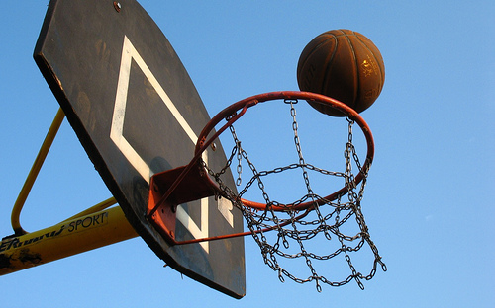
der Basketball
Basketball

Slide 11
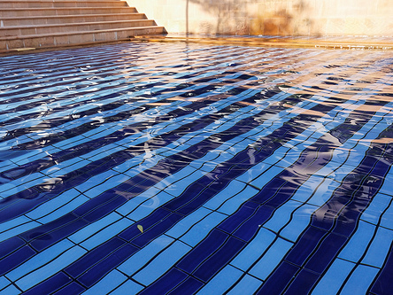
das Schwimmen
Swimming

Slide 12
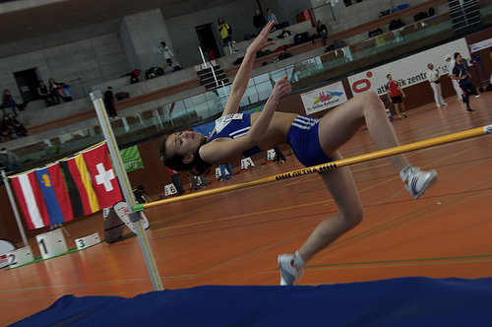
die Leichtathletik
Athletics

Slide 13
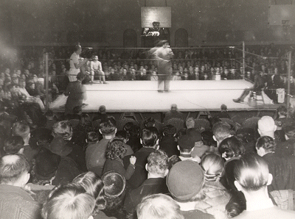
das Boxen
Boxing

Slide 14
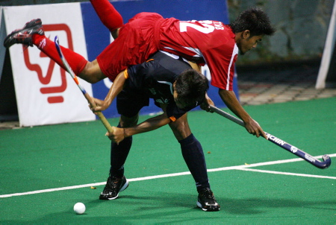
das Hockey
Hockey

Slide 15
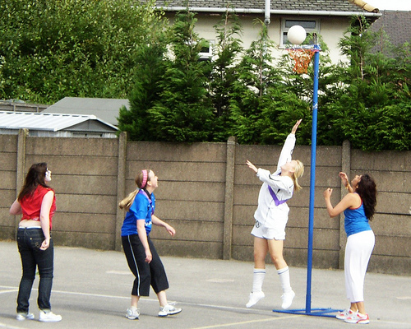
der Korbball
Netball

Slide 16

I was not wrong, they are all sports.

Slide 17


















Join us again!

