Slide 1

Handy Sports Vocab 2
Sports People
with Mr. Evil, Very Evil Parsnip-Face

Slide 2
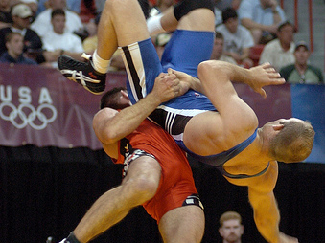

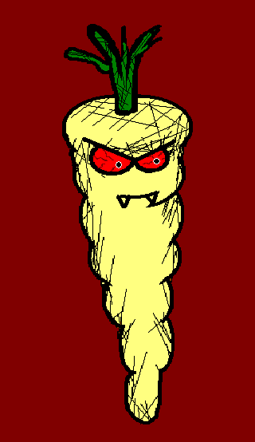
People who do sports are called…

Slide 3
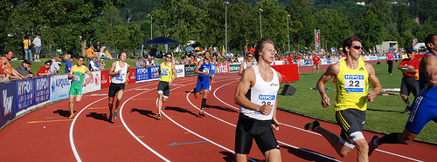
Sportler
Athletes

Slide 4
…for example…

Slide 5
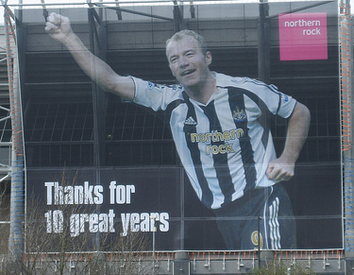
der Fußballer
Footballer

Slide 6
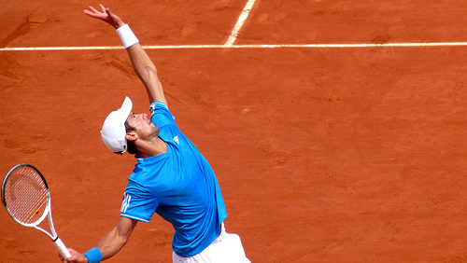
der Tennisspieler
Tennis Player

Slide 7
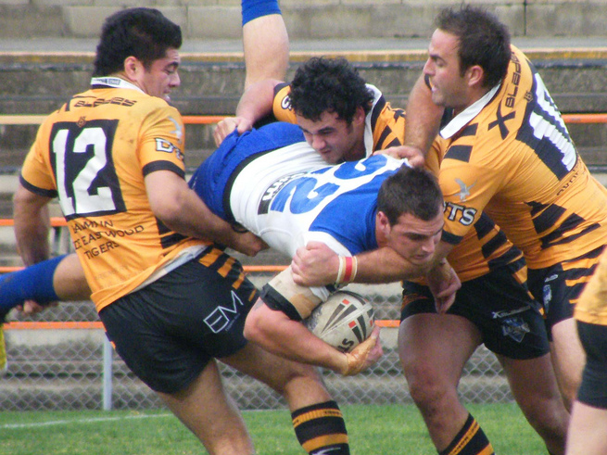
der Rugbyspieler
Rugby Player

Slide 8
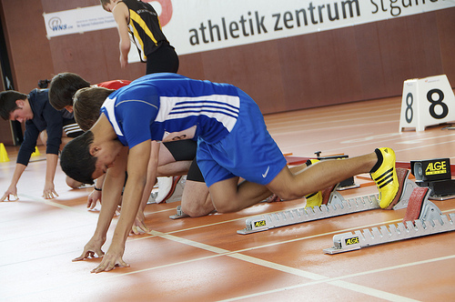
der Läufer
Runner

Slide 9
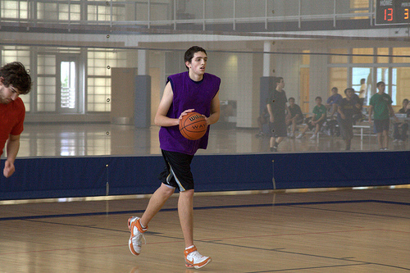
der Basketballspieler
Basketball Player

Slide 10
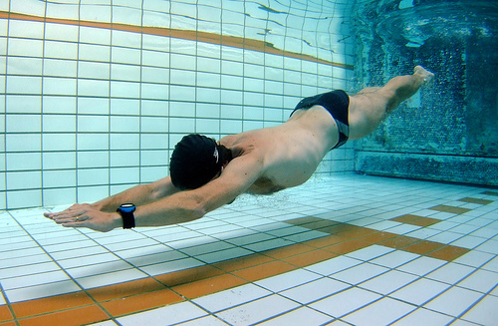
der Schwimmer
Swimmer

Slide 11
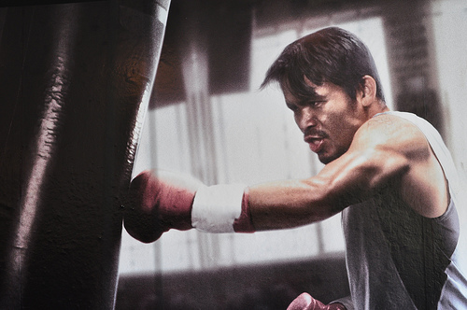
der Boxer
Boxer

Slide 12
Then there is…

Slide 13
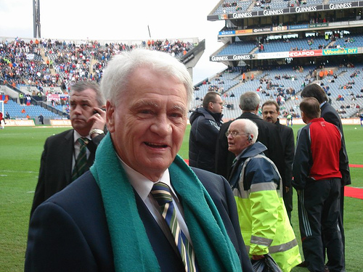
der Manager
The Manager

Slide 14
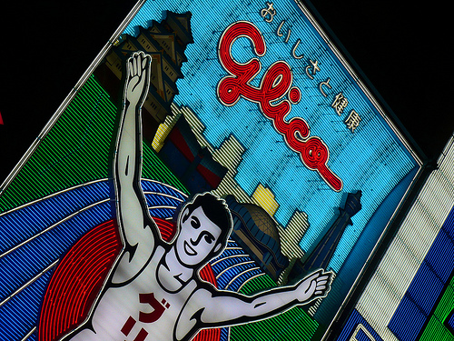
der Sieger
The Winner

Slide 15
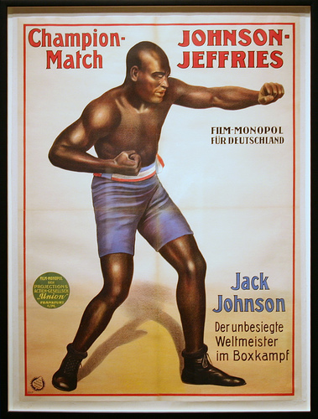
der Meister
The Champion

Slide 16
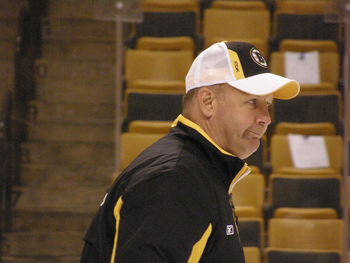
der Trainer
The Coach

Slide 17
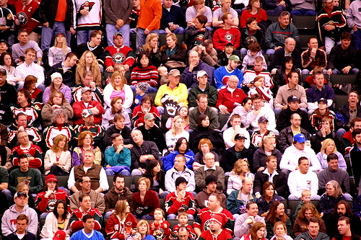
die Menge
The Crowd

Slide 18
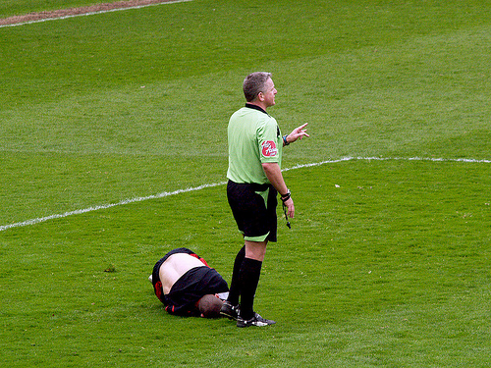
Und der Schiedsrichter.
And the Referee.

Slide 19
For women you just have to add
“-in” for the singular or
“-innen” for the plural.

Slide 20
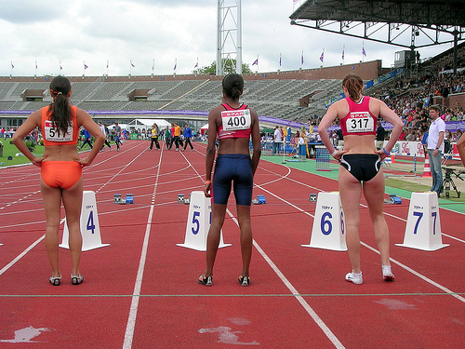
Sportlerinnen
Athletes

Slide 21
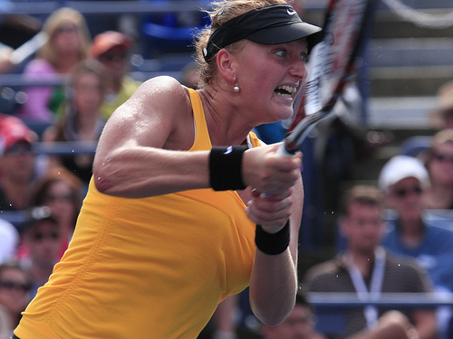
die Tennisspielerin
Tennis Player

Slide 22
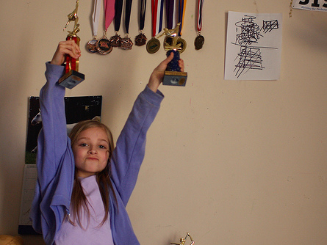
die Meisterin
The Champion

Slide 23
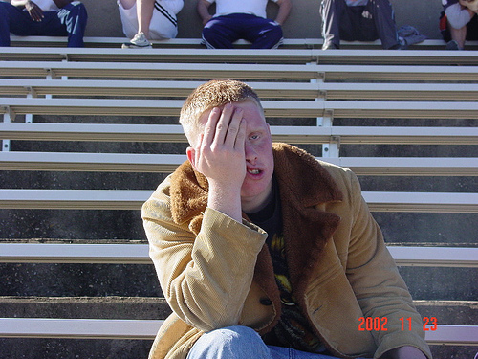
I was not wrong, listen to me!

Slide 24


















Join us again!

