Slide 1

Handy Sports Vocab 4
Adjectives
with Mr. Evil, Very Evil Parsnip-Face

Slide 2
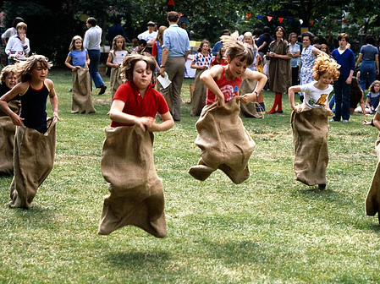


Sports can be…

Slide 3
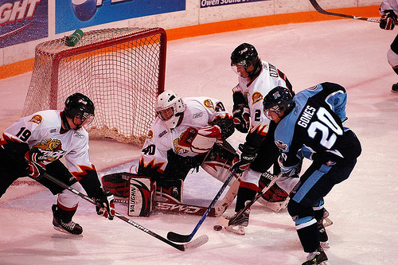
spannend
exciting

Slide 4
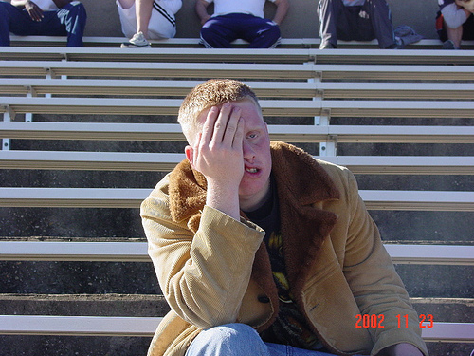
langweilig
boring

Slide 5
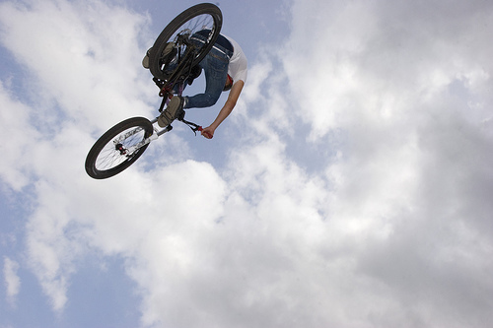
extrem
extreme

Slide 6
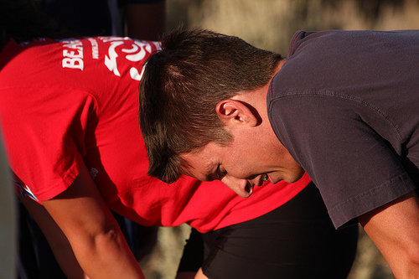
anstrengend
exhausting

Slide 7
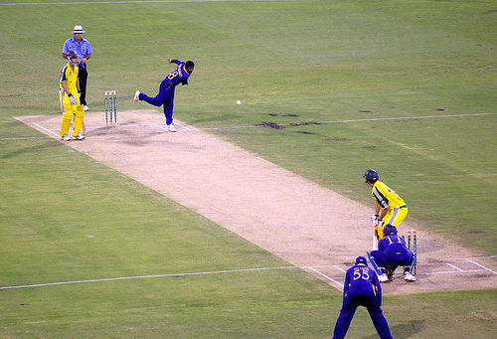
…and the athletes can be…

Slide 8
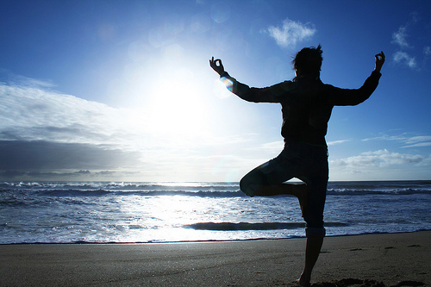
gesund
healthy

Slide 9
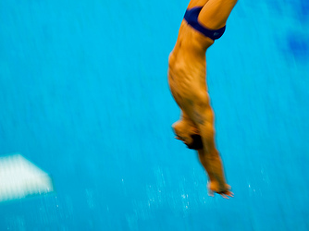
sportlich
athletic

Slide 10
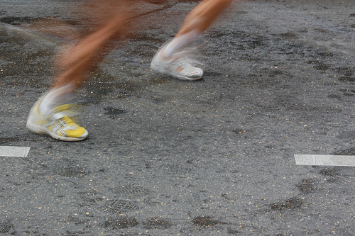
schnell
fast

Slide 11
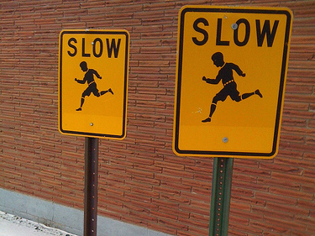
langsam
slow

Slide 12
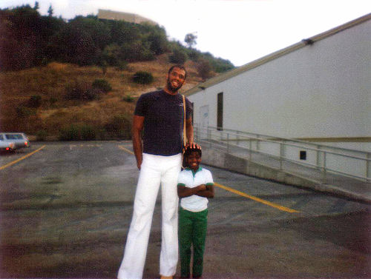
groß
tall

Slide 13
klein
short

Slide 14
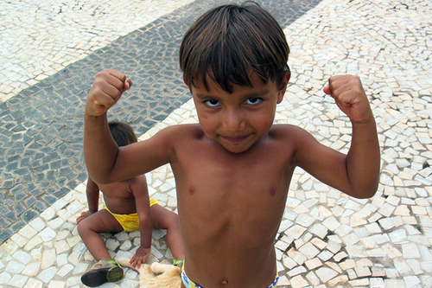
stark
strong

Slide 15
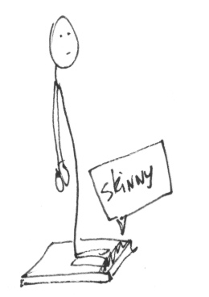
schwach
weak

Slide 16

großartig
great

Slide 17
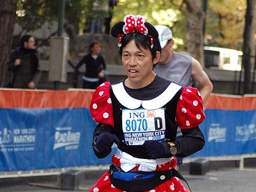
furchtbar
terrible

Slide 18
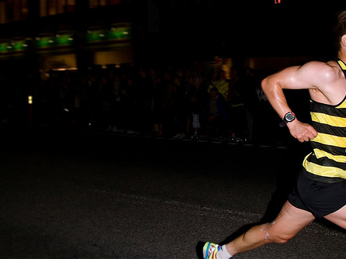
I wonder what you’re like at sports. I’m great, and I would definitely beat you.

Slide 19


















Join us again!

