Slide 1

Handy Time Vocab 2
-
Days of the week
With Miss Digitally Angry Clock-Face

Slide 2
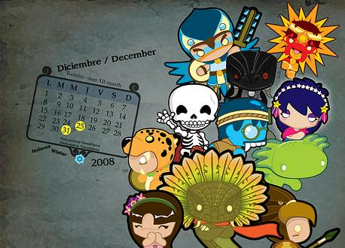
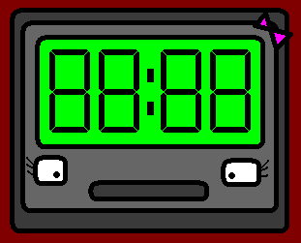

Hello, I am Miss Digitally Angry Clock-Face. Today I’m going to teach you the days of the week. So pay attention.

Slide 3
This is really easy, like in English each day ends with the word ‘day’…

Slide 4
In German all the days but Wednesday end in...

Slide 5
-tag

Slide 6
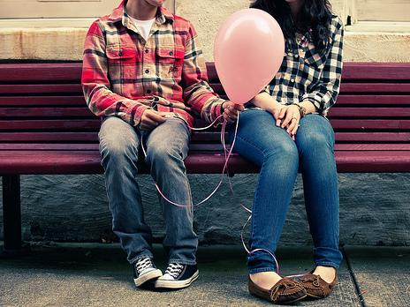
Montag
Monday

Slide 7
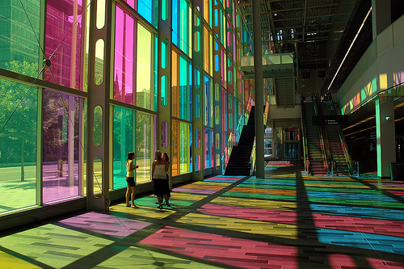
Dienstag
Tuesday

Slide 8
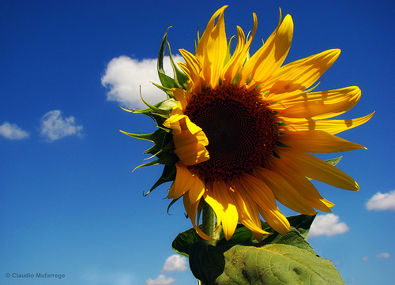
Mittwoch
Wednesday

Slide 9
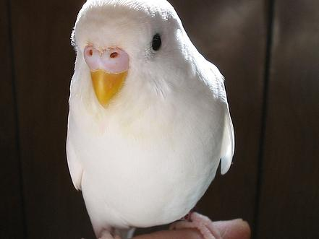
Donnerstag
Thursday

Slide 10
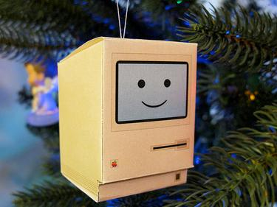
Freitag
Friday

Slide 11
And, finally, the weekend!
Das Wochenende!

Slide 12
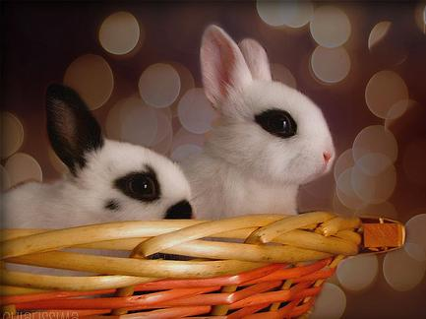
sábado
Samstag
Saturday

Slide 13
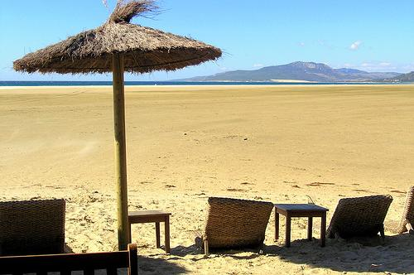
Sonntag
Sunday

Slide 14
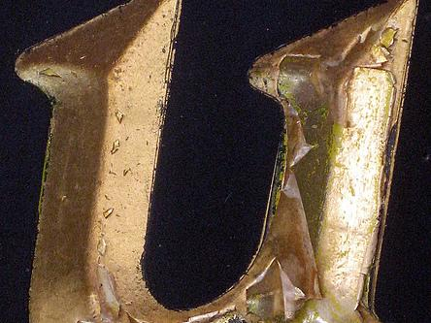
Here are two more useful words for you.

Slide 15
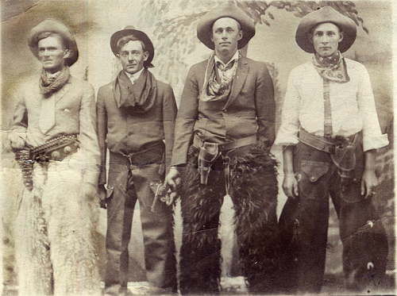
Wochentag und Wochenende!
Weekday and weekend!

Slide 16
















Join us again!

