Slide 1

Handy Weather Vocab 1
Basics
with Miss Digitally Angry Clock-Face

Slide 2
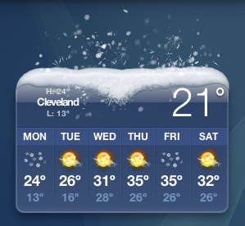
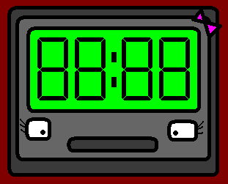

Hello. I am Miss Digitally Angry Clock-Face. Today I’m going to talk to you about the weather.

Slide 3
Let’s start with some useful words!

Slide 4
das Wetter
Weather

Slide 5

die Sonne
Sun

Slide 6
der Tag
Day

Slide 7
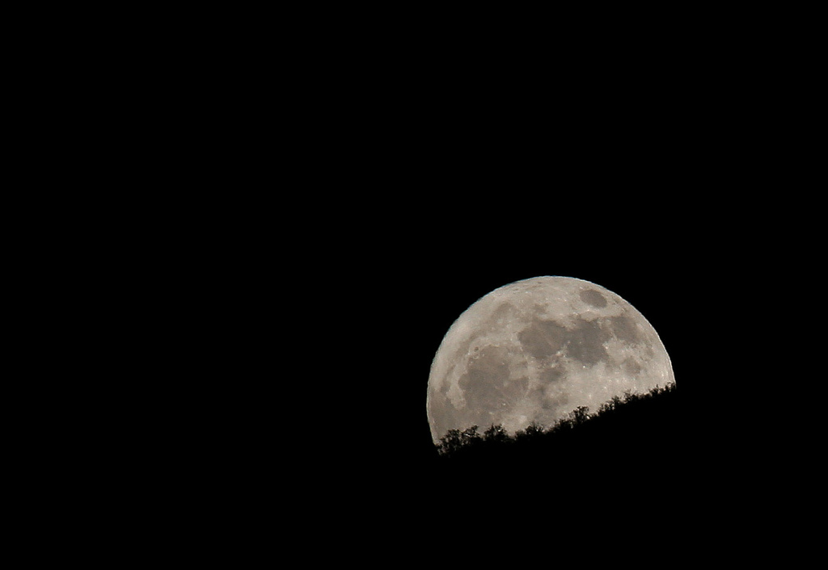
der Mond
Moon

Slide 8
die Nacht
Night

Slide 9
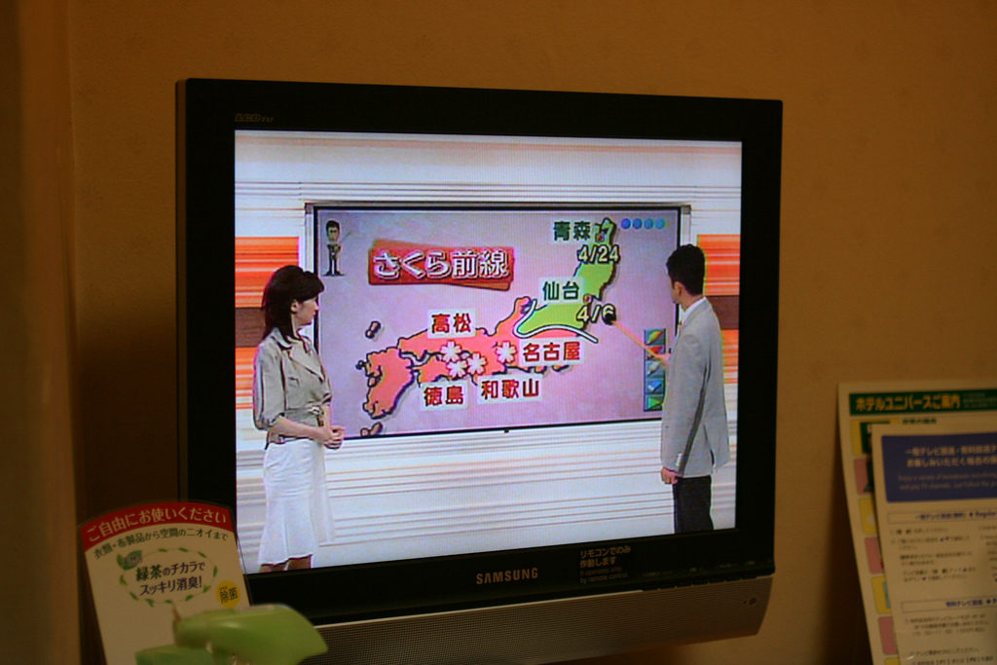
der Wetterbericht
Weather forecast

Slide 10
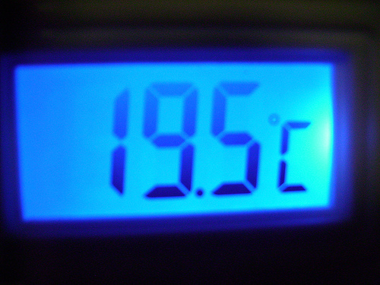
das Grad
Degree

Slide 11
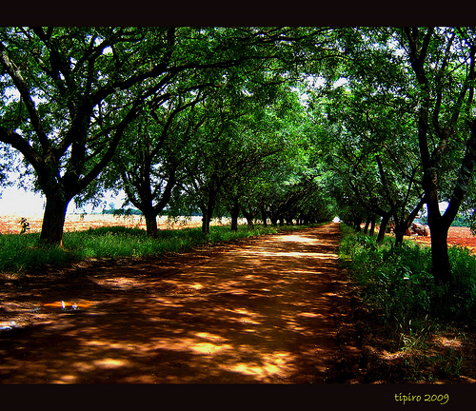
der Schatten
Shade

Slide 12
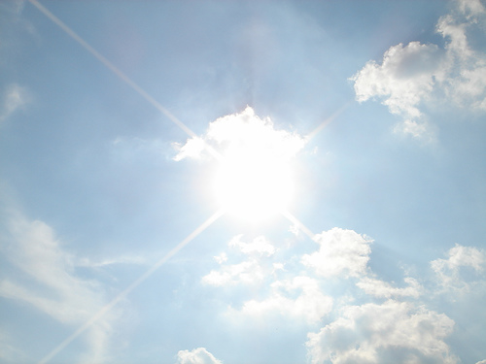
der Himmel
Sky

Slide 13
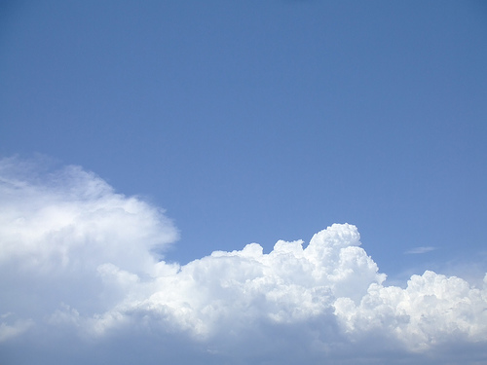


Mwahahaha!!!
die Wolke
Cloud

Slide 14
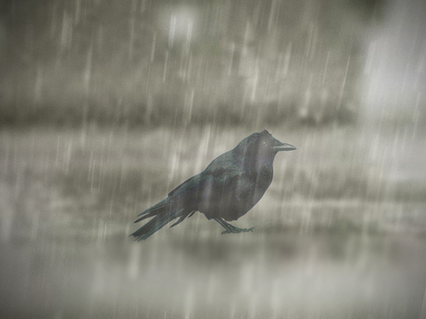
der Regen
Rain

Slide 15
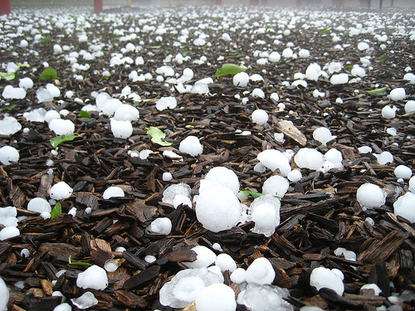
der Hagel
Hail

Slide 16
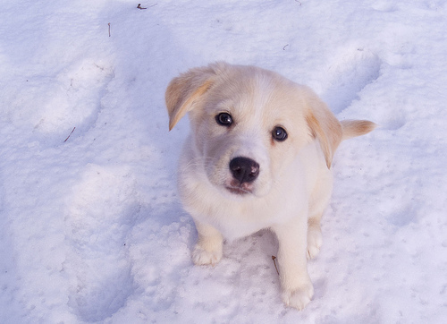
der Schnee
Snow

Slide 17
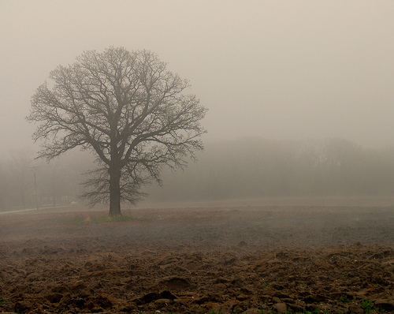
der Nebel
Fog

Slide 18
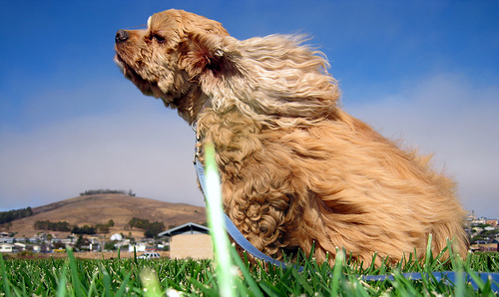
der Wind
Wind

Slide 19
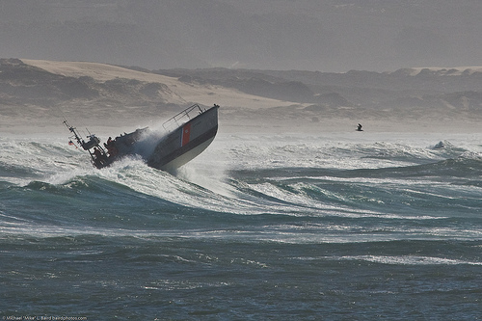
der Sturm
-
Weeeee!
Storm

Slide 20
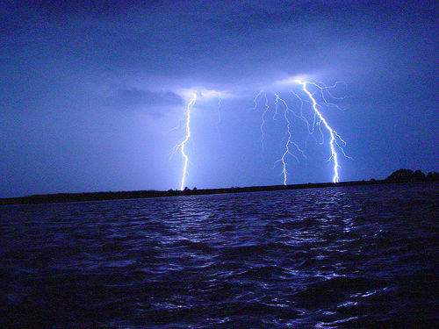
der Donner und der Blitz
Thunder and lightning

Slide 21
If you want to learn more about weather, try Handy Weather Vocab 2, and then maybe you’ll be ready for our weather machine!

Slide 22
















Join us again!

