Slide 1

Handy Weather Vocab 2
Adjectives
with Miss Digitally Angry Clock-Face

Slide 2
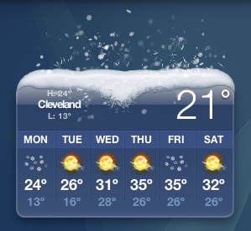
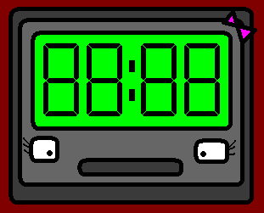

Hello. I am Miss Digitally Angry Clock-Face. Today we’ll describe the weather.

Slide 3
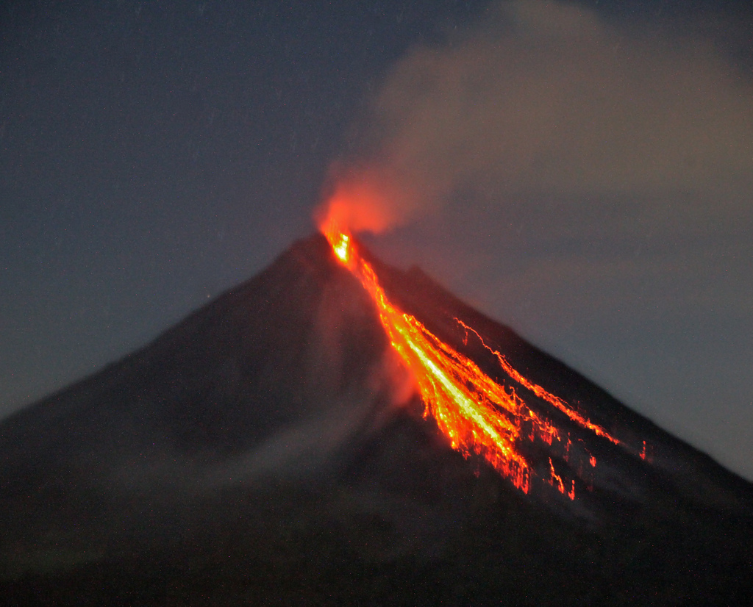
heiß
Hot

Slide 4

warm
Warm

Slide 5
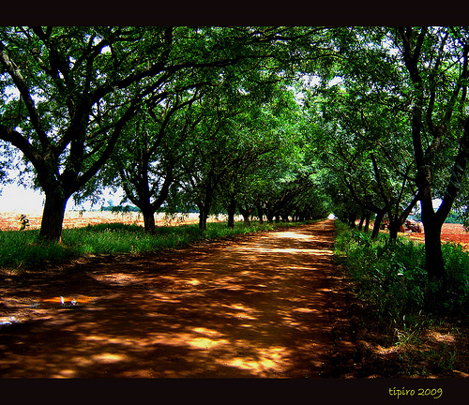
kühl
Cool

Slide 6
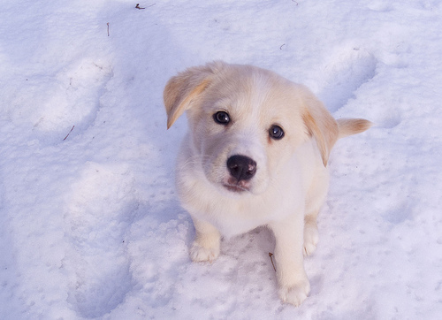
kalt
Cold

Slide 7
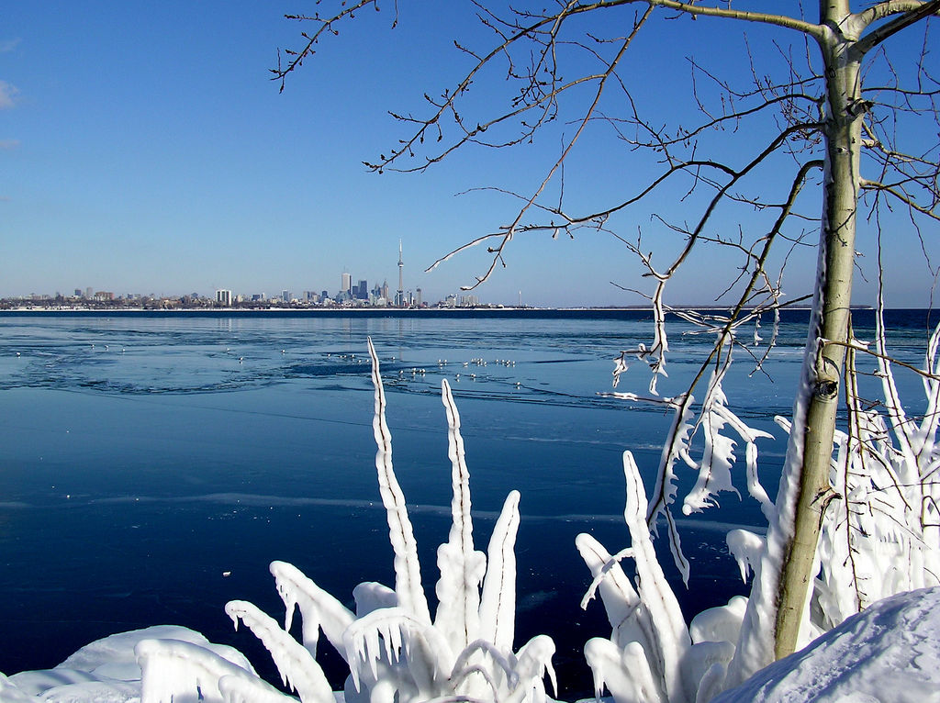
eiskalt
Freezing

Slide 8

sonnig
Sunny

Slide 9
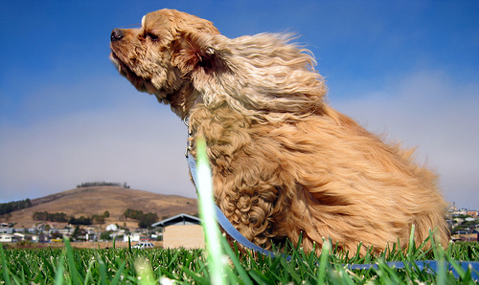
windig
Windy

Slide 10



Mwahahaha!!!
bewölkt
Cloudy

Slide 11
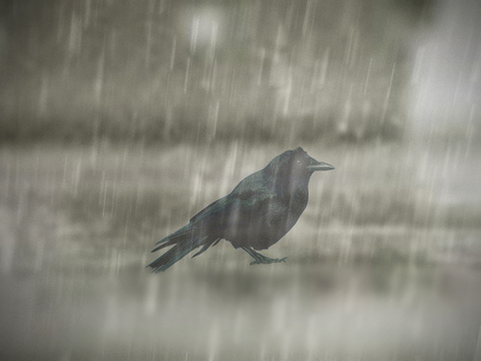
regnerisch
Rainy

Slide 12
nass
Wet

Slide 13
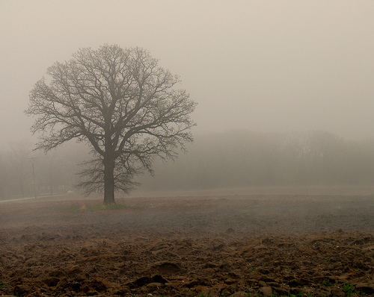
neblig
Foggy

Slide 14
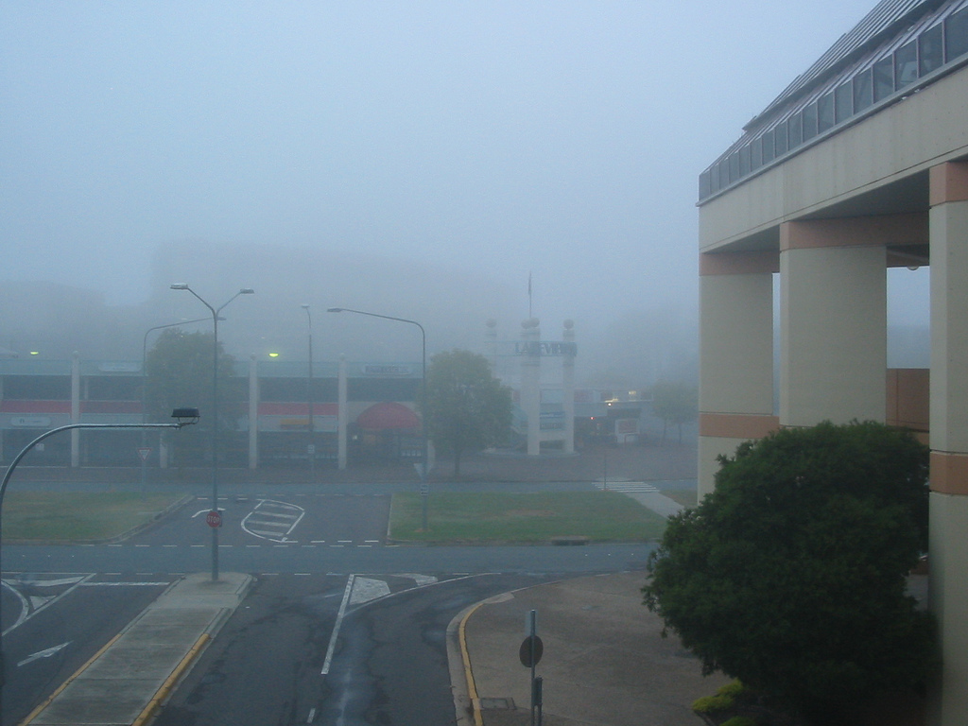
bedeckt
Overcast

Slide 15
heiter
Fine

Slide 16
There you go! Now, if you want to learn more about weather, try out the weather machine!

Slide 17
















Join us again!

