Slide 1

Handy Ordinal Numbers
With Miss Digitally Angry Clock-Face

Slide 2
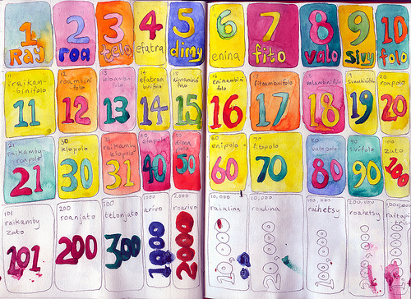
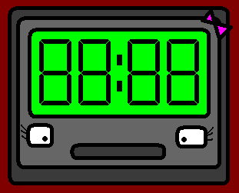

Hello! I am Miss Digitally Angry Clock-Face, and I am here to teach you ordinal numbers. So pay attention.

Slide 3
Ordinal numbers show you which order things are in. (Just in case you didn’t know.)

Slide 4
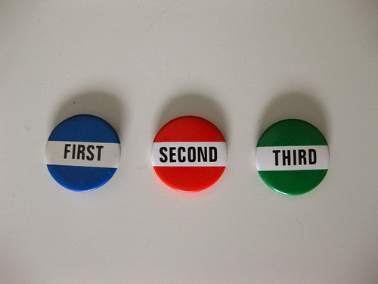
erste (1.)
first (1st)

Slide 5
zweite (2.)
second (2nd)

Slide 6
dritte (3.)
third (3rd)

Slide 7

vierte (4.)
fourth (4rd)

Slide 8
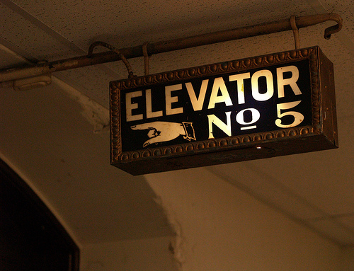
fünfte (5.)
fifth (5th)

Slide 9
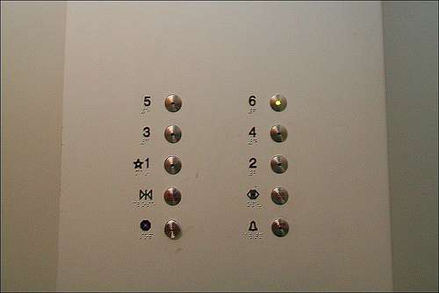
sechste (6.)
sixth (6th)

Slide 10
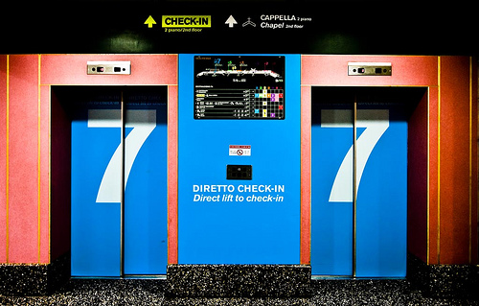
siebte (7.)
seventh (7th)

Slide 11
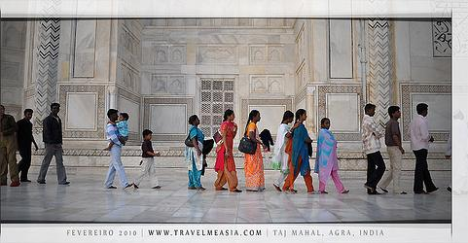
achte (8.)
eighth (8th)

Slide 12
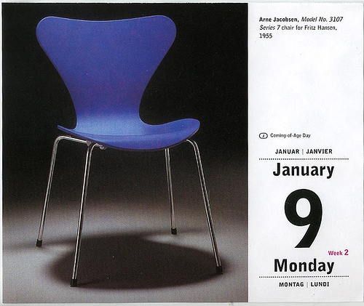
neunte(9.)
ninth (9th)

Slide 13
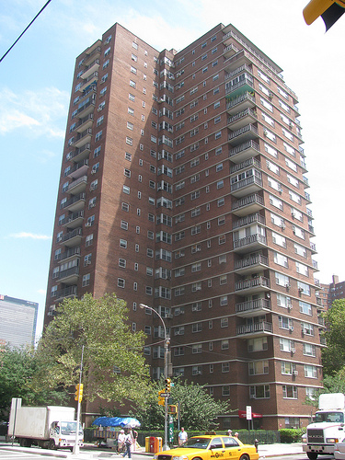
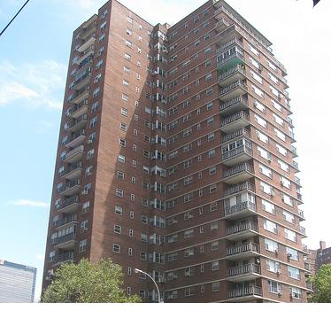
zehnte (10.)
tenth (10th)

Slide 14
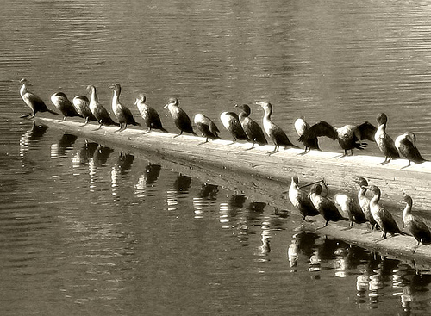
elfte (11.)
eleventh (11th)

Slide 15
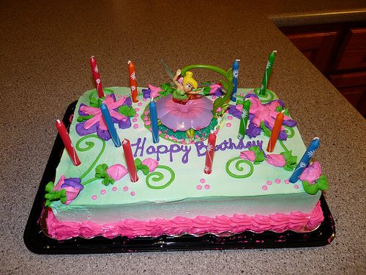
zwölfte (12.)
twelfth (12th)

Slide 16

From 13th to 20th, you only have to add the ordinal number we just learned: “zehnte” (10th)...

Slide 17
THIRTEENTH: 3 (drei) + 10th (zehnte)
→ dreizehnte
FOURTEENTH (14TH) = vierzehnte
FIFTEENTH (15TH) = fünfzehnte
SIXTEENTH (16TH) = sechzehnte
SEVENTEENTH (17TH) = siebzehnte
EIGHTEENTH (18TH) = achtzehnte
NINETEENTH (19TH) = neunzehnte

Slide 18

Und natürlich zwanzigste!
And of course, twentieth!

Slide 19
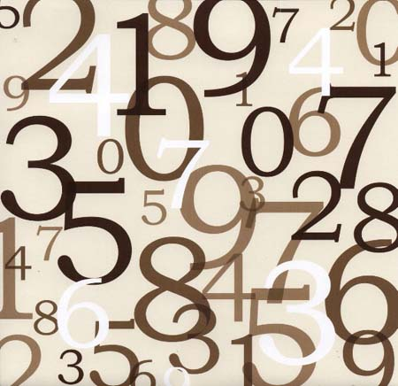
Here are some examples!

Slide 20
You’ll find the ordinal number between the article and the noun, like in....

Slide 21
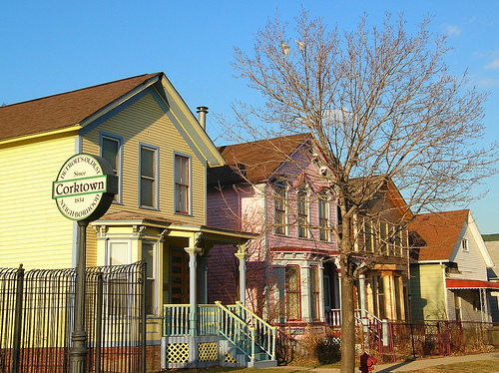
das erste Haus
the first house

Slide 22
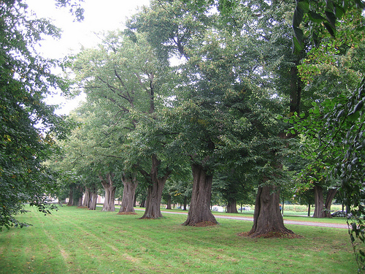
der zweite Baum
the second tree

Slide 23
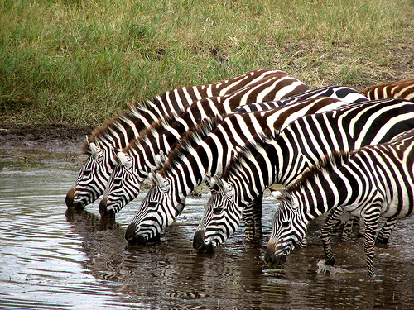
das dritte Zebra
the third zebra

Slide 24
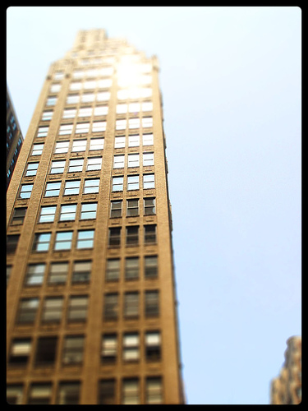
die vierte Etage
the fourth floor

Slide 25

1 2 3 4 5 6 7
die fünfte Flasche
the fifth bottle

Slide 26
And so on! Now watch Angry Olympics 10, you’re ready for some practice!

Slide 27
















Join us again!

