Slide 1

Handy Verbs
Future Tense
With the Angry Family
will

Slide 2
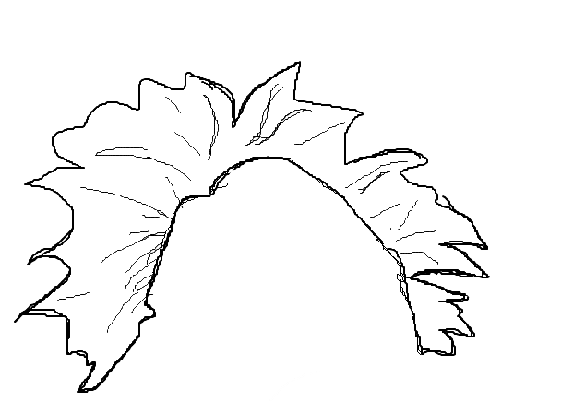



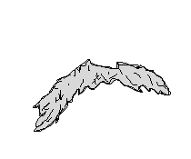
Hello, my name is Mr. Angry Potato Head. I will be a master of tenses. And I will start with the future!
Notes:
Hello, my name is angrt potato head

Slide 3
The future tense is not very difficult in Spanish and I will tell you why…
Notes:
Hello, my name is angrt potato head

Slide 4
Most essentially you will need to remember this simple set of endings...
Notes:
Hello, my name is angrt potato head

Slide 5
(I) -é
(you) -ás
(he/she) -á
(we) -emos
(you pl.) -éis
(they) -án
Notes:
Hello, my name is angrt potato head

Slide 6
Once you learn them, you can form the future tense of all verbs by simply adding the endings to the infinitive of any verb...
Notes:
Hello, my name is angrt potato head

Slide 7
... Remember that the INFINITIVE is the form of the verb ending in
-AR, -ER or -IR
Notes:
Hello, my name is angrt potato head

Slide 8
Like...
CANTAR (to sing),
HABLAR (to speak),
BEBER (to drink),
COMER (to eat)
VIVIR (to live)
REÍR (to laugh)
Notes:
Hello, my name is angrt potato head

Slide 9

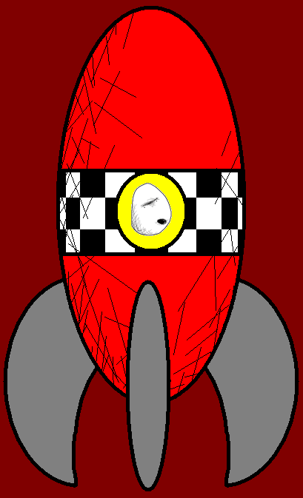



Con esta máquina del tiempo viajaré al futuro.
With this time machine I will travel to the future.

Slide 10
¡Tú me acompañarás!
YOU will accompany me!

Slide 11

¿Para qué lo quieres a él?
¡Lo desordenará todo.
What do you want him for? He will mess it up!

Slide 12

Nosotras también iremos.
Wir werden mitkommen
We will come too.

Slide 13

No tenéis ni idea del futuro. Las bombillas estarán totalmente pasadas de moda.
You have no clue about the future.
Light bulbs will be totally old-fashioned.

Slide 14
¡Y los teléfonos móviles sustituirán a las tostadoras!
And toasters will be replaced by mobile phones!

Slide 15
Vosotras esperaréis aquí.
You will wait here.

Slide 16
¿Cuándo os volveremos a ver?
When will we see you again?

Slide 17
Pues, volverémos para la hora de la comida.
Uhm… We will be back for lunch time.

Slide 18
the return...
el regreso...
I will be back
You will be back
He/She/It will be back
We will be back
You (pl.) will be back
They will be back
Yo volver-é
Tú volver-ás
Él/Ella/Usted volver-á
Nosotros/as volver-emos
Vosotros/as volver-éis
Ellos/as volver-án

Slide 19
Vocab
Time machine
Future
Travel
To accompany
Mobile phone
Old-fashioned
To wait
Lunch time
Máquina del tiempo
Futuro
Viaje
Acompañar
Teléfono móvil
Pasado de moda
Esperar
Hora de la comida

Slide 20















Join us again!

