Slide 1
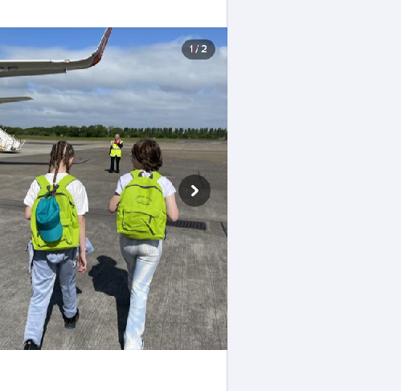
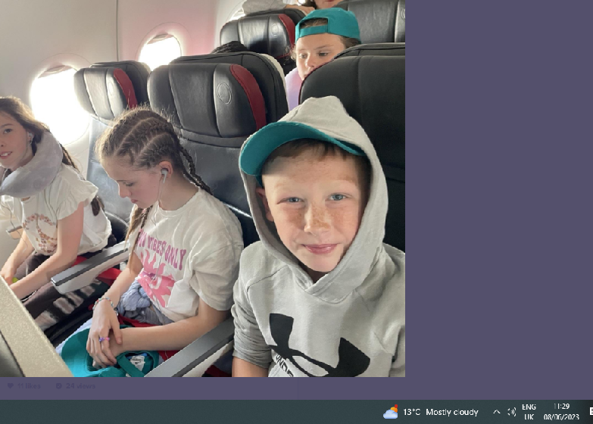
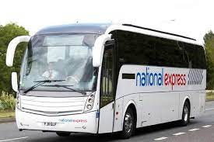
Tyneview trip to Istanbul
24th - 28th May 2023

Slide 2
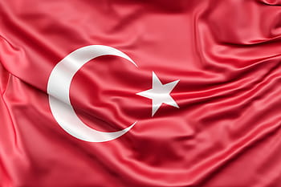
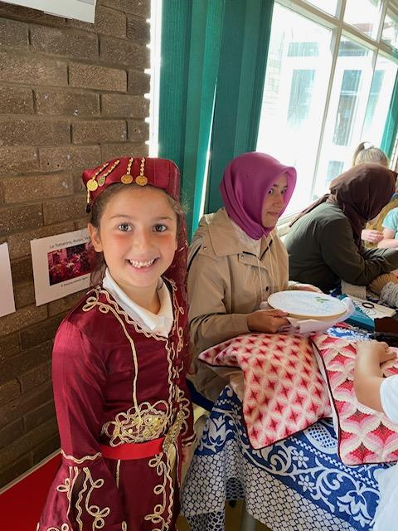
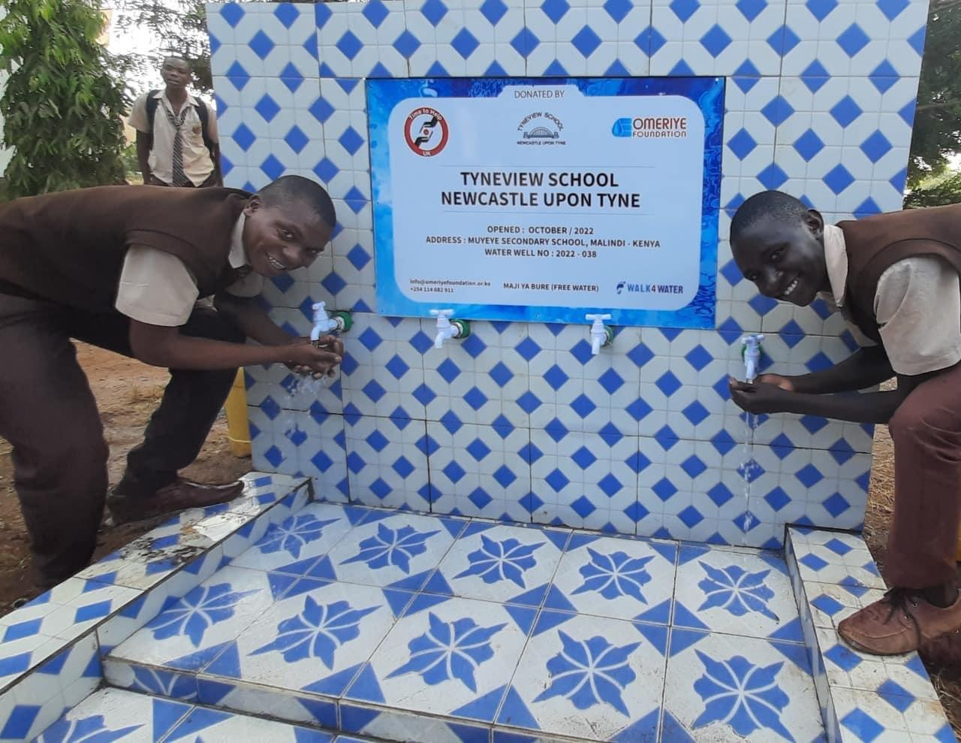
Why Istanbul?
Istanbul was chosen as we have began to forge links with the Turkish community in our school.
Hamza, a parent in year 3 has introduced us to the Dialogue Society. This is a charity which does community fund raising. Together we recently raised enough money for a water well in Africa and celebrated the Turkish culture with a Turkish Community Day

Slide 3
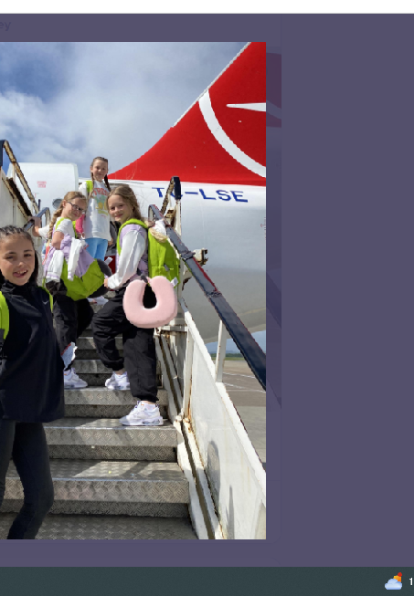
Many of our children have ‘firsts’ on this incredible trip. These include:
Eating in a restaurant
Leaving Newcastle
Getting a passport
Going on a plane, train, boat.
Wearing hijab.
Going to a mosque
Eating Turkish food
We did many lessons on what airports would be like, cultural etiquette, boat safety and we even had a Turkish meal in Newcastle first!
Zoey

Slide 4
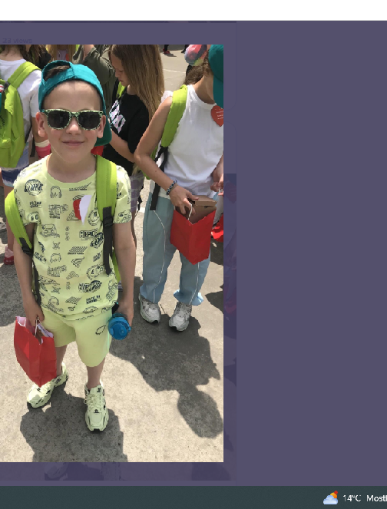
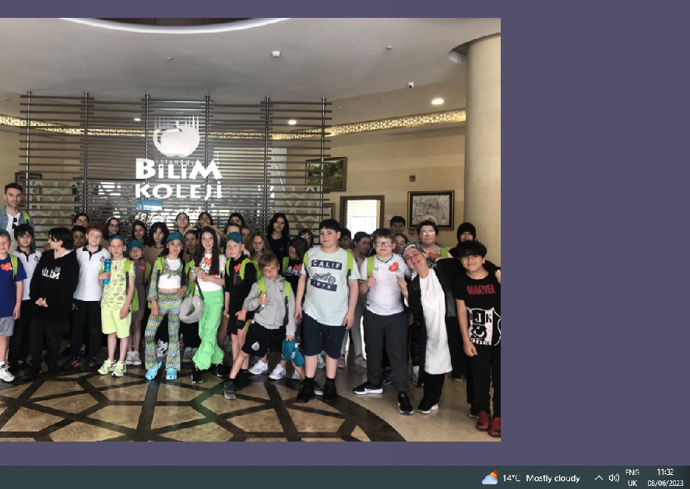
We made links with a Turkish international school named Bilim Koleji. Their school was huge and had so many facilities. Their English skills were so good!!
Zoey

Slide 5
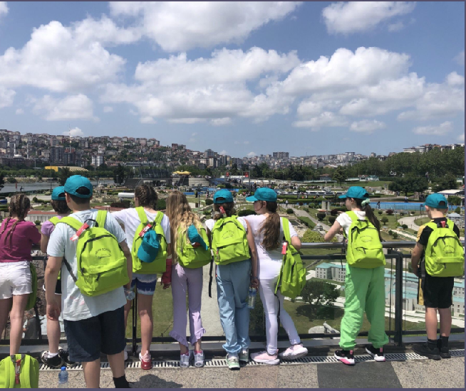
We visited Mini Turk which showed us miniature creations of all major landmarks across Turkey. We loved the Stadium and the airport model.
Jazmine

Slide 6
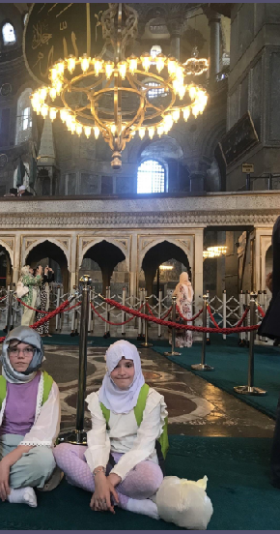
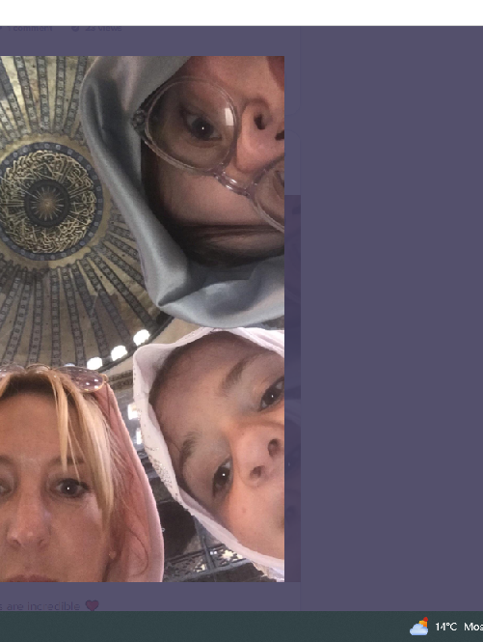
Our school community has been largely white and of none or Christian faith. From work carried out we realised we needed to teach a stronger curriculum which incorporates all groups.
Over the past few years we have began to welcome other major religions into Walker.

Slide 7
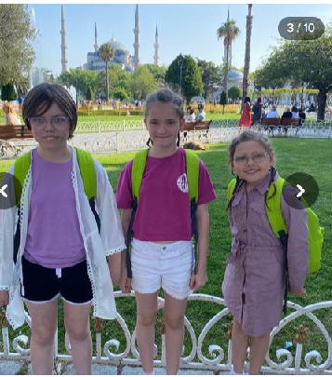
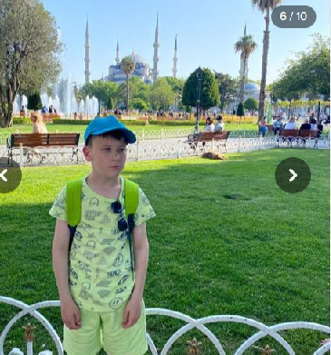
We visited 3 Mosques.
The Blue Mosque, Hagia Sophia Mosque and the Suleymaniye Mosque. Leading up to these visits the children learned about Islam in RE and had PHSE lessons on different cultures and traditions.
Marley H

Slide 8
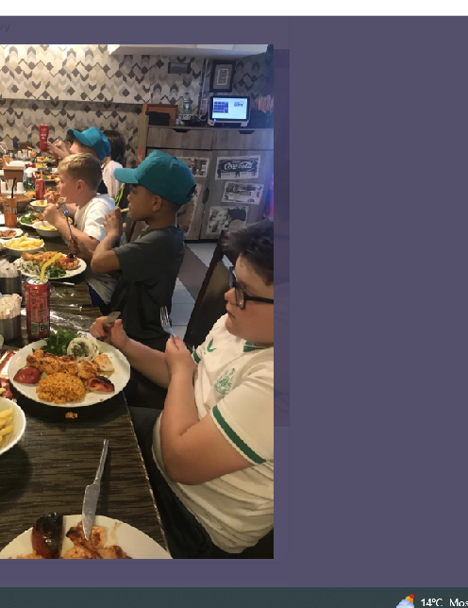
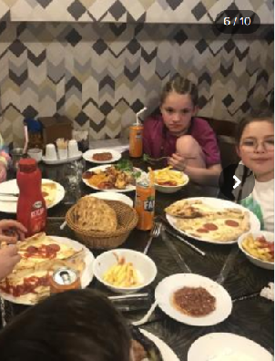
Eating out was fun we got to try many new foods which included Turkish kebabs, lamb koftas, flatbreads, houmous, ground beef and the teachers had turkish tea!
Amelia Sh

Slide 9
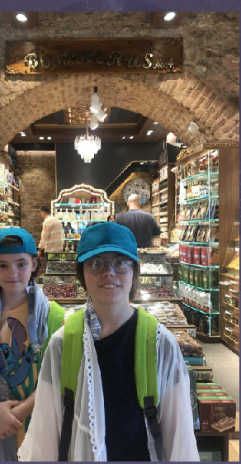
Spice Market
What incredible sights and sounds there were in the spice market.
Some of the people let us try things from their stalls like baklava and turkish delight.
Hetty

Slide 10
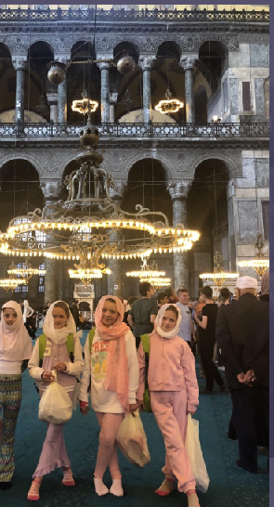
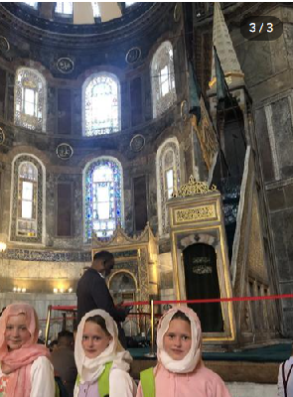
When visiting the mosques we had to show respect by removing our shoes, covering our arms and legs and wearing a hijab.
Some of us loved wearing our hijab.

Slide 11
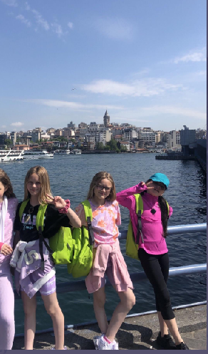
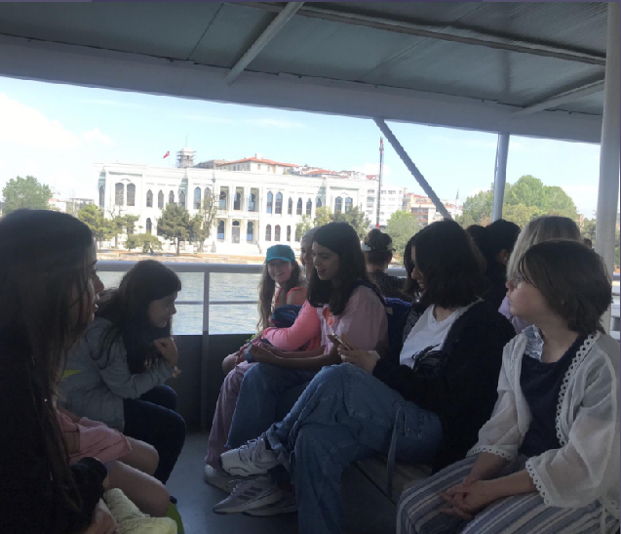
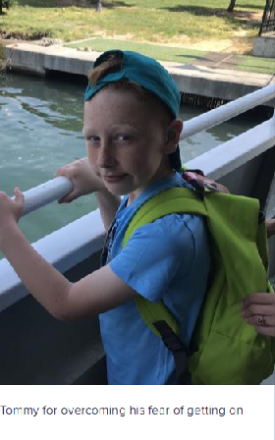
We took the boat from the European shore to the Asian shore.
Tommy overcame is fear over boats by stepping on board!
Marley H

Slide 12
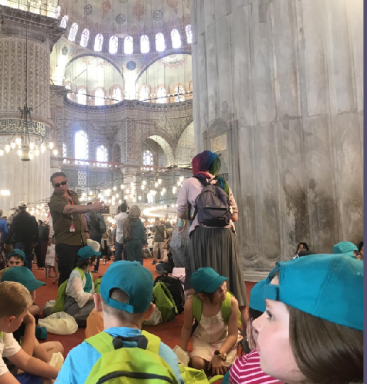

Our trip would not have been possible without the advice and planning support from Walks in Europe who were our tour guides.
Cetin and Kubra were invaluable in helping us to get around Istanbul, translate and navigate trips.
We would love to work with them again in the future.

Slide 13
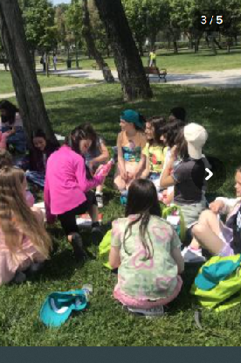
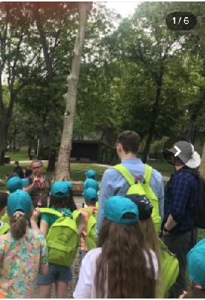
We now have pen friends with a friend in year 5 and they will come to visit us next May!
All

