Slide 1

Face to Clock Face
With Mr. Angry Toaster-Brow, The Radio and Miss Digitally Angry Clock-Face

Slide 2
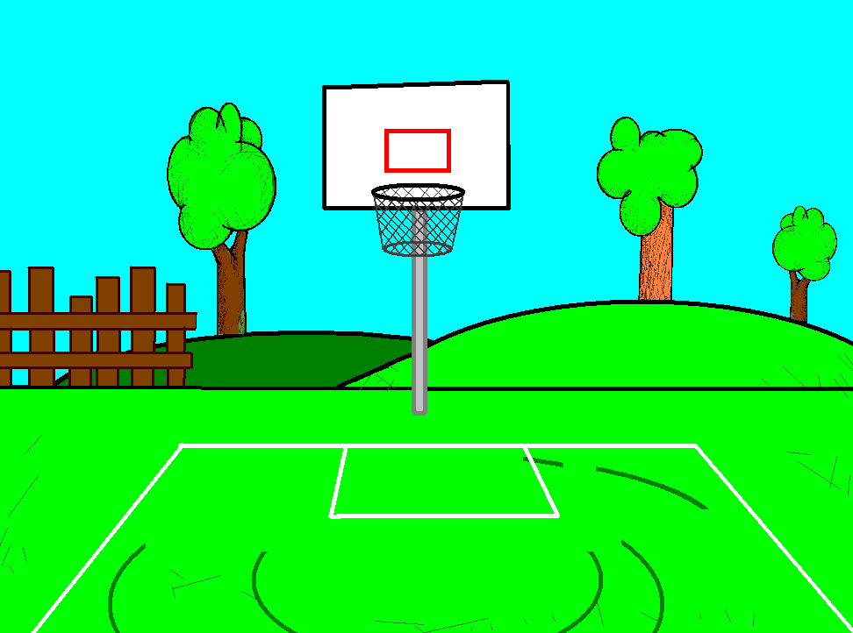


The radio believes he can win the love of my dear Miss Digitally Angry Clock-Face.

Slide 3
So we are going to have a duel to see who can read her the best.

Slide 4

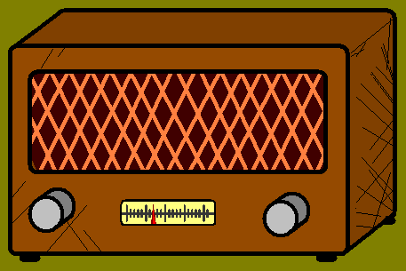

Slide 5
Mwahaha… there you are!

Slide 6
En garde!

Slide 7

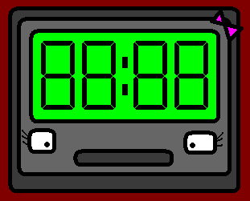

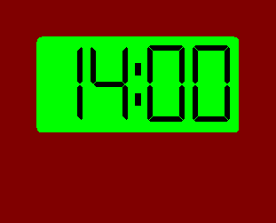

Slide 8
Il est… il est… trois heures!
It is three o’clock!

Slide 9
Non, il est deux heures!
No, it is two!

Slide 10
Il est deux heures de l’après-midi.
It is two o’clock in the afternoon.

Slide 11
Mwahaha…
I won!

Slide 12
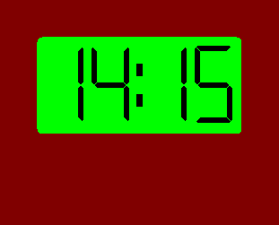

Slide 13
Il est deux heures et quart!
It is quarter past two!

Slide 14
Non, il est deux heures moins le quart!
No, it is quarter to two!

Slide 15
Et l‘heure exacte est… „deux heures et quart de l‘après-midi“!
And the right time is…
“quarter past two in the afternoon”!

Slide 16
Ha, ha, ha, I am closer to the love of my sweet clock!

Slide 17
Never! One more go!

Slide 18
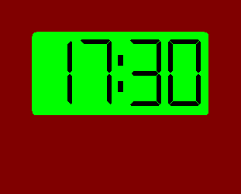

Slide 19
C’est facile, il est cinq heures et demi!
It is easy, it is half past five!

Slide 20
Pas juste, j’allais justement dire la même chose!
Il est cinq heures et demi!
Not fair, I was about to say the same! It is half past five!

Slide 21
Vous avez tous les deux raison, mes très chers, il est cinq heures et demi.
You are both right, my dears, it is half past five.

Slide 22
We need to have a tie-breaker, and the winner will take me to dinner.

Slide 23
It will be me,
I am sure.

Slide 24
Shut up, you!

Slide 25
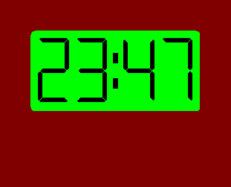

Slide 26
It is too much, I can’t work it out!

Slide 27
I can see myself now with my sweet clock.

Slide 28
Il est… mmm… moins… moins treize…
It is… thirteen to… to… to…

Slide 29
Il est onze heures moins treize!
It is thirteen to eleven!!

Slide 30
Minuit… minuit moins treize!
To… twelve!

Slide 31
Il est minuit moins treize, et pas onze heures moins treize!!
It is thirteen to twelve, not to eleven!!

Slide 32
My dear toaster… you finally won my love, it is all yours!!

Slide 33















Join us again!

