Slide 1

Handy Verbs
Present Tense
With the Angry Family
To like

Slide 2
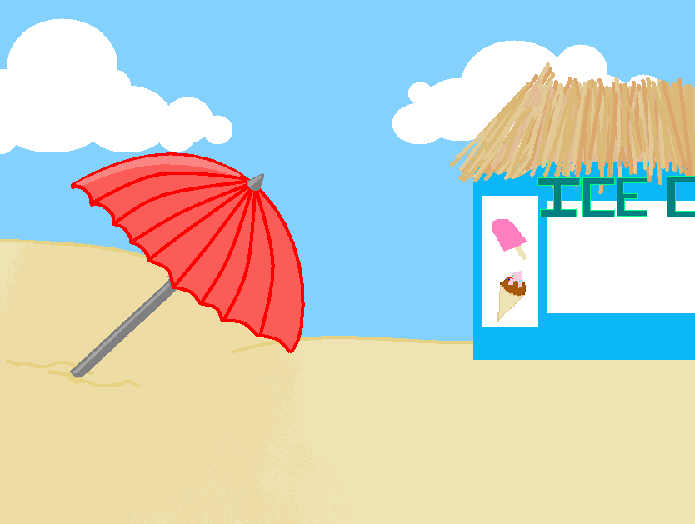



II l’aime bien, mais elle ne l’aime pas.
He likes her, but she doesn’t like him.
Notes:
Said by Potato before he enters

Slide 3

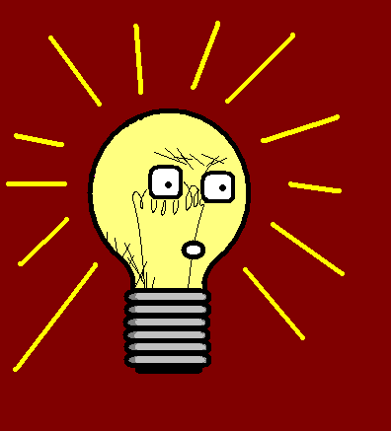

Quoi?! Tu l’aimes vraiment bien?
What!? You like him?

Slide 4


Oui, nous l’aimons tous.
Yes, we all like him.

Slide 5
Vous l’aimez tous! Vraiment?!
You all like him! Really!?

Slide 6

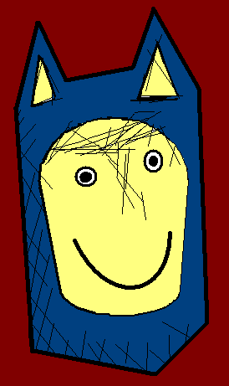
Ils m’aiment tous?
They all like me?

Slide 7
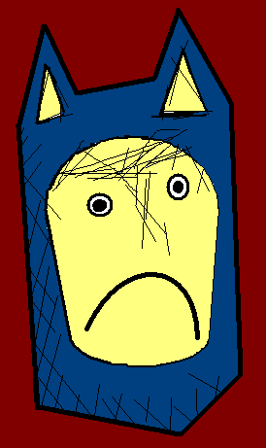
Eh bien, moi je ne t’aime pas.
Well, I don’t like you.

Slide 8
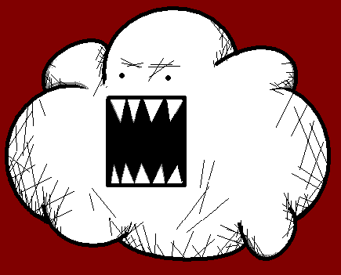
to like – aimer
I like
You like
He/she/it likes
We like
You (pl.) like
They like
J’aime
Tu aimes
Il/elle/on aime
Nous aimons
Vous aimez
Ils/elles aiment

Slide 9


















Join us again!

