Slide 1

Handy Verbs
Present Tense
With the Angry Family
To have: Avoir

Slide 2
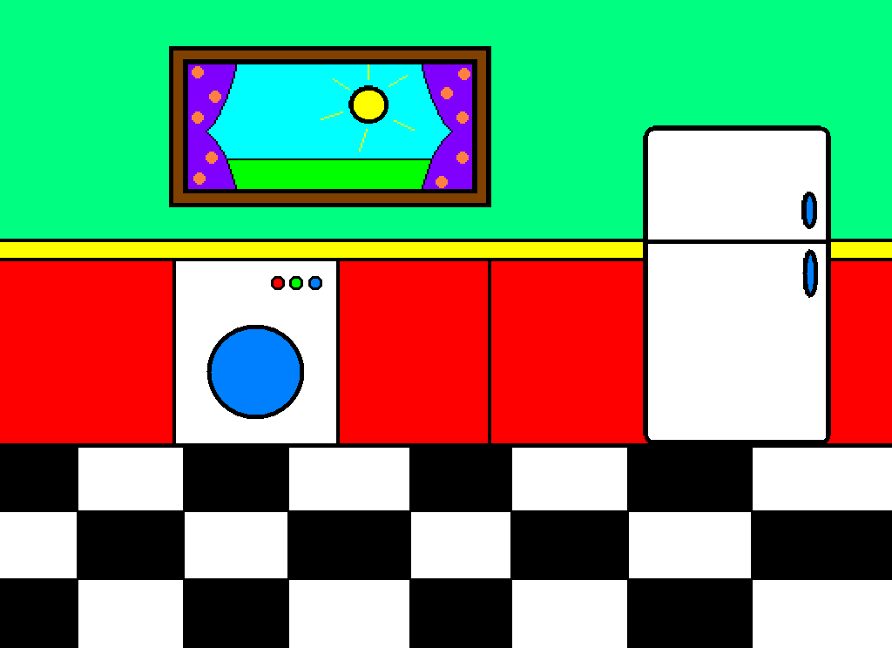




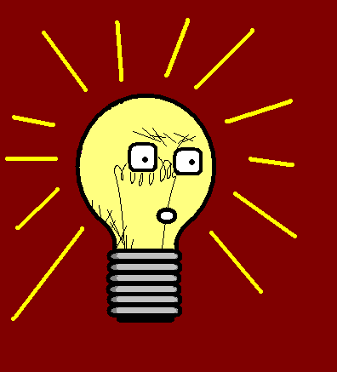

These biscuits are delicious.
Ces biscuits sont délicieux !

Slide 3

I know. I have one.
Je sais. J’en ai un.

Slide 4


You have two, I’m sure.
Tu en as deux, j’en suis sûre.

Slide 5

She has three. I saw her.
Elle en a trois. Je l’ai vue.

Slide 6
We have no biscuits. It’s not fair.
On n’a aucun biscuit. Ce n’est pas juste.
Notes:
Aucun + singular form (I checked out)

Slide 7
They have lots of biscuits.
Ils ont plein de biscuits.

Slide 8
to have avoir
I have J’ai
You have Tu as
He/She/It has Il, elle, on a
We have Nous avons
You (pl./form.) have Vous avez
They have Ils, elles ont

Slide 9
















Join us again!

